Slide 1


UpTraK Training Programme
Module 5
Setting up of an up-cycling atelier:
self-employment and entrepreneurship within sartorial craftsmanship
www.fashionupproject.com

Slide 2
UpTraK Training Programme
Funded by the European Union. Views and opinions expressed are however those of the author(s) only and do not necessarily reflect those of the European Union or the European Education and Culture Executive Agency (EACEA). Neither the European Union nor EACEA can be held responsible for them.
www.fashionupproject.com

Slide 3
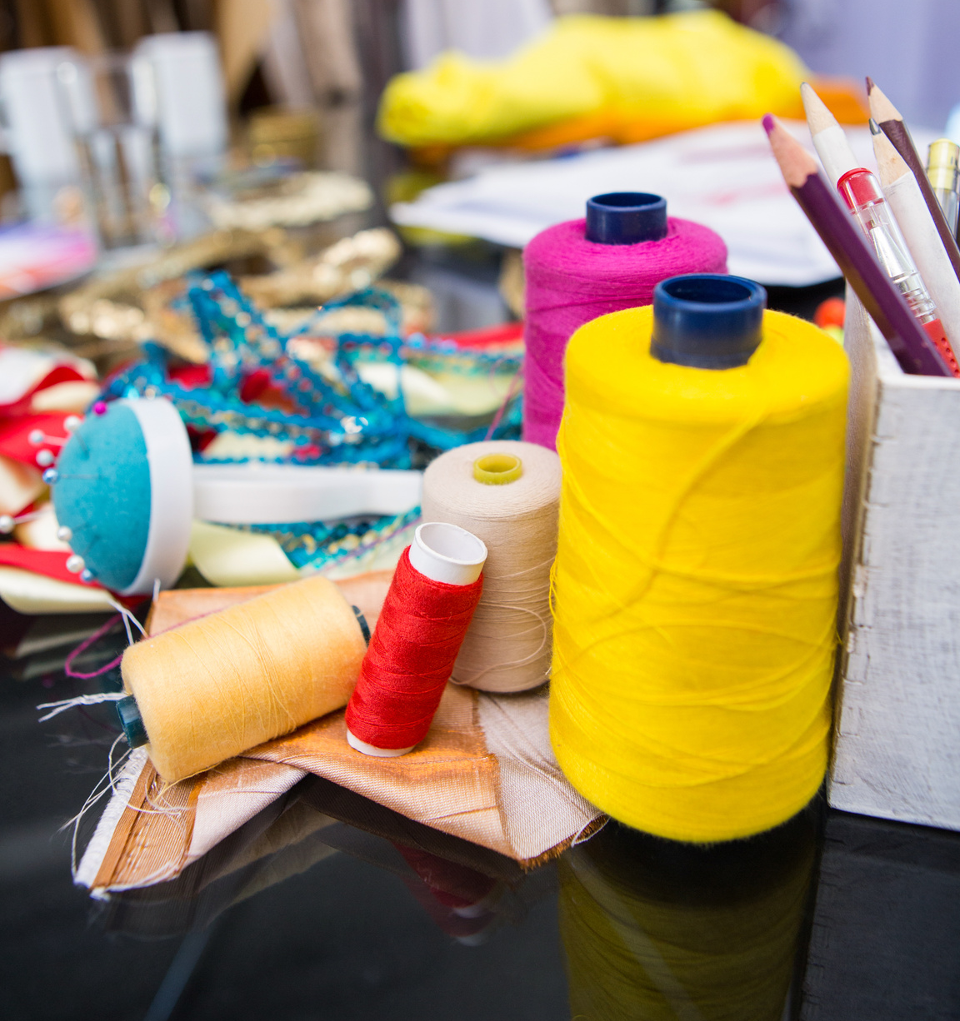
UpTraK Training Programme
Module 5, SETTING UP OF AN UP-CYCLING ATELIER
Module 5
Learning Objectives
This Module aims to provide knowledge on how to set up an Upcycling Atelier in terms of self-employment and entrepreneurship.
In detail, the learners are going to learn about how to develop business and financial plans, how to comply with national and EU regulations and policies, and how to set up the production process for upcycled garments. Furthermore, they will learn how to develop marketing strategies and a brand identity, as well as how to identify and enhance their entrepreneurial skills.
www.fashionupproject.com

Slide 4
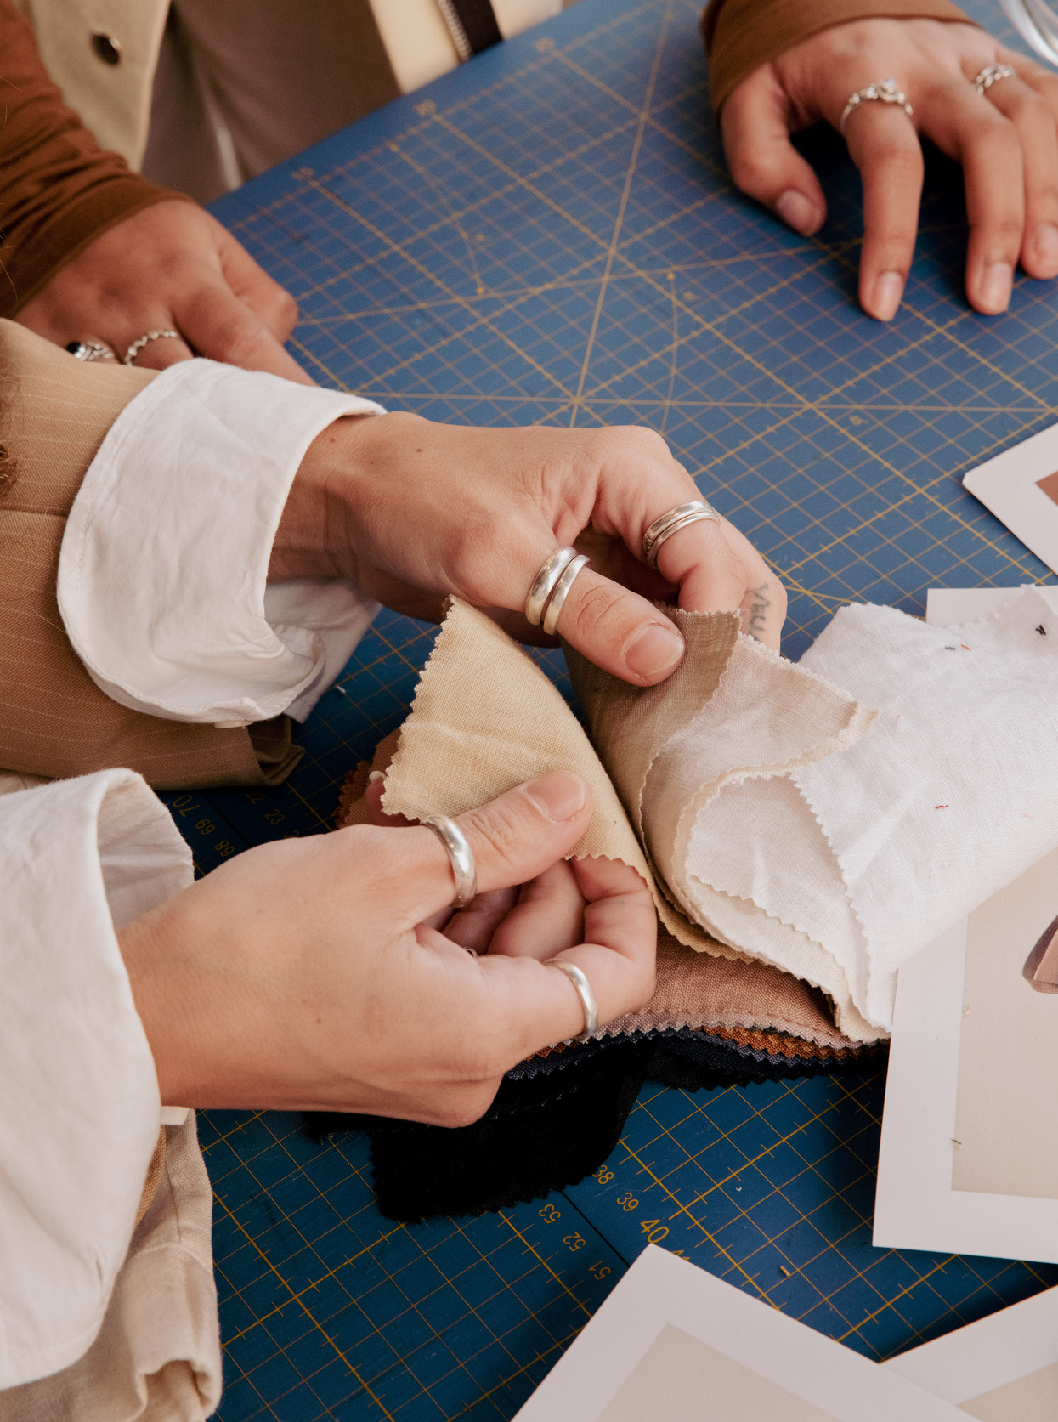
UpTraK Training Programme
Module 5, SETTING UP OF AN UP-CYCLING ATELIER
Expected
Learning Outcomes
By the end of this Module, learners will be able to:
Develop a comprehensive business plan for an upcycling atelier and conduct the relevant market research
Interpret the legal framework for setting-up an upcycling atelier
Identify the supply demands of an upcycling atelier and assess the market offerings
Recognize the production and quality control measures needed for an artisanal business
Design a marketing plan for an upcycling atelier
Illustrate the competencies of an artisanal entrepreneur
www.fashionupproject.com

Slide 5
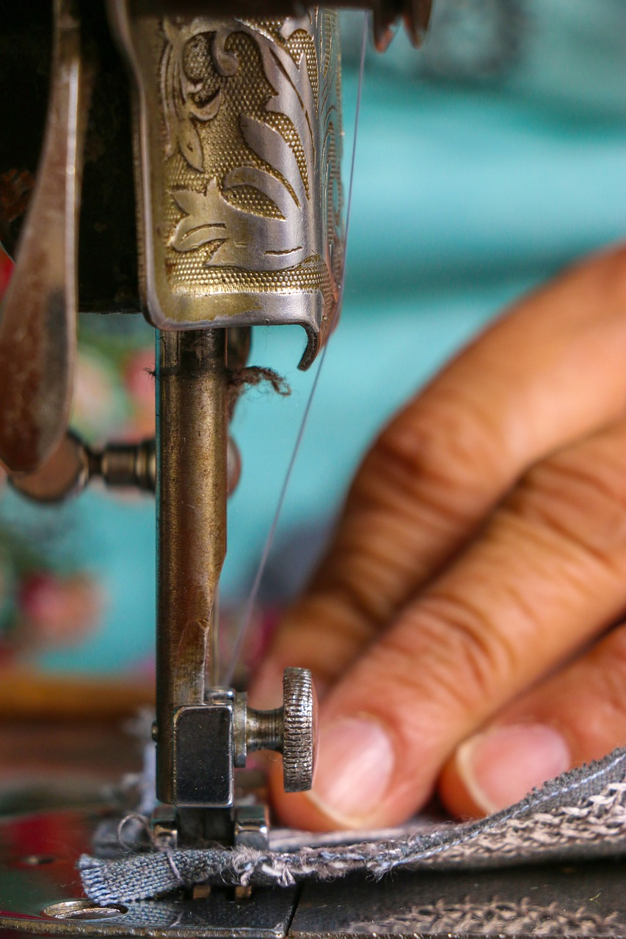
UpTraK Training Programme
Module 5, SETTING UP OF AN UP-CYCLING ATELIER
Methodology
This Module will be based on both project-based and experiential learning methodologies.
Project-based methodology is a dynamic approach that will allow the learners to actively explore real situations, challenges, and problems of setting-up an Upcycling Atelier. This will be achieved by implementing authentic tasks.
Experiential learning methodology is an approach that emphasizes learning through doing, i.e. experiencing. The learners will conduct simulate problem-solving scenarios and will apply their knowledge in designing their own Upcycling Atelier experience.
www.fashionupproject.com

Slide 6

UpTraK Training Programme
Module 5, SETTING UP OF AN UP-CYCLING ATELIER
Necessary equipment
For this Module is necessary to have:
A laptop with access to the internet
A projector
A flipchart
Notepaper with pens and markers
Post-it notes
Printed flashcards
Module 5 Duration
10 hours
Assessment Criteria
www.fashionupproject.com
A 5 closed questions quiz will be submitted to learners to ascertain the reaching of learning goals set for this Module

Slide 7
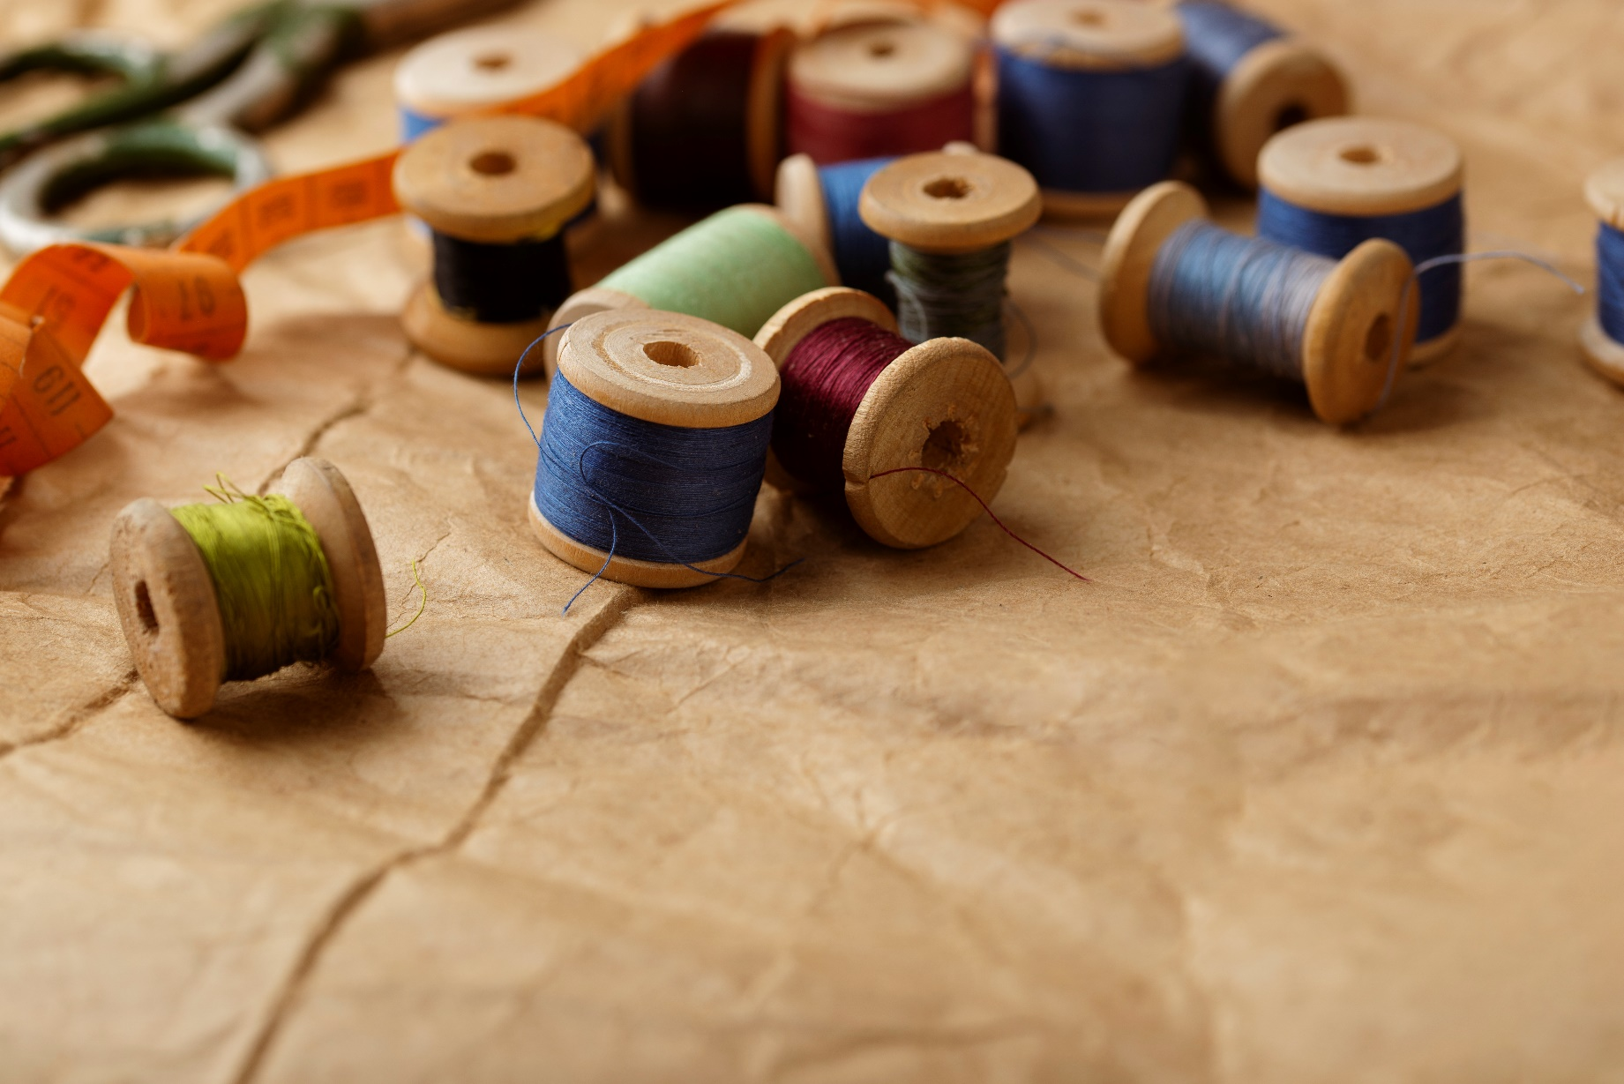
UpTraK Training Programme
Module 5, SETTING UP OF AN UP-CYCLING ATELIER
This Module includes theoretical Training Materials on PPT format. Theoretical materials are available for each Training Unit constituting the Module. Video tutorials are available only for Modules with high performative-practical learning contents.
Training Materials & Video-Tutorials
www.fashionupproject.com

Slide 8

UpTraK Training Programme
Module 5, SETTING UP OF AN UP-CYCLING ATELIER
Technical:
Understanding of sewing, pattern making, textile manipulation, and garment construction techniques
Familiarity with various textiles, and their properties and suitability for upcycling
Knowledge of the upcycling market, trends, and consumer preferences
Pedagogical:
Experience in teaching adult learners and understanding their learning styles
Strong communication and presentation skills to engage learners
www.fashionupproject.com
Trainer(s) competence profile

Slide 9
UpTraK Training Programme
Module 5, SETTING UP OF AN UP-CYCLING ATELIER
Business and Entrepreneurial:
Proficiency in developing comprehensive business plans for small enterprises
Knowledge of marketing strategies, branding, sales techniques, and customer relationship management
Knowledge of business laws, permits, licenses, and tax regulations
Understanding of sourcing materials, inventory management, and production processes
Understanding of budgeting, pricing, cost control, and financial forecasting
www.fashionupproject.com
Trainer(s) competence profile

Slide 10
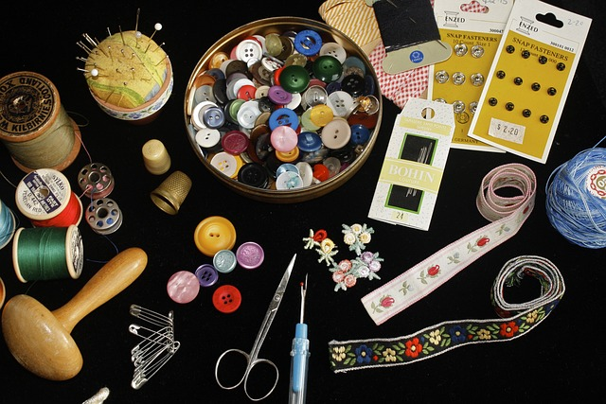
UpTraK Training Programme
Module 5, SETTING UP OF AN UP-CYCLING ATELIER
Module 5
www.fashionupproject.com
TRAINING UNITS

Slide 11
UpTraK Training Programme
Module 5, SETTING UP OF AN UP-CYCLING ATELIER
Module 5 Training Units
These Training Units compose Module 5
01
02
03
0
02
BUSINESS PLANNING FOR AN UPCYCLING ATELIER
LAWS AND REGULATIONS
PRODUCTION AND QUALITY CONTROL
content
www.fashionupproject.com
Duration 2 hours
Duration 2 hours
Duration 2 hours

Slide 12
UpTraK Training Programme
Module 5, SETTING UP OF AN UP-CYCLING ATELIER
Module 5 Training Units
04
05
0
02
MARKETING AND SALES
ENTREPRENEURSHIP AND BUSINESS MANAGEMENT
content
www.fashionupproject.com
Duration 2 hours
Duration 2 hours

Slide 13
UpTraK Training Programme
Module 5, SETTING UP OF AN UP-CYCLING ATELIER
  Barrow, C., Barrow, P. and Brown, R., 2005. The business plan workbook. Kogan Page Publishers.
  Tajuddin, R.M., Hashim, S.F. and Zainol, A.S., 2017. The role of brand identity in creating resilient small enterprises (SMEs) in fashion industry. International Journal of Supply Chain Management, 6(2), pp.140-146.
  Sebastianelli, R. and Tamimi, N., 2002. How product quality dimensions relate to defining quality. International Journal of Quality & Reliability Management, 19(4), pp.442-453.
  Gupta, C.B. and Khanka, S.S., 2003. Entrepreneurship and small business management. Sultan Chand & Sons, New Delhi.
References
www.fashionupproject.com

