Slide 1

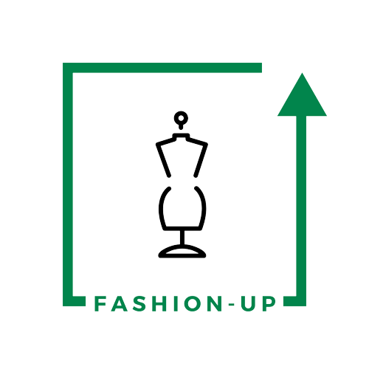
UpTraK Training Programme
Module 1
UNIT 2
  Sourcing and Selecting Materials
www.fashionupproject.com
Duration: 1 hour

Slide 2
UpTraK Training Programme
Funded by the European Union. Views and opinions expressed are however those of the author(s) only and do not necessarily reflect those of the European Union or the European Education and Culture Executive Agency (EACEA). Neither the European Union nor EACEA can be held responsible for them.
www.fashionupproject.com

Slide 3
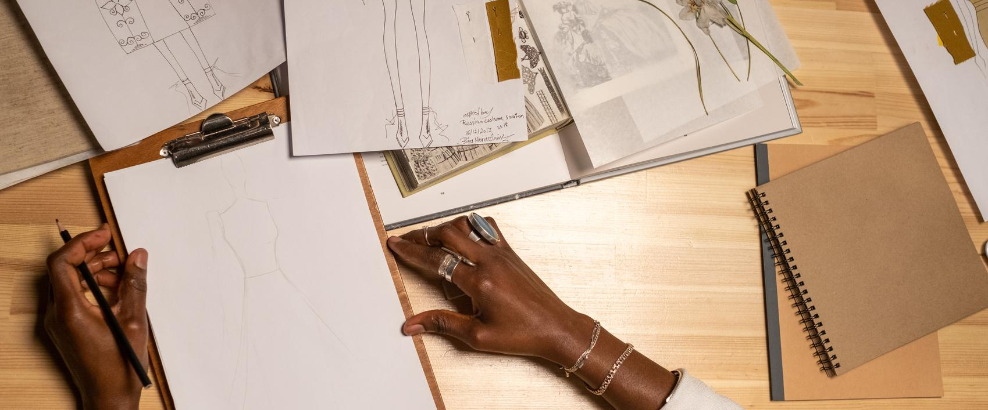
UpTraK Training Programme
Module 1, Unit 2
Overview of the Unit
This Unit focuses on how to identify materials suitable for recycling, upcycling, and downcycling. Learners will explore criteria for material selection and discover the role of circular fashion boutiques as sources of reusable textiles.
www.fashionupproject.com

Slide 4
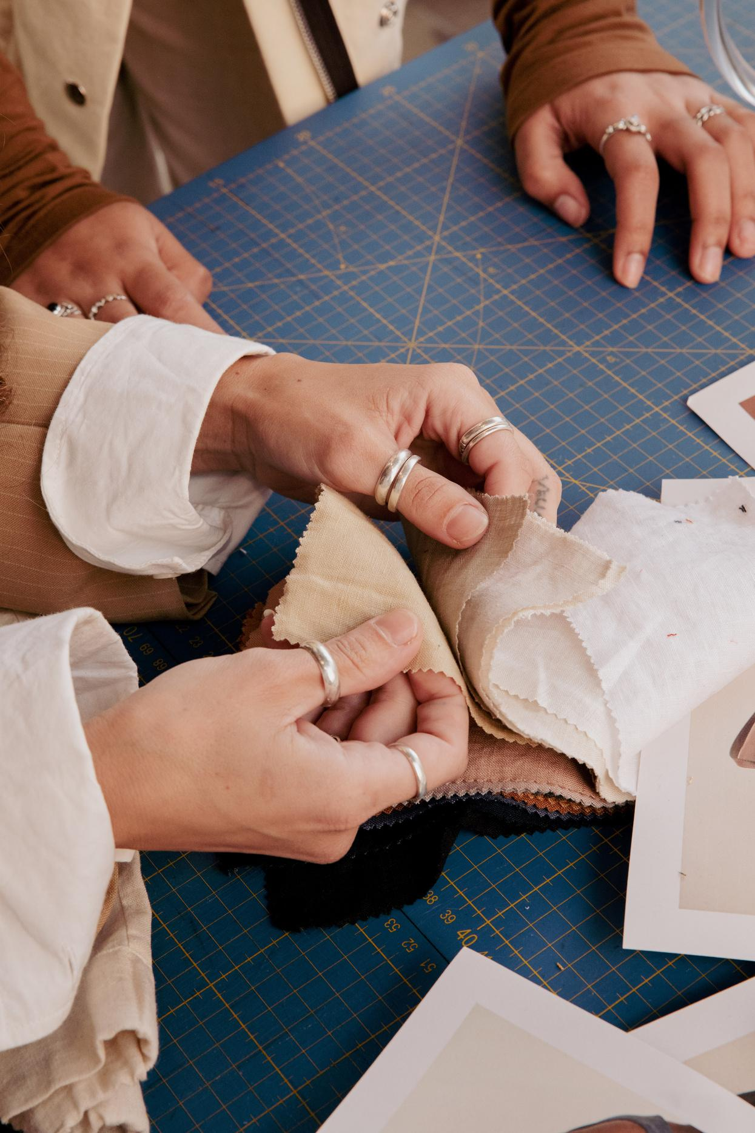
UpTraK Training Programme
Module 1, Unit 2
Expected
Learning Outcomes
By the end of this unit, you will be able to:
Identify and evaluate suitable materials for upcycling projects.
Recognize and select appropriate sources, such as circular boutiques and second-hand stores, for material acquisition.
Match fabric types and qualities to specific sewing or design projects.
www.fashionupproject.com
Pre-requisite knowledge
No prerequisite knowledge is necessary for this Unit.
Estimated Reading Time
10 minutes

Slide 5

UpTraK Training Programme
Module 1, Unit 2
Target Audience
Learning
Objective
This Unit targets young learners and students interested in sustainable fashion
This unit teaches how to recognize which fabrics can be reused through recycling, upcycling, or downcycling. It also introduces circular boutiques as valuable places to find materials.
Key concepts
www.fashionupproject.com
Criteria for selecting reusable materials
Identifying fabric quality and durability
Sources of second-hand textiles
Circular boutiques as material hubs

Slide 6
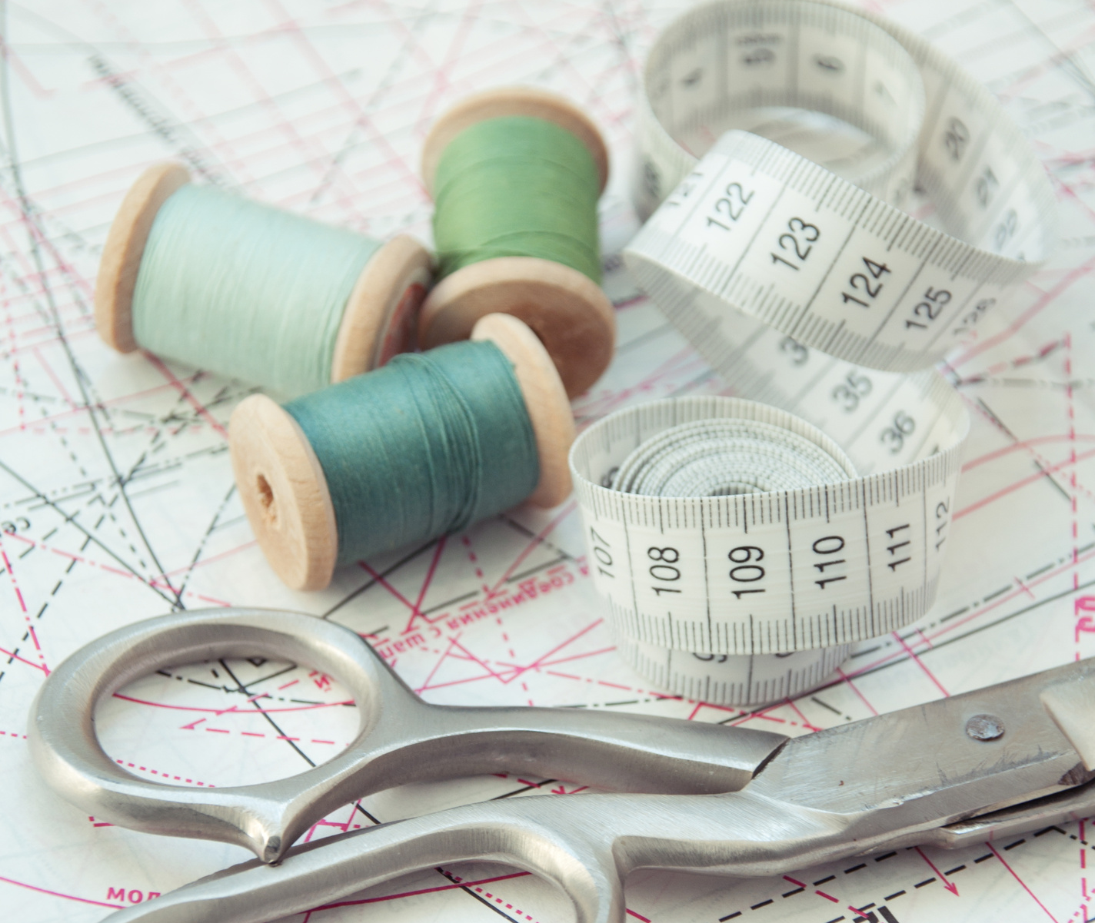
UpTraK Training Programme
Module 1, Unit 2
Scissors, measuring tape
Checklist to inspect materials like
secon-hand clothing (provided in this Unit)
Textile scraps, and deadstock fabrics.
Necessary
equipment
www.fashionupproject.com

Slide 7
UpTraK Training Programme
Module 1, Unit 2
03
Teacher's Profile
Sustainable fashion expert
Skilled in textile recycling methods
Creative and hands-on approach
Inspires eco-conscious choices
03
Methodology
This Unit will be based on both interactive and reflective learning methodologies.
www.fashionupproject.com

Slide 8
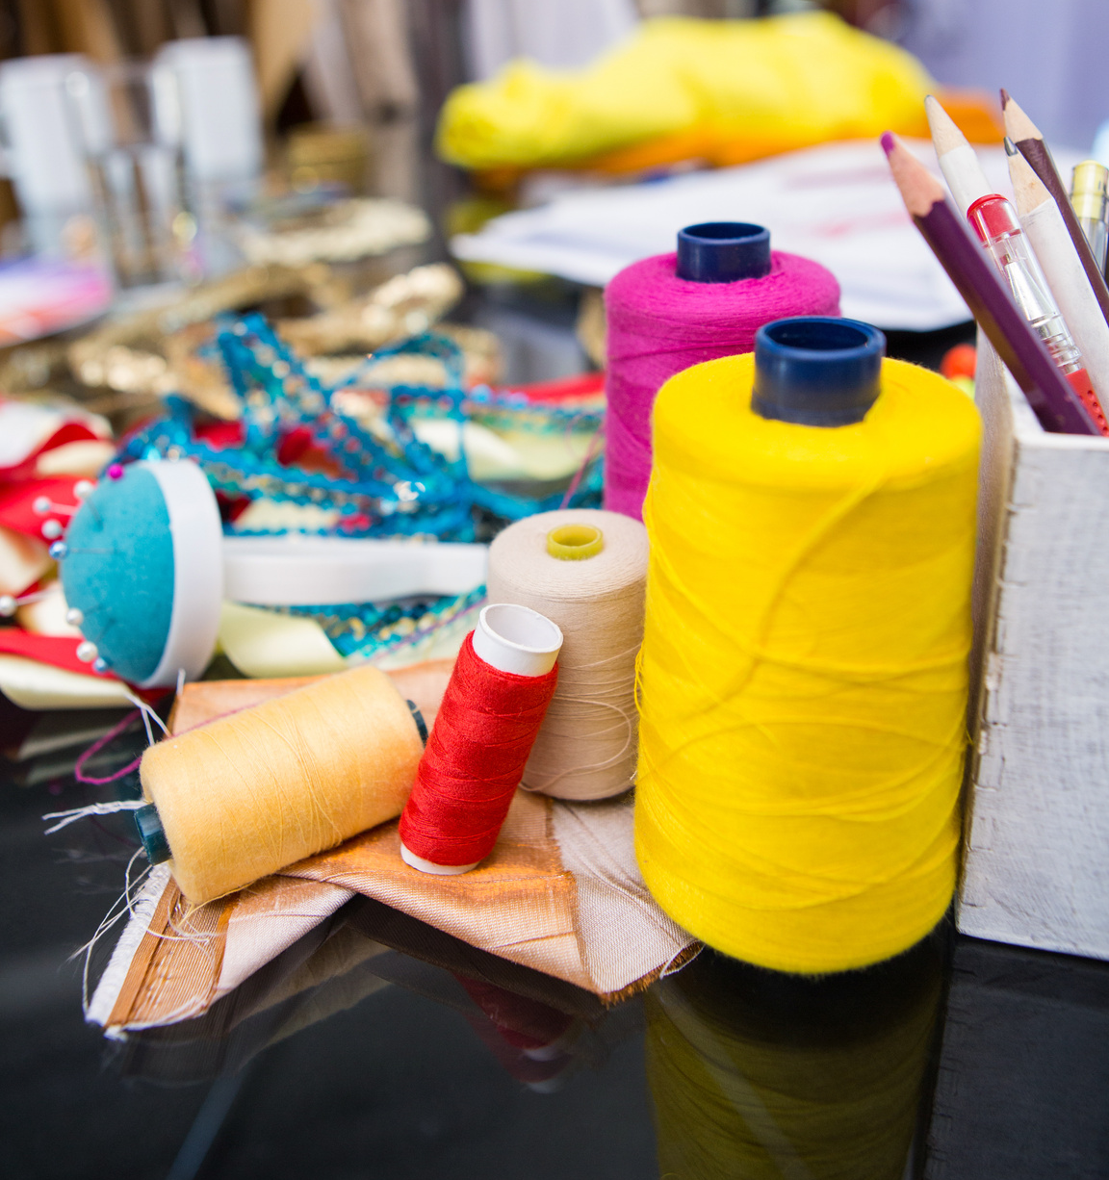
UpTraK Training Programme
Module 1, Unit 2
Introduction
Understanding how to choose and source materials for recycling, upcycling, and downcycling is a key step in sustainable fashion. For students and young people, affordable and accessible options are essential — from second-hand shops and circular boutiques to community exchanges and donations. Learning these skills not only supports creativity and budget-friendly projects but also contributes to protecting the environment by making the most of what already exists.
www.fashionupproject.com

Slide 9
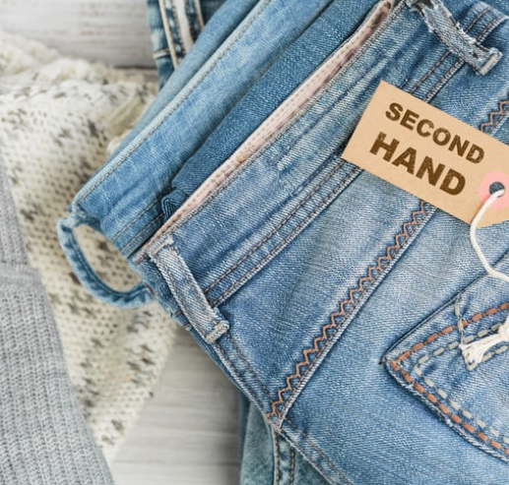
UpTraK Training Programme
Module 1, Unit 2
Where to Find Materials?
Second-hand stores:
Second-hand stores are retail outlets that sell pre-owned clothing and accessories, offering an affordable and sustainable alternative to fast fashion. These stores are excellent sources for upcycling materials, providing unique and diverse pieces that can be repurposed into new designs while reducing textile waste.
Textile scraps:
Textile scraps are leftover fabric pieces from garment production or other textile-related processes, often discarded as waste. These scraps are ideal for upcycling projects, as they can be transformed into patchwork designs, accessories, or other creative products, contributing to a zero-waste approach in fashion.
Deadstock fabrics:
Deadstock fabrics are unused textile materials that were produced in excess or deemed unfit for sale, often stored by manufacturers or designers. Upcycling these fabrics helps prevent them from going to waste, offering an eco-friendly option to create unique, limited-edition garments or accessories.
www.fashionupproject.com

Slide 10

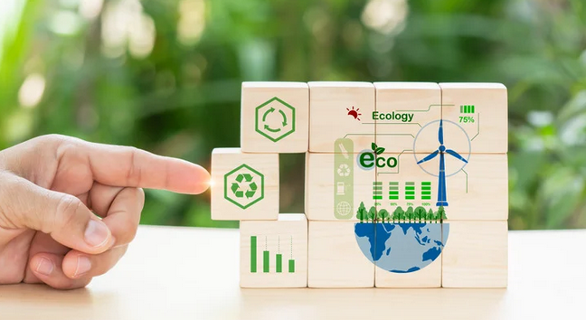
UpTraK Training Programme
Module 1, Unit 2
Circular Boutiques – do you know this concept?
Circular boutiques are stores that operate on a closed-loop system. This means that clothing and other items that come into these stores are not treated as waste, but as resources that can be reused.​
How do circular boutiques work?​
​Collection: Customers can bring their unwanted clothes, shoes, accessories, and other items to the boutique.​
​Selection and cleaning: Boutique employees carefully select the items brought in. Those that are in good condition are cleaned and prepared for sale.​
​Sale: Clothes and other items are sold in the boutique at attractive prices.​
​Reuse: Some of the clothes that are not suitable for sale can be used to produce new clothes or other items.
www.fashionupproject.com

Slide 11
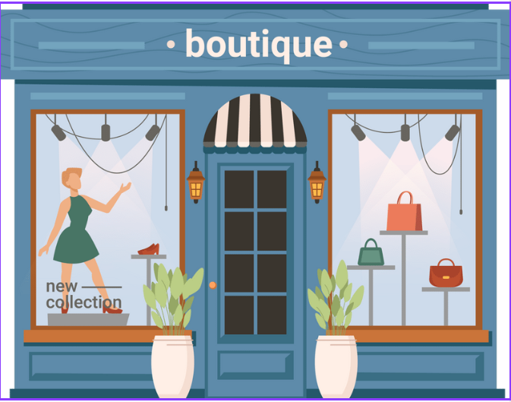
UpTraK Training Programme
Module 1, Unit 2
Benefits of circular boutiques:
Environmental protection: Circular boutiques help to reduce the amount of waste that goes to landfills.
Resource conservation: Reusing clothes and other items saves water, energy, and natural resources.
Support for the local community: Circular boutiques often work with local charities, donating some of the proceeds from sales to them.
Affordable fashion: In circular boutiques, you can find unique clothes and accessories at attractive prices.
Circular boutiques are an increasingly popular trend that fits in with the idea of sustainable development and responsible consumption
www.fashionupproject.com

Slide 12




UpTraK Training Programme
Module 1, Unit 2
Assessing Material Suitability –
Criteria for Assessing Material Suitability
01
02
03
04
Quality
Design Potential
Sustainability
Chemical Pollution
Condition:
Check for tears, stains, or significant wear that might limit usability.
Durability:
Evaluate the strength of the fabric to ensure it can withstand repurposing.
Texture:
Determine if the material’s texture suits the intended project (e.g., smooth for fashion, rugged for accessories).
Versatility:
Consider if the material can be used for various designs or applications.
Aesthetic Appeal:
Look for patterns, colors, or unique features (e.g., embroidery, embellishments) that add value.
Size and Shape:
Assess whether the material is large enough or can be pieced together for the desired product.
Origin:
Prefer materials that are natural, biodegradable, or sourced from ethical suppliers.
Environmental Impact:
Select materials with minimal environmental footprints (e.g., organic cotton, recycled polyester).
Reuse Feasibility:
Ensure the material can be repurposed multiple times without significant degradation.
Ease of Manipulation:
Determine if the material is easy to cut, sew, or reshape.
Cost Efficiency:
Ensure the material’s cost aligns with the project’s budget.
Availability:
Check if the material is accessible in sufficient quantities for scaling the project.
www.fashionupproject.com

Slide 13

UpTraK Training Programme
Module 1, Unit 2
Checklist for Material Assessment
Material is in good physical condition (no major defects).
Fabric texture suits the intended product.
Patterns or colors align with design goals.
Material is sustainably sourced.
Meets durability and quality standards.
Size and quantity are sufficient for the project.
Fits within project budget.
www.fashionupproject.com

Slide 14


UpTraK Training Programme
Module 1, Unit 2
Steps:
Gather Tools and Materials:
Use the provided scissors, measuring tape, and checklist to inspect materials like second-hand clothing, textile scraps, and deadstock fabrics.
Assess Materials:
Apply the material assessment criteria (quality, design potential, sustainability, chemical pollution) to determine suitability for upcycling.
Group Discussion:
Work in teams to discuss and select materials for your project.
Present Findings:
Share your choices and explain your decisions to the group.
www.fashionupproject.com
Hands-On Exercise
Learn how to identify upcycling potential in everyday materials while fostering creativity and teamwork.

Slide 15
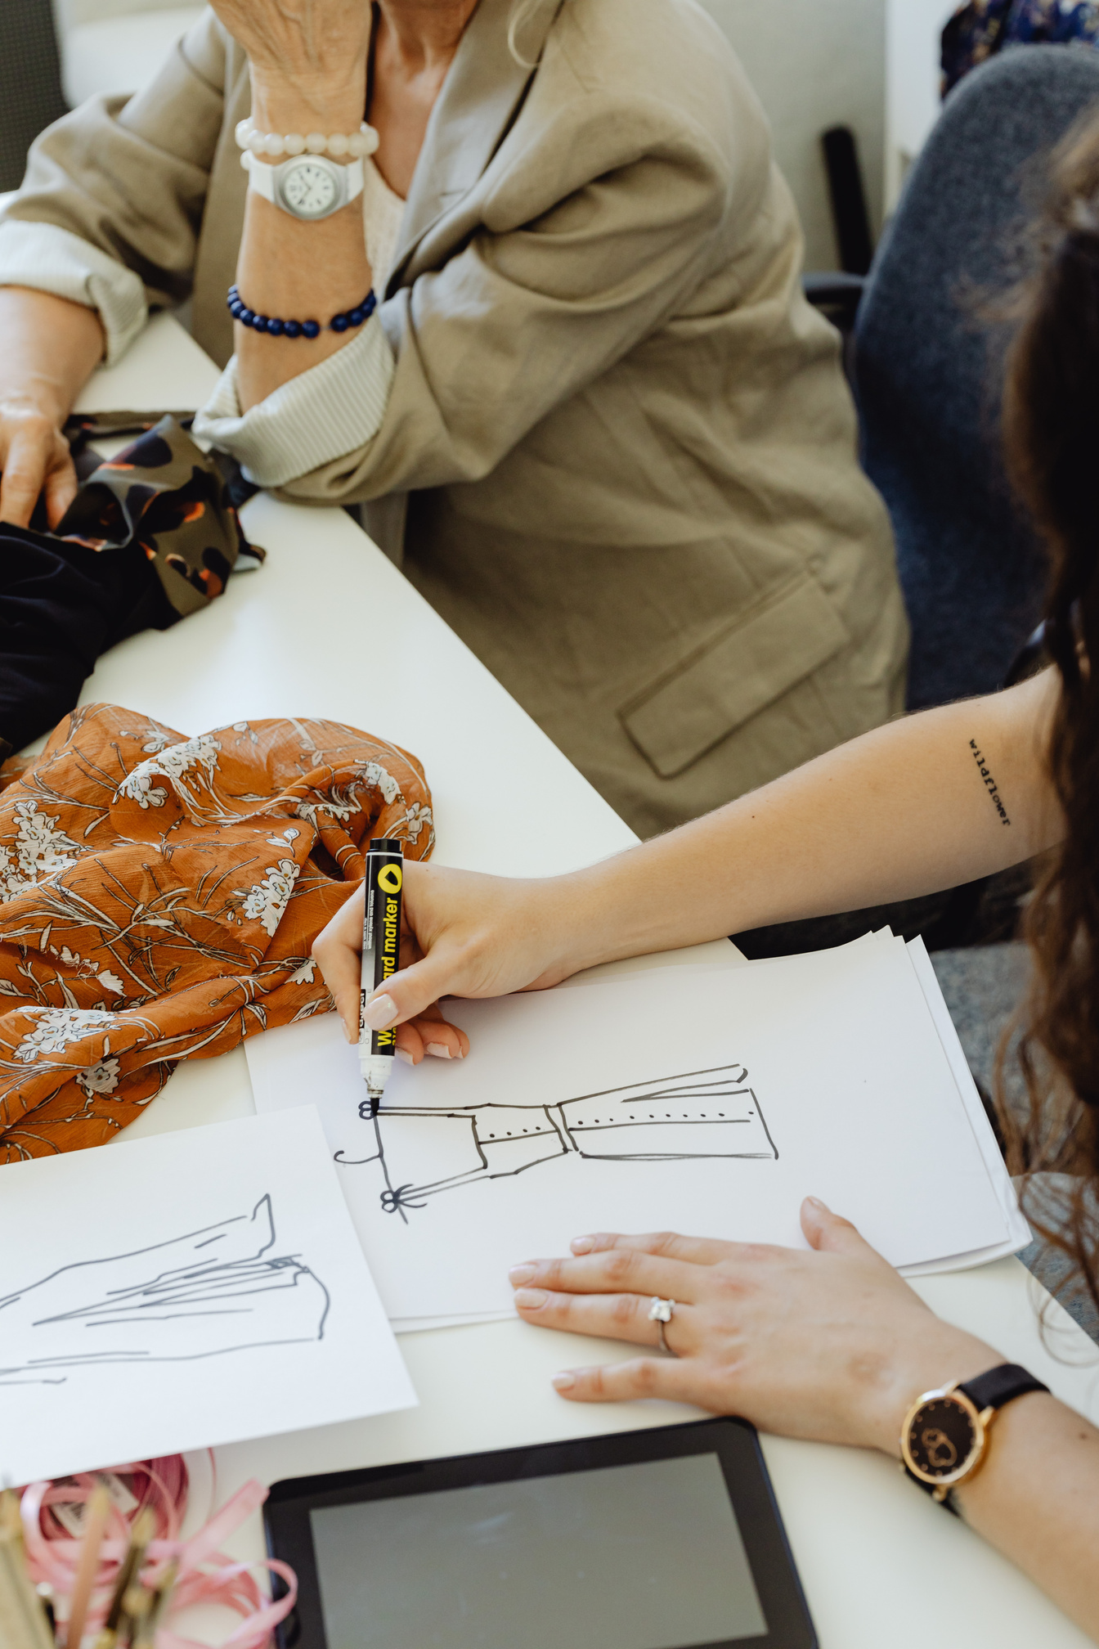
UpTraK Training Programme
Module 1, Unit 2
Unit
Summary
In this unit, learners discovered where to source materials for upcycling projects and how to choose suitable places, such as circular boutiques or second-hand stores. They also learnt how to select fabrics that fit their project needs while ensuring quality and environmental responsibility.
www.fashionupproject.com

Slide 16
UpTraK Training Programme
Module 1, Unit 2
  Fashion Revolution - "Why We Need to Reuse and Upcycle Clothing"
    Website: www.fashionrevolution.org
  The Ellen MacArthur Foundation - "A New Textiles Economy: Redesigning Fashion’s Future"
    Website: www.ellenmacarthurfoundation.org
  Greenpeace International - "The Environmental Impact of Fast Fashion"
    Website: www.greenpeace.org
  Textile Exchange - "Preferred Fiber & Materials Market Report"
    Website: www.textileexchange.org
  Sustainable Apparel Coalition - "Higg Index: Sustainable Materials"
    Website: www.apparelcoalition.org
  The Upcycle Movement - Resources and guides on upcycling practices
    Website: www.theupcyclemovement.com
  British Fashion Council - "Circular Fashion and Upcycling Initiatives"
    Website: www.britishfashioncouncil.co.uk
  Eco-Age - "Guide to Sustainable Fashion: Understanding Upcycling"
    Website: www.eco-age.com
References
www.fashionupproject.com

