Slide 1

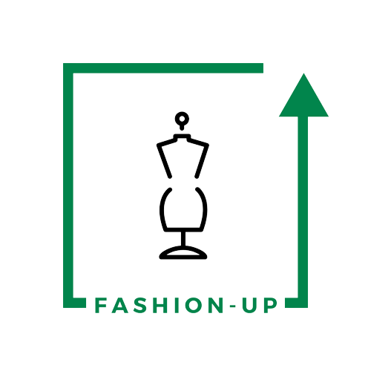
UpTraK Training Programme
Module 1
UNIT 3
  Business of Upcycling
www.fashionupproject.com
Duration: 2 hours

Slide 2
UpTraK Training Programme
Funded by the European Union. Views and opinions expressed are however those of the author(s) only and do not necessarily reflect those of the European Union or the European Education and Culture Executive Agency (EACEA). Neither the European Union nor EACEA can be held responsible for them.
www.fashionupproject.com

Slide 3
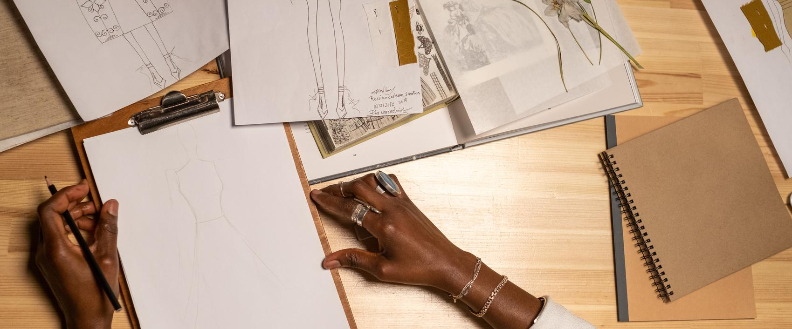
UpTraK Training Programme
Module 1, Unit 3
Overview of the Unit
This unit explores upcycling as a sustainable approach within fashion craftsmanship, emphasizing material sourcing and the business potential of upcycled design. Learners gain insight into the environmental advantages of upcycling, practical methods for sourcing materials, and key principles for building a sustainable fashion business model​.
www.fashionupproject.com

Slide 4
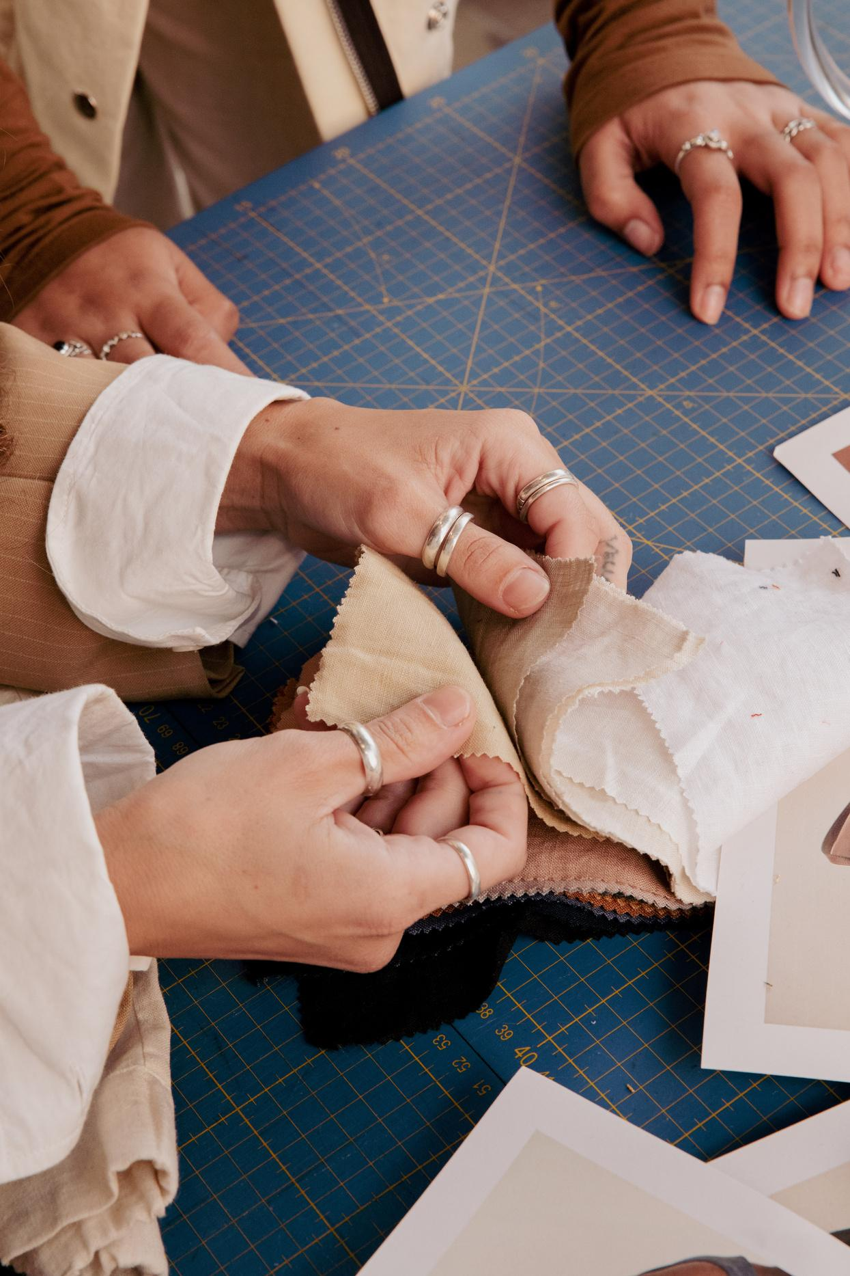
UpTraK Training Programme
Module 1, Unit 3
Expected
Learning Outcomes
By the end of this unit, you will be able to:
  Distinguish upcycling from other sustainable practices in fashion, such as recycling
  Identify and evaluate suitable materials for upcycling projects.
  Develop a basic business model and unique selling proposition for upcycled fashion items​
Pre-requisite knowledge
www.fashionupproject.com
No prerequisite knowledge is necessary for this Unit.
Estimated Reading Time
10 minutes

Slide 5

UpTraK Training Programme
Module 1, Unit 3
Target Audience
Learning
Objective
This Unit targets young learners and students interested in sustainable fashion
This Unit aims to introduce learners to the concept of upcycling as a new sustainable business model in sartorial craftsmanship.
Key concepts
www.fashionupproject.com
Make one-of-a-kind pieces from upcycled materials.
Tap into growing demand for sustainable fashion.
Target eco-conscious, unique-style customers.
Start small, using accessible resources.

Slide 6
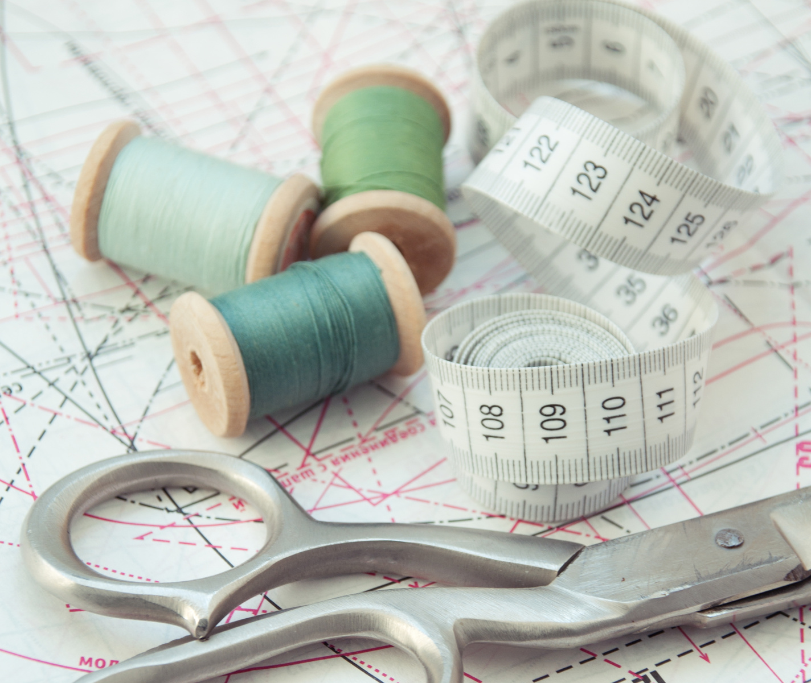
UpTraK Training Programme
Module 1, Unit 3
Computer/laptop with internet for research.
Access to examples of business cases and upcycling brands.
Worksheets for drafting value propositions.
Flipchart/markers for brainstorming business strategies.
Necessary
equipment
www.fashionupproject.com

Slide 7
UpTraK Training Programme
Module 1, Unit 3
01
Teacher's Profile
Experienced in sustainable business and entrepreneurship
Knowledgeable in fashion marketing and branding
Creative thinker with problem-solving skills
01
Methodology
This Unit will be based on both interactive and reflective learning methodologies.
www.fashionupproject.com

Slide 8
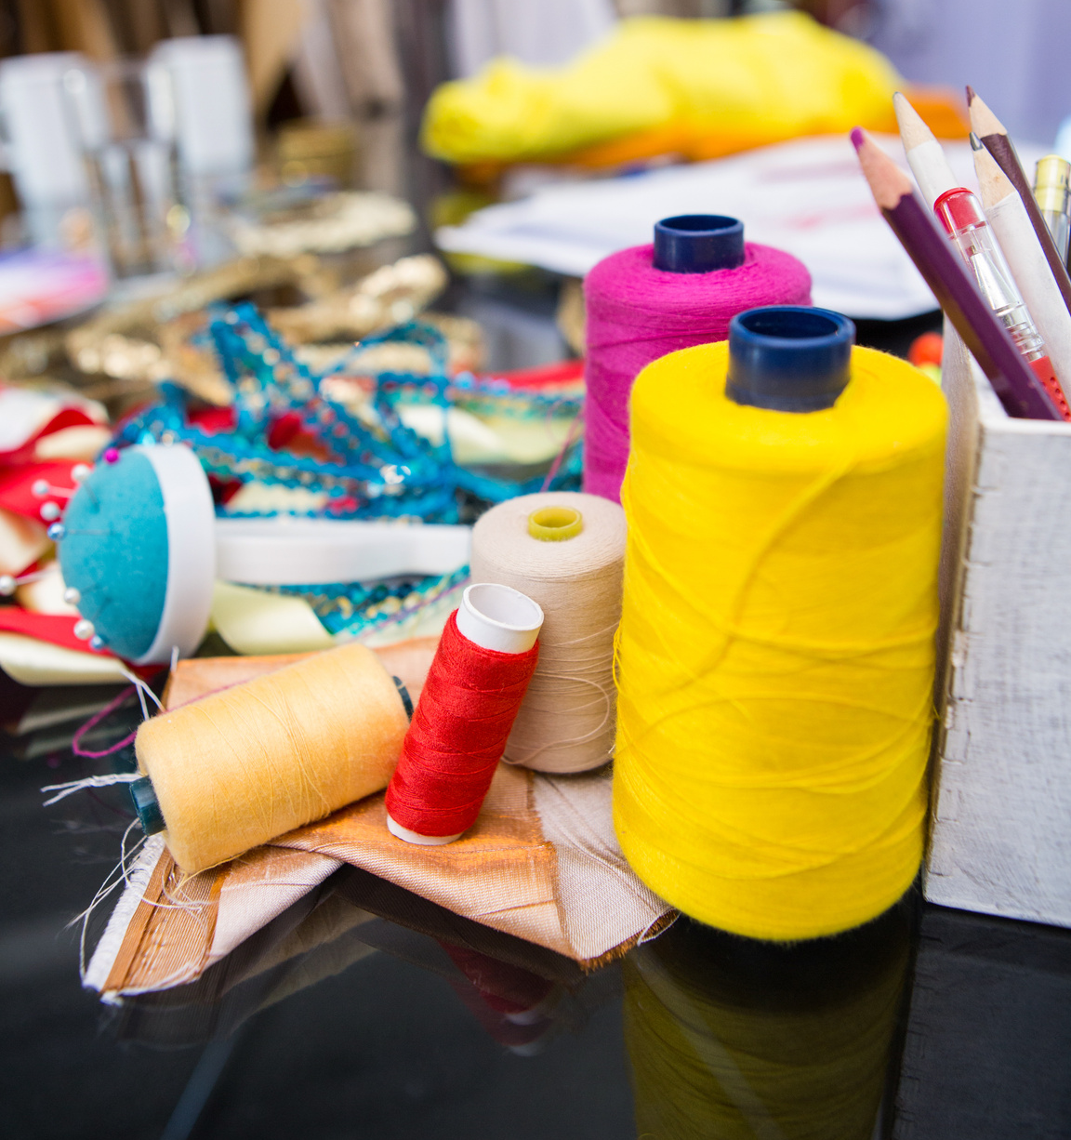
UpTraK Training Programme
Module 1, Unit 3
Introduction
Sustainable fashion is gaining momentum as consumers increasingly seek eco-friendly and unique clothing. Upcycling allows designers and entrepreneurs to transform vintage or second-hand materials into one-of-a-kind fashion pieces. This approach not only reduces waste but also creates products with a story and distinctive appeal.
For students and aspiring creators, starting
a small-scale upcycling business is an accessible way to explore creativity, respond to market demand, and learn the fundamentals of running a sustainable fashion venture.
www.fashionupproject.com

Slide 9
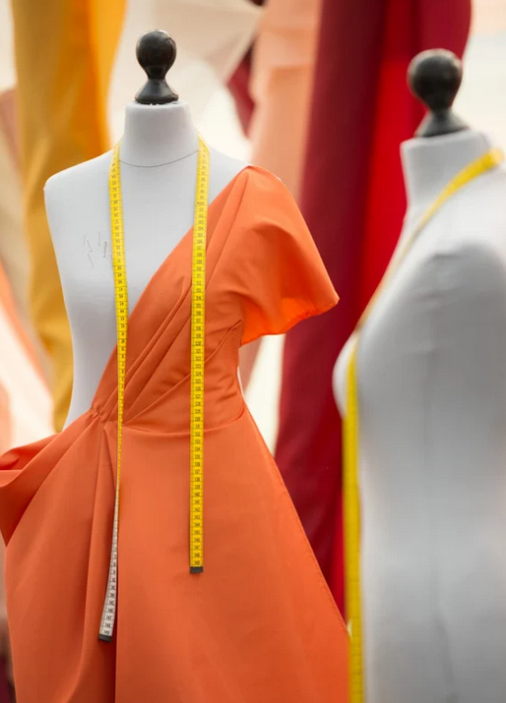
UpTraK Training Programme
Module 1, Unit 3
Market Potential of Sustainable Fashion
Growing Consumer Demand:
  Consumers are increasingly prioritizing sustainable products due to heightened awareness of environmental issues.
  Studies show that 73% of Gen Z consumers are willing to pay more for eco-friendly products, making them a key target demographic.
Sustainability Trends in Fashion:
  The global sustainable fashion market is projected to reach $15 billion by 2030, with an annual growth rate of 9.1%.
  Circular economy principles, such as upcycling and second-hand fashion, are gaining traction among both consumers and brands.
Opportunities for Innovation:
  Upcycling provides a competitive edge by offering unique, personalized products while reducing production costs.
  Partnerships with second-hand retailers and textile recycling initiatives are on the rise, enabling businesses to tap into a growing market.
Environmental and Ethical Appeal:
  Brands with transparent, sustainable practices are preferred by 88% of millennials, who value ethical and environmental responsibility.
  Reducing waste and promoting circularity resonate with modern consumers looking to align their values with their purchases.
www.fashionupproject.com

Slide 10
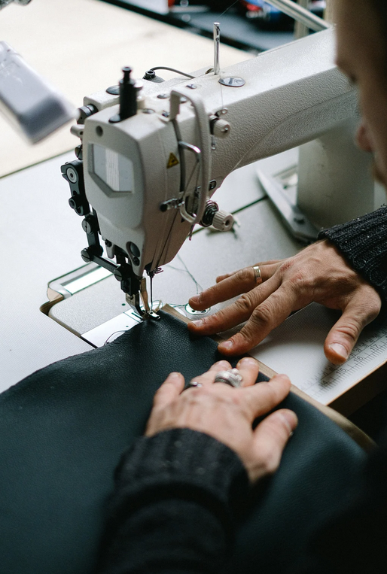
UpTraK Training Programme
Module 1, Unit 3
Creating a Unique Value Proposition
Strategies to differentiate upcycled products
Differentiating Upcycled Products
Strategies:
Tell the story behind the materials and transformation process.
Offer customized or limited-edition designs.
Use eco-certifications to build trust and credibility.
Collaborate with local artists or influencers for exclusive collections.
Examples:
Handcrafted bags from decommissioned fire hoses – durable and stylish.
Limited-edition fashion made from vintage fabrics – every piece is unique.
www.fashionupproject.com

Slide 11
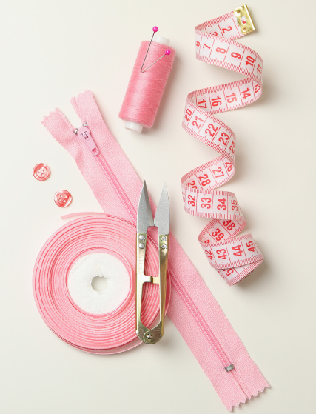
UpTraK Training Programme
Module 1, Unit 3
Examples of Propositions
Limited-edition fashion pieces made from vintage fabrics – each item tells a unique story.
Outcome:
Appeals to customers looking for exclusive, one-of-a-kind products.
Differentiates the brand from mass-produced fashion.
Encourages customer loyalty due to the exclusivity of the designs.
Tote bags crafted from textile scraps, with 10% of profits donated to environmental causes.
Outcome:
Enhances the emotional connection with ethically-minded consumers.
Provides a competitive edge by linking products to a greater cause.
Increases sales as customers feel their purchase makes a positive impact.
Fashion accessories made from post-consumer plastics – modern designs reducing ocean waste.
Outcome:
Attracts media attention for innovative use of waste materials.
Expands reach to consumers interested in combating plastic pollution.
Encourages collaboration with environmental organizations.
www.fashionupproject.com

Slide 12
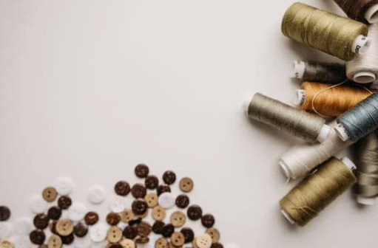
UpTraK Training Programme
Module 1, Unit 3
Building a Sustainable Business Model for Upcycling
Pricing Strategies:
Set premium prices by emphasizing product uniqueness and sustainability.
Offer tiered pricing (e.g., custom designs vs. standard upcycled items).
Highlight cost savings from reduced material expenses to justify price points.
Marketing Channels:
Leverage social media platforms to share transformation stories and reach eco-conscious consumers.
Collaborate with local markets, sustainable fairs, and online marketplaces focused on green products.
Build a direct-to-consumer (D2C) model through an engaging website showcasing transparency.
Scalability:
Partner with second-hand suppliers or deadstock distributors for consistent material sourcing.
Introduce limited-edition collections to test demand before expanding production.
Use modular production methods to adapt easily to changing material availability.
www.fashionupproject.com
You can read more about Marketing and Sales in Module 5.

Slide 13
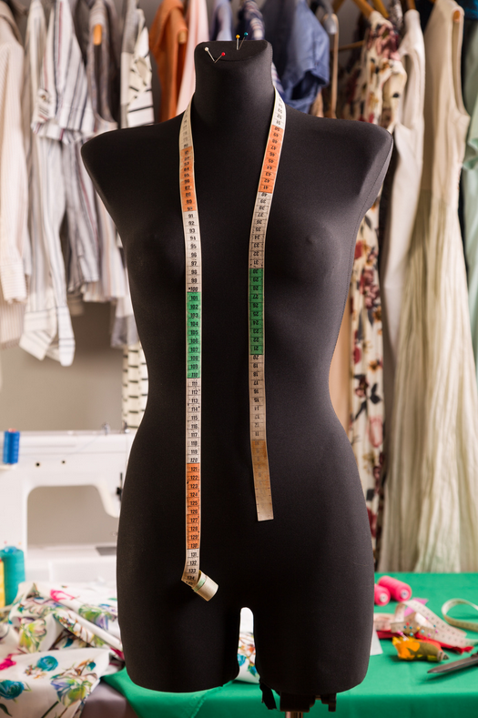
UpTraK Training Programme
Module 1, Unit 3
Takeaways and Next Steps
Key Takeaways:
Upcycling offers a sustainable and innovative approach to fashion, reducing waste and promoting creativity.
Successful upcycling requires careful material selection, a strong value proposition, and a clear business model.
The growing demand for sustainable products presents significant opportunities in the market.
Next Steps:
Identify potential upcycling projects within your scope.
Apply the material assessment criteria to select suitable materials.
Develop a unique value proposition and test it through small-scale projects.
Together, we can transform waste into opportunity and lead the way toward a more sustainable future in fashion.
Checklist for Material Assessment
www.fashionupproject.com

Slide 14
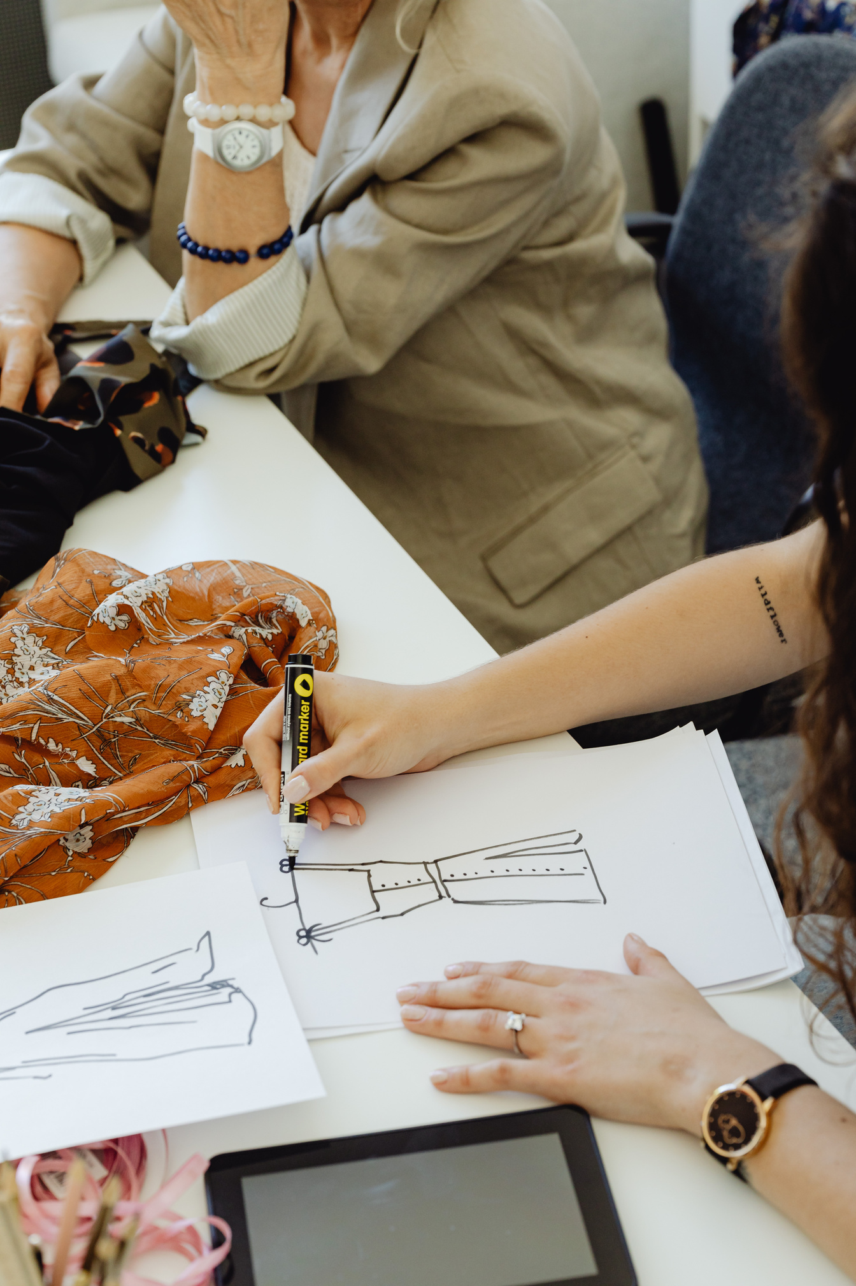
UpTraK Training Programme
Module 1, Unit 3
Unit
Summary
In this unit, learners learnt how to distinguish upcycling from other sustainable practices in fashion, such as recycling. Learners have been firstly introduced to basic business model and unique selling proposition for upcycled fashion items, and they also acquired introductive knowledge and skills to identify and evaluate suitable materials for upcycling projects.
These aspects will be deepened in the following tailored Modules (3-4-5)
www.fashionupproject.com

Slide 15
UpTraK Training Programme
Module 1, Unit 3
  Fashion Revolution - "Why We Need to Reuse and Upcycle Clothing"
    Website: www.fashionrevolution.org
  The Ellen MacArthur Foundation - "A New Textiles Economy: Redesigning Fashion’s Future"
    Website: www.ellenmacarthurfoundation.org
  Greenpeace International - "The Environmental Impact of Fast Fashion"
    Website: www.greenpeace.org
  Textile Exchange - "Preferred Fiber & Materials Market Report"
    Website: www.textileexchange.org
  Sustainable Apparel Coalition - "Higg Index: Sustainable Materials"
    Website: www.apparelcoalition.org
  The Upcycle Movement - Resources and guides on upcycling practices
    Website: www.theupcyclemovement.com
  British Fashion Council - "Circular Fashion and Upcycling Initiatives"
    Website: www.britishfashioncouncil.co.uk
  Eco-Age - "Guide to Sustainable Fashion: Understanding Upcycling"
    Website: www.eco-age.com
References
www.fashionupproject.com

