Slide 1



UpTraK Training Programme
Module 6
UNIT 3
SUSTAINABLE DESIGN AS A HYBRID 2D-3D ACTIVITY
www.fashionupproject.com
Duration: 2 hours

Slide 2
UpTraK Training Programme
Funded by the European Union. Views and opinions expressed are however those of the author(s) only and do not necessarily reflect those of the European Union or the European Education and Culture Executive Agency (EACEA). Neither the European Union nor EACEA can be held responsible for them.
www.fashionupproject.com

Slide 3
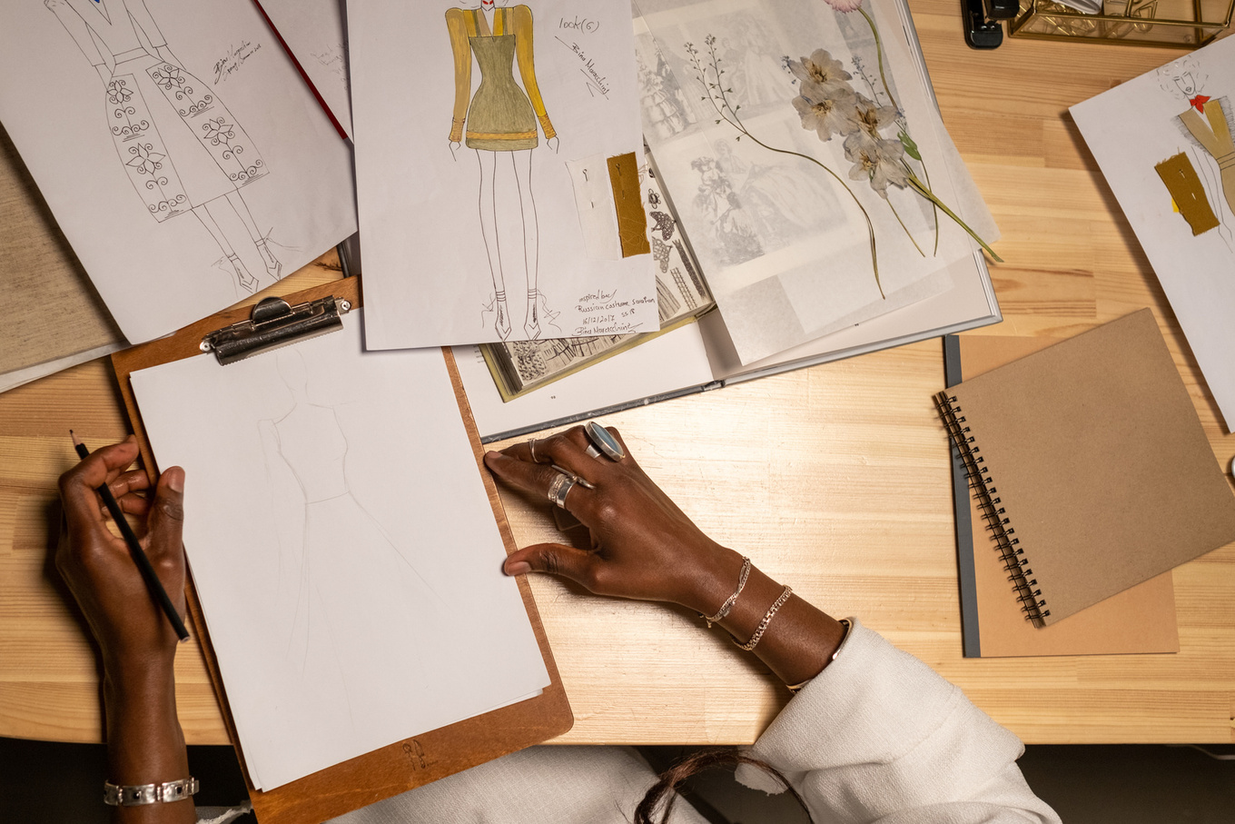

UpTraK Training Programme
Module 6, Unit 3
Overview of the Unit
This unit explores how to transition from 2D fashion patterns to 3D digital models, integrating traditional and digital techniques for sustainable design. By building on a 2D paper pattern, learners will digitize their work and develop 3D garments in Blender. To complete this unit, the 2D pattern can be the one created within Module 4 or it can be chosen directly by the trainer. This hybrid approach reduces waste, improves precision, and enhances design flexibility while preparing for Unit 4.
www.fashionupproject.com

Slide 4
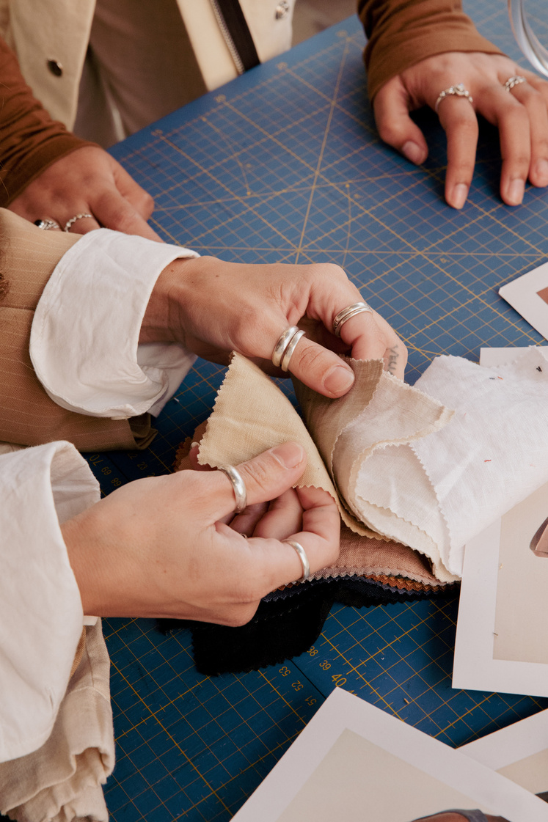

UpTraK Training Programme
Module 6, Unit 3
Expected
Learning Outcomes
By the end of this Unit, you will be able to:
Convert a handmade 2D pattern into a 3D digital model using Blender.
Understand the workflow for hybrid 2D/3D design in fashion.
Recognize the sustainability benefits of digital garment modeling.
Prepare a 3D garment for further exercises in Unit 4.
www.fashionupproject.com
Pre-requisite knowledge
  Basic fashion patternmaking (Module 4).
  Familiarity with fashion construction and computer-based design tools.
  An interest in sustainability and digital fashion innovation.
Estimated Reading Time
7 minutes

Slide 5


UpTraK Training Programme
Module 6, Unit 3
Target Audience
Learning
Objective
This Unit targets learners who are seeking basic knowledge on how to pass from a 2D pattern to a 3D project for a garment
The goal of the Unit is to equip learners with the ability to translate a 2D pattern into a 3D digital garment, integrating traditional patternmaking with digital modeling in Blender. Learners will gain practical skills in digitization, virtual garment construction, and sustainable fashion design, preparing them for advanced exercises in Unit 4.
Key concepts
2D-to-3D Workflow, Digital Patternmaking, Virtual Garment Prototyping, Sustainable Fashion Design, Seam Alignment & Fit Testing, Blender for Fashion Design
www.fashionupproject.com

Slide 6
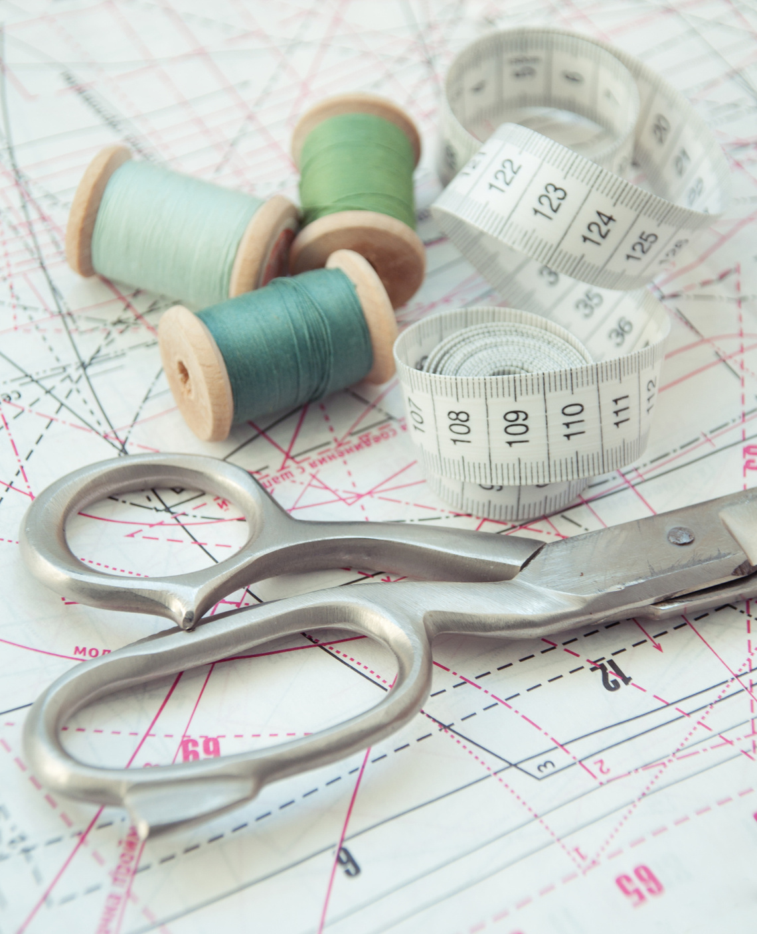

UpTraK Training Programme
Module 6, Unit 3
To complete the exercises in this unit, you will need:
  2D paper pattern (from Module 4 or other).
  Scanner or smartphone camera (to digitize the pattern).
  Computer with Blender installed.
  Stylus or mouse (for digital adjustments).
Necessary
equipment
www.fashionupproject.com

Slide 7




UpTraK Training Programme
Module 6, Unit 3
01
Teacher's Profile
PROFESSIONAL FASHION DESIGNER EXPERT IN 3D DESIGN
or
TRAINER FOR FASHION DESIGN & MODELING EXPERT IN 3D DESIGN
01
Methodology
Mixed: traditional teaching + experiential learning
www.fashionupproject.com

Slide 8

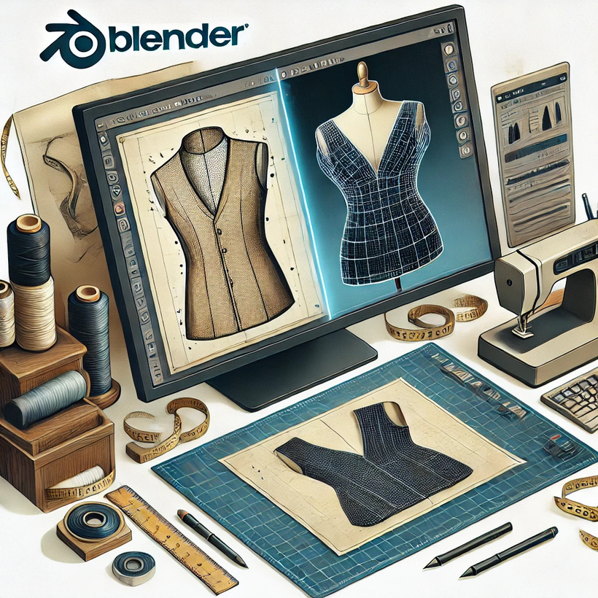
UpTraK Training Programme
Module 6, Unit 3
The transition from 2D to 3D in sustainable Fashion Design
Traditional fashion design relies on physical prototyping, which can be wasteful and time-consuming. By integrating 3D modeling, designers can create, test, and refine garments without material waste. This hybrid method bridges craftsmanship and technology, ensuring better fit, faster iterations, and reduced production costs.
📌 Why It Matters:
  Avoids unnecessary fabric waste.
  Speeds up design revisions without creating multiple physical prototypes.
  Enhances sustainability in the fashion industry.
www.fashionupproject.com

Slide 9
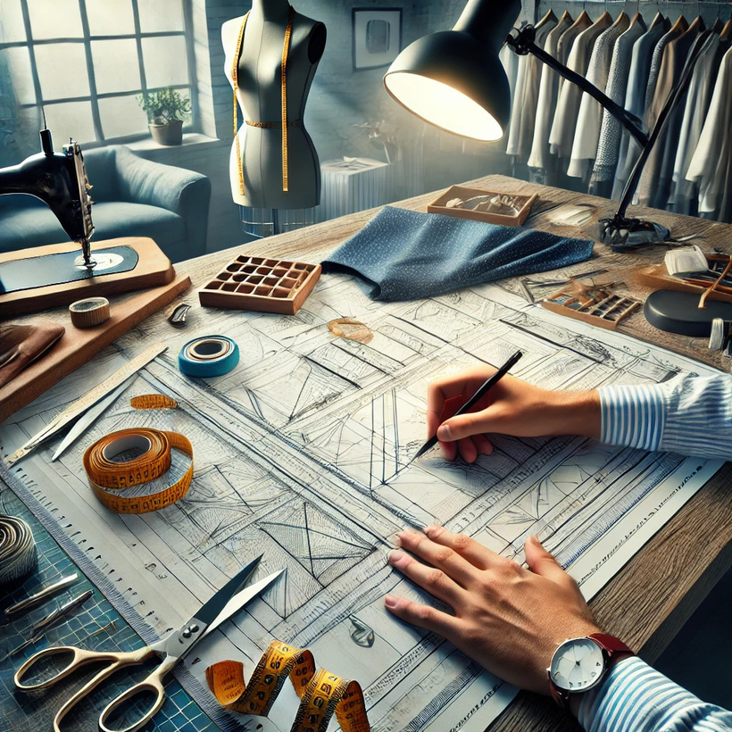
UpTraK Training Programme
Module 6, Unit 3
Overview of traditional 2D patternmaking
Fashion designers start with a 2D pattern, carefully measuring, cutting, and assembling fabric to form a garment. In Module 4, you created a 2D paper pattern, which we will now digitize and transform into 3D.
📌 Limitations of 2D Patterns:
  Must be physically adjusted if changes are needed.
  Requires multiple test garments before achieving the final fit.
  Does not allow for instant visualization of fit, drape, or movement.
By digitizing the pattern, is possible to overcome these challenges and enable a more flexible, sustainable design process.
www.fashionupproject.com

Slide 10


UpTraK Training Programme
Module 6, Unit 3
3D fashion design software like Blender allows us to:
  Import scanned 2D patterns and align them in 3D space.
  Simulate garment construction, ensuring accuracy before production.
  Modify designs instantly without re-cutting physical fabric.
Digital tools for 2D-to-3D translation
Blender is an open-source, free software with advanced 3D modeling tools, physics simulations, and rendering capabilities, making it a powerful tool for sustainable fashion design.
Why Blender?
www.fashionupproject.com
Watch
https://www.youtube.com/watch?v=AlPPYkZg9D4

Slide 11



UpTraK Training Programme
Module 6, Unit 3
Step-by-step process - from 2D paper pattern to 3D model
The process of converting a paper pattern into a 3D garment in Blender includes:
01
02
03
04
Scanning the 2D Pattern – Importing the physical pattern into the digital workspace.
Tracing and Adjusting in Blender – Aligning edges, defining seams, and ensuring proportion accuracy.
Extruding to 3D – Transforming the flat pattern into a full garment shape.
Refining Fit & Shape – Adjusting structure and stitching for realism.
www.fashionupproject.com
Watch
https://www.youtube.com/watch?v=GLxMYj-pBQs

Slide 12

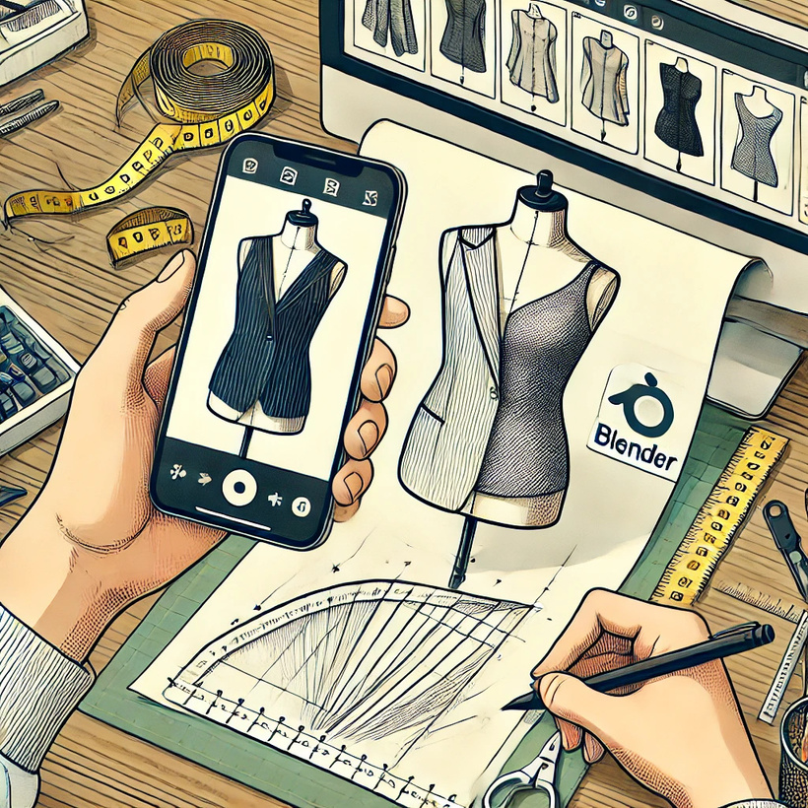

UpTraK Training Programme
Module 6, Unit 3
Exercise 1 - digitizing the paper pattern
📌 Objective: Convert your 2D paper pattern into a digital file.
Instructions:
  Scan or take a high-resolution photo of your paper pattern.
  Import the image into Blender as a background reference.
  Trace the outline using Blender’s mesh tools.
  Save and export the digitized pattern for 3D modeling.
🛠 Tools Needed: Scanner/phone camera, Blender software.
www.fashionupproject.com

Slide 13
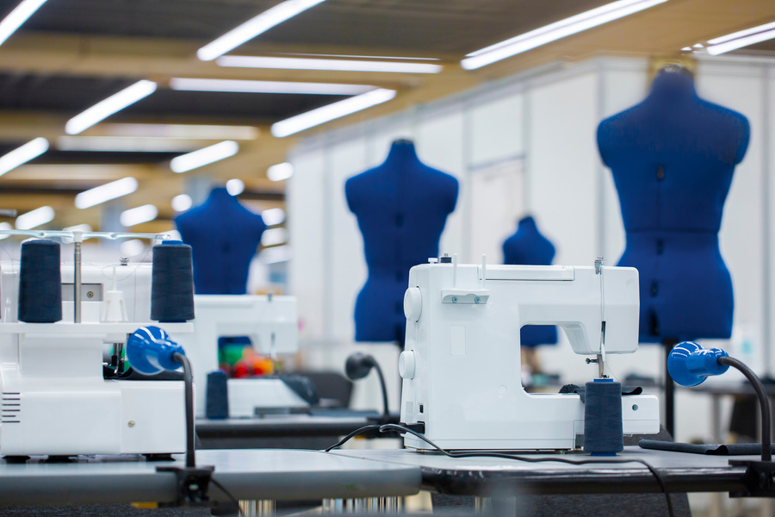
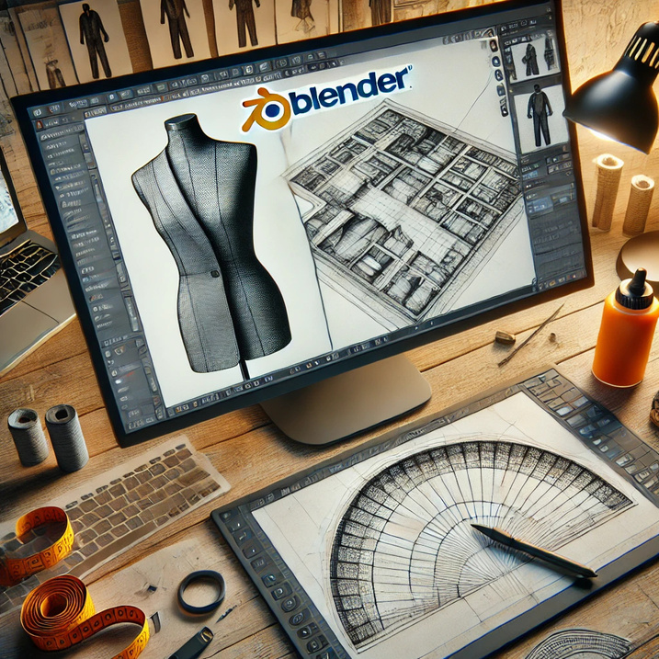

UpTraK Training Programme
Module 6, Unit 3
https://www.youtube.com/watch?v=qwFepcMiE18
Watch
Video Demonstration - Importing a 2D Pattern into Blender
www.fashionupproject.com

Slide 14
UpTraK Training Programme
Module 6, Unit 3
Exercise 2 - Building the 3D garment in Blender
📌 Objective: Convert your digitized 2D pattern into a 3D shape.
Instructions:
  Use Blender’s extrusion tools to give depth to your pattern.
  Connect pattern pieces to form a structured garment.
  Refine proportions and adjust seams for accuracy.
  Apply preliminary fabric properties to check fit and drape.
🛠 Tools Needed: Blender software, digitized pattern.
www.fashionupproject.com

Slide 15
UpTraK Training Programme
Module 6, Unit 3
Sustainable benefits of hybrid 2D/3D design
Why is this important for sustainability?
01
02
03
Reduces fabric waste by minimizing physical prototyping.
Saves time and costs by allowing digital adjustments.
Enables instant visualization of garment fit before production.
www.fashionupproject.com
By adopting a hybrid workflow, designers can merge craftsmanship with technology for a more efficient and eco-friendly fashion industry.

Slide 16
UpTraK Training Programme
Module 6, Unit 3
Case studies - Brands using hybrid 2D/3D workflows
Examples of Fashion Brands Using 2D/3D Hybrid Design:
01
02
03
Adidas – Uses digital modeling for prototyping and fit testing.
Balenciaga – Integrates virtual design with traditional tailoring.
Stella McCartney – Combines digital and sustainable materials.
www.fashionupproject.com
Take a look on how 3D design is changing fashion.
Watch
https://www.youtube.com/watch?v=OBkriWZM7a0

Slide 17
UpTraK Training Programme
Module 6, Unit 3
Exercise 3 - Preparing the 3D model for fabric simulation
📌 Objective: Finalize your 3D garment for fabric testing in Unit 4.
Instructions:
  Ensure all pattern pieces are connected properly in Blender.
  Apply fabric settings to prepare for draping and movement tests.
  Save your 3D model in a format ready for further simulation.
🛠 Tools Needed: Blender software, exported 3D model.
www.fashionupproject.com

Slide 18


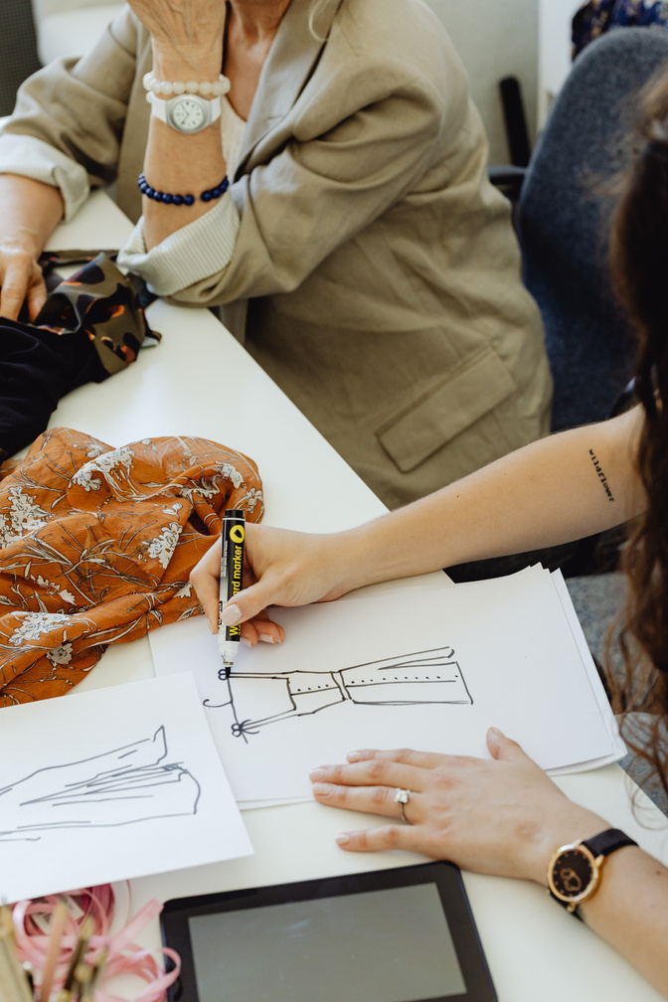

UpTraK Training Programme
Module 6, Unit 3
Unit
Summary
In this Unit, you learned:
  How to digitize a 2D paper pattern and convert it into a 3D model in Blender.
  The workflow of hybrid 2D/3D design, combining traditional patternmaking with digital tools.
  The importance of digital patternmaking for accuracy, efficiency, and sustainability.
  How to import, trace, and refine patterns in Blender for garment construction.
  The benefits of virtual garment prototyping, reducing waste and improving design flexibility.
  How fashion brands use hybrid 2D/3D workflows to optimize their creative and production processes.
www.fashionupproject.com

Slide 19


UpTraK Training Programme
Module 6, Unit 3
    Blender Documentation – www.blender.org
    Sustainable Fashion Articles – www.ellenmacarthurfoundation.org
    Virtual Prototyping Research – www.businessoffashion.com
References
www.fashionupproject.com

