Slide 1


UpTraK Training Programme
Module 2
IDEA GENERATION: CREATIVITY APPLYING TO THE CLOTHES UP-CYCLING PROCESS (PRODUCT RE-DESIGN AND RENOVATION)
www.fashionupproject.com

Slide 2
UpTraK Training Programme
Funded by the European Union. Views and opinions expressed are however those of the author(s) only and do not necessarily reflect those of the European Union or the European Education and Culture Executive Agency (EACEA). Neither the European Union nor EACEA can be held responsible for them.
www.fashionupproject.com

Slide 3
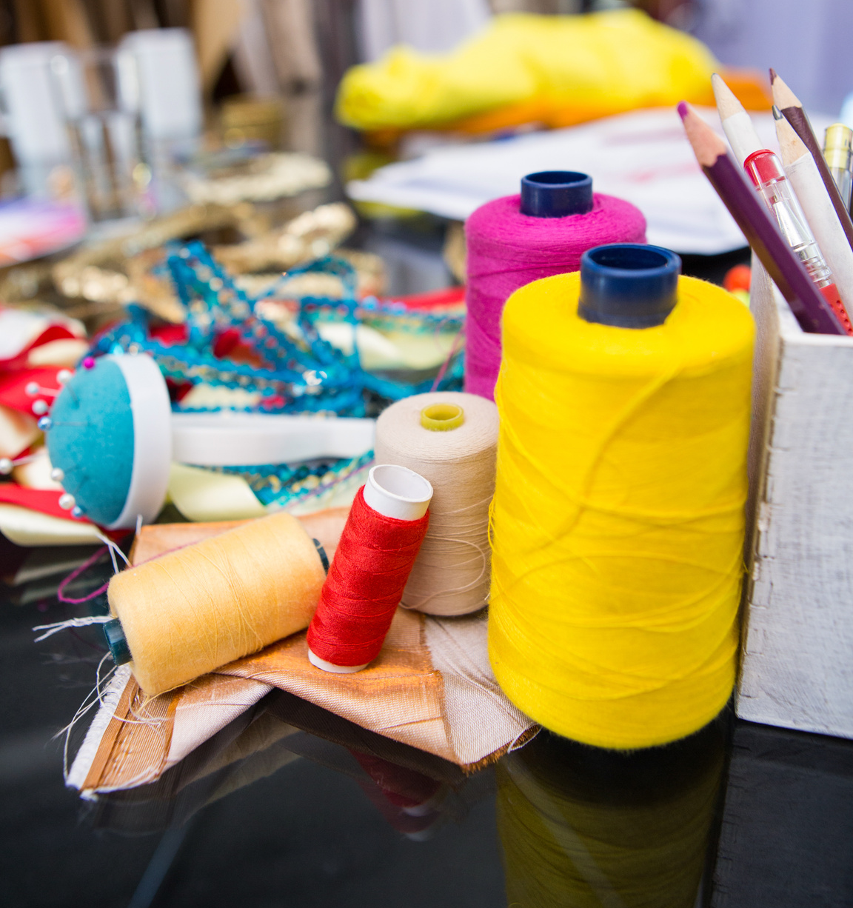
UpTraK Training Programme
Module 2, IDEA GENERATION: CREATIVITY APPLYING TO
THE CLOTHES UP-CYCLING PROCESS
Module 2 Learning Objectives
At the end of the module the students will be able to:
• understanding sustainable fashion
• learn about the principles of upcycling and its importance in reducing waste
• learning from historical and cultural research, applying these influences creatively to redesign and renovate garments
• developing creative skills, enhance creative thinking and problem-solving skills applied to clothing redesign
• applying various redesign techniques to specific stretch garments
The module will guide students in understanding sustainable fashion and upcycling design methods.
They will learn about the principles of upcycling and its importance in reducing waste, developing skills to redesign and renovate various garments.
www.fashionupproject.com

Slide 4
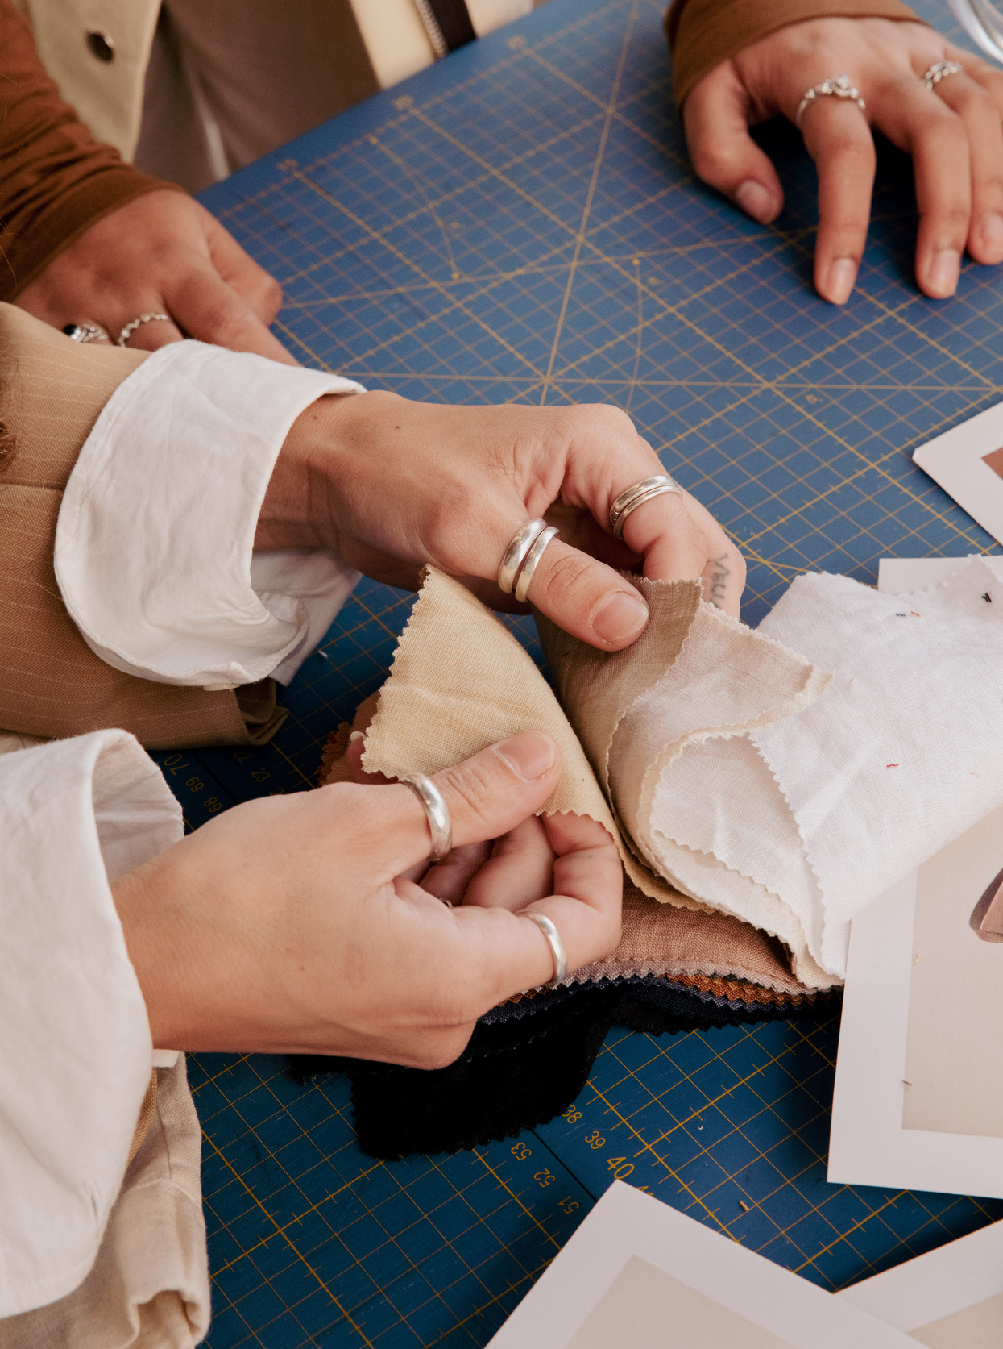
UpTraK Training Programme
Module 2, IDEA GENERATION: CREATIVITY APPLYING TO
THE CLOTHES UP-CYCLING PROCESS
Expected
Learning Outcomes
By the end of this Module, learners will understand sustainable fashion and learn about the principles of upcycling, its vocabulary and its importance in reducing waste.
Exploring historical, contemporary and cultural research, they will be able to apply creative thinking and problem-solving skills to clothing redesign through moodboards.
Learners will explore garment deconstruction learning to transform existing garments/second-hand or vintage clothes into new, innovative, and responsible fashion items thanks to redesign techniques. They will approach a range of different fabrics and garments, with an understanding of how to redesign modular items such as towels, kitchenware through zero waste techniques.
They will also learn how to work with stretchy fabrics, with the use of overlock machine.
www.fashionupproject.com

Slide 5
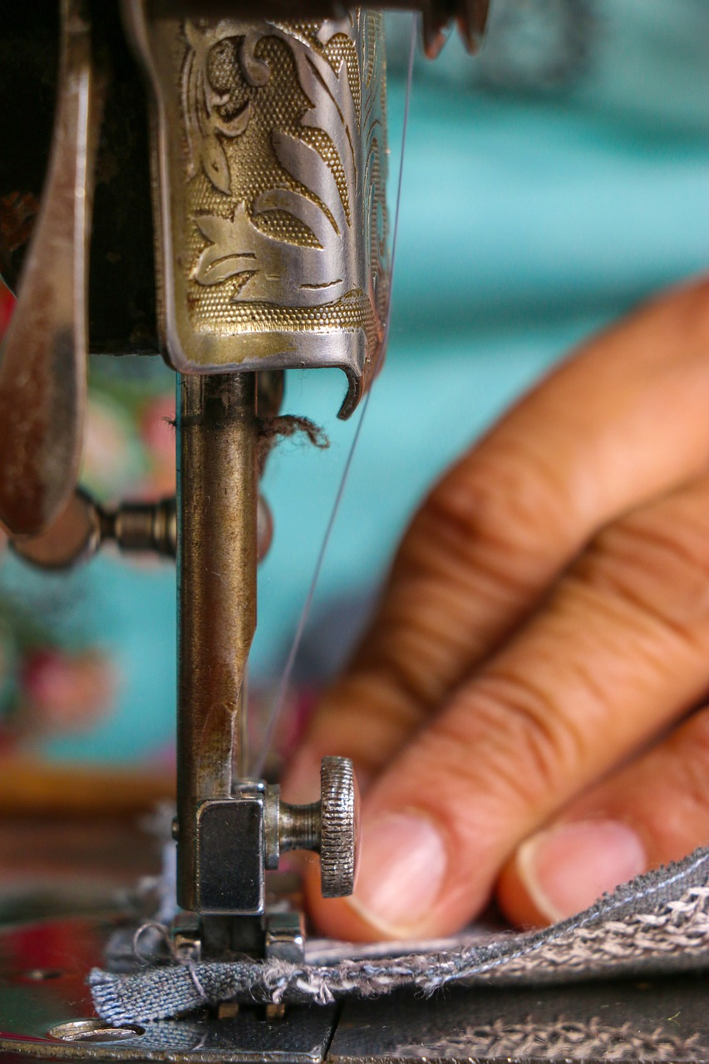
UpTraK Training Programme
Module 2, IDEA GENERATION: CREATIVITY APPLYING TO
THE CLOTHES UP-CYCLING PROCESS
Methodology
The methodology will be an experiential learning, a blend of theoretical instruction and hands-on practice, to build students' critical thinking and deep comprehension.
The aim is to provide learners with a comprehensive understanding of upcycling while fostering creativity, sustainability awareness and idea generation within the upcycling process.
Case studies will be presented, showing successful brands projects committed to upcycling and sustainability.
Creative risk-taking will be encouraged, helping participants to feel comfortable with experimentation.
Instructors offer guidance, helping learners overcome challenges in execution and guiding them on practical approaches to upcycling.
The module provides resources or ideas for continuing upcycling journey for participants.
www.fashionupproject.com

Slide 6

UpTraK Training Programme
Module 2, IDEA GENERATION: CREATIVITY APPLYING TO
THE CLOTHES UP-CYCLING PROCESS
Necessary equipment
notebook
laptop
magazines (fashion, travel, nature, design, food)
A3 220gr paper
sketchbook or similar
pencil, colours (markers and/or coloured pencils)
domestic sewing machine and overlock machine
pins
chalk or similar
fabric scissors and different color sewing threads
paper pattern and tape measure
see through ruler
deadstock fabric, second-hand garments (shirt, denim trousers, trench coat), second-hand home wear (towels, pillowcases), second-hand t-shirts.
Module 2 Duration
56 hours
www.fashionupproject.com
Assessment Criteria
A 5 closed questions quiz will be submitted to learners to ascertain the reaching of learning goals set for this Module.

Slide 7
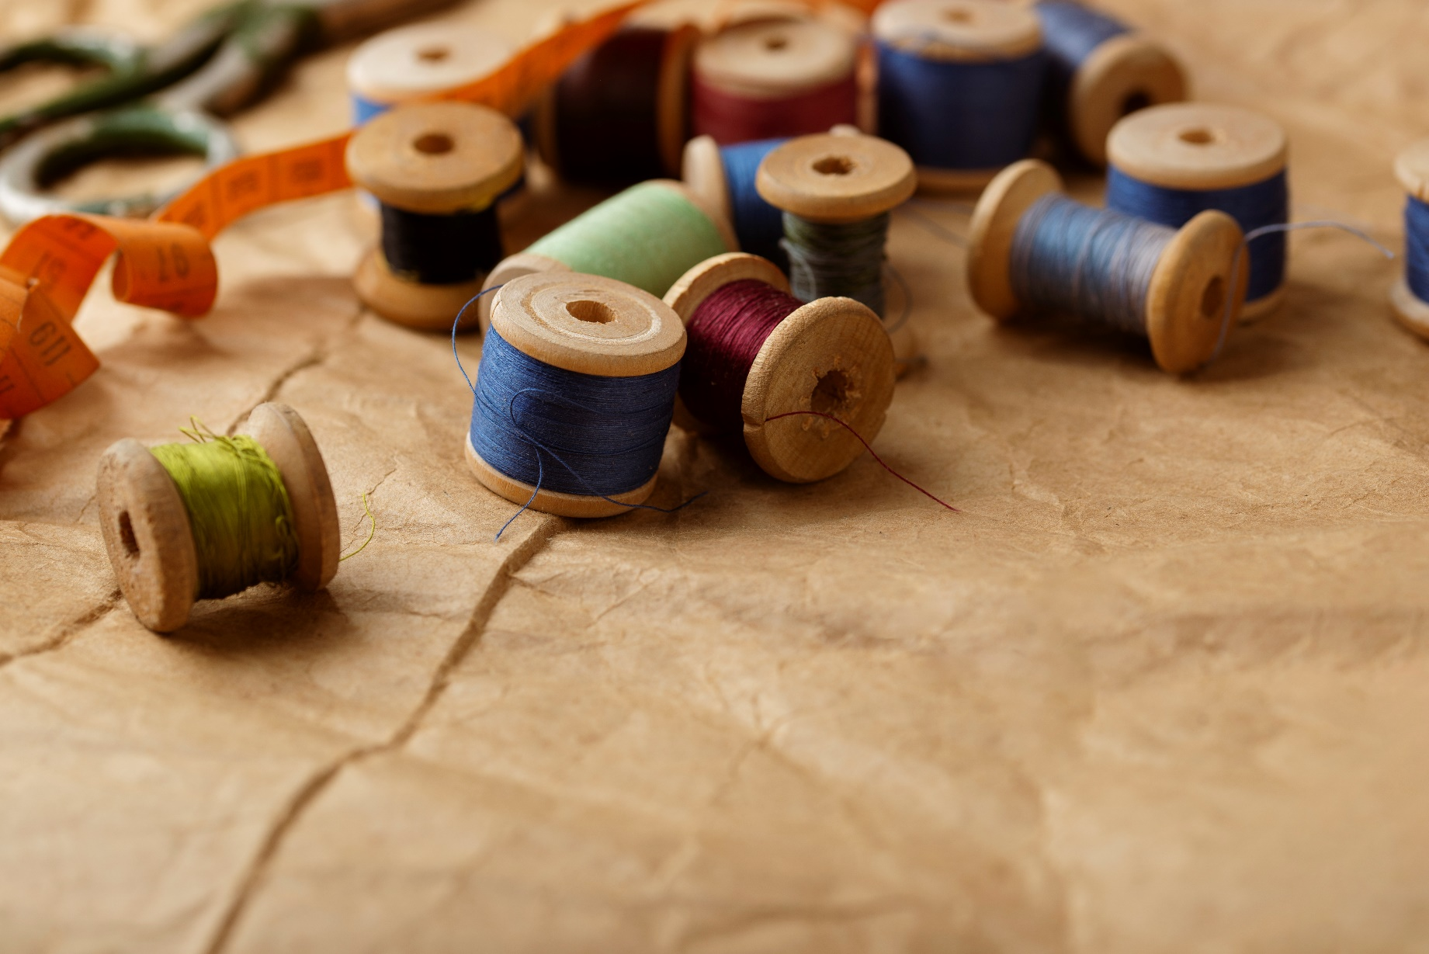
UpTraK Training Programme
Module 2, IDEA GENERATION: CREATIVITY APPLYING TO
THE CLOTHES UP-CYCLING PROCESS
This Module includes theoretical Training Materials on PPT or Canva format and, because of its high performative-practical learning contents, is complemented by 3 video tutorials.
Theoretical materials are available for each Training Unit constituting the Module.
The available video-tutorials concern:
Different styles of visible mending
Upcycling from already existing vintage/used clothes
Upcycling from deadstock fabrics/ fabrics destined for waste/not used or not fit for sale fabrics/defective fabrics
Training Materials & Video-Tutorials
www.fashionupproject.com

Slide 8
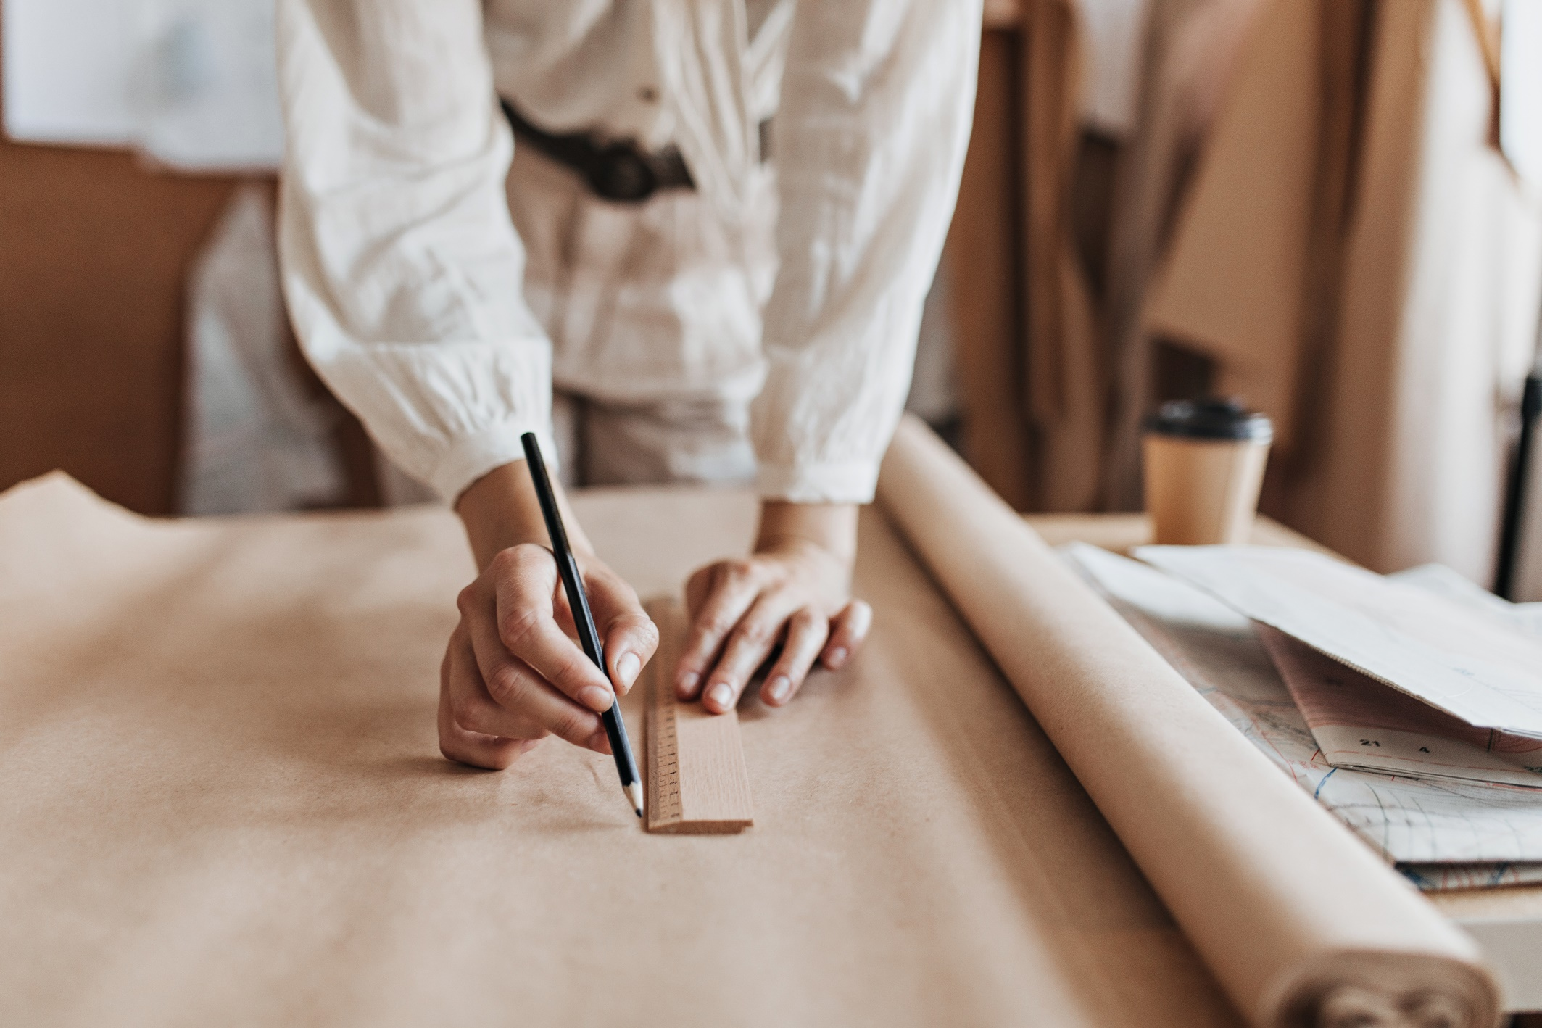
UpTraK Training Programme
Module 2, IDEA GENERATION: CREATIVITY APPLYING TO
THE CLOTHES UP-CYCLING PROCESS
Pedagogical competences:
Experience in teaching adult learners and understanding their learning styles;
Strong communication and presentation skills to engage learners.
Technical competences:
history of tradition/fashion/costume, knowledge about the upcycling process and conscious fashion, skills on redesign, research processes and mood boards (intermediate level);
zero waste design and redesign techniques, overlock machine and hand sewing skills, pattern making, textile manipulation, garment disassembly and construction techniques: familiarity with various and stretchy textiles, and their properties and suitability for upcycling (high level).
www.fashionupproject.com
Trainer(s) competence profile

Slide 9
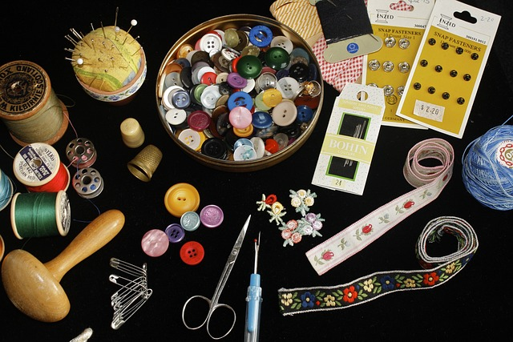
UpTraK Training Programme
Module 2, IDEA GENERATION: CREATIVITY APPLYING TO
THE CLOTHES UP-CYCLING PROCESS
Module 2
www.fashionupproject.com
TRAINING UNITS

Slide 10
UpTraK Training Programme
Module 2, IDEA GENERATION: CREATIVITY APPLYING TO
THE CLOTHES UP-CYCLING PROCESS
Module 2 Training Units
These Training Units compose Module 2
01
02
03
0
02
THE ORIGIN OF UPCYCLING, ITS EVOLUTION AND CONTEMPORARY CREATIVE PRACTICE
GARMENT DECONSTRUCTION AND PRODUCT REDESIGN METHODOLOGIES
CLOTHING MODULAR ITEMS AND CREATIVE UPCYCLING APPROACHES
content
www.fashionupproject.com
Duration: 7 hours
Duration: 13 hours
Duration: 13 hours

Slide 11
UpTraK Training Programme
Module 2, IDEA GENERATION: CREATIVITY APPLYING TO
THE CLOTHES UP-CYCLING PROCESS
Module 2 Training Units
04
05
06
0
02
DEADSTOCK FABRIC BACK TO LIFE: CREATION PROCESS AND IDEA GENERATION IN DESIGN
UPCYCLING SPECIFIC CLOTHING CATEGORIES: A FOCUS ON REDESIGNING STRETCH GARMENTS
TITLE
content
www.fashionupproject.com
Duration: 10 hours
Duration: 13 hours
Duration.

Slide 12
UpTraK Training Programme
Module 2, IDEA GENERATION: CREATIVITY APPLYING TO
THE CLOTHES UP-CYCLING PROCESS
  Brown, S. (2013) ReFashioned: Cutting-Edge Clothing from Upcycled Materials, Laurence King Publishing, Kingston University London
  Rissanen, T. and McQuillan, H. (2023) Zero Waste Fashion Design, Bloomsbury Publishing PLC, London
  Gwilt, A. and Rissanen, T. (2011) Shaping Sustainable Fashion: changing the way we make and use clothes, Taylor & Francis Ltd, Milton Park
  Banzi, N. (1976) Fiorucci presenta: vestiti per un anno. Ricette per far da soli il vostro guardaroba e riutilizzare gli abiti usati, AMZ Marietti, Torino
  make/use: a modular system for zero-waste fashion (makeuse.nz)
  (PDF) From 15% to 0: Investigating the creation of fashion without the creation of fabric waste | Timo Rissanen - Academia.edu
References
www.fashionupproject.com

