Slide 1


UpTraK Training Programme
Module 4
The upcycling process: techniques of tailoring for re-styling and renovation
www.fashionupproject.com

Slide 2
UpTraK Training Programme
Funded by the European Union. Views and opinions expressed are however those of the author(s) only and do not necessarily reflect those of the European Union or the European Education and Culture Executive Agency (EACEA). Neither the European Union nor EACEA can be held responsible for them.
www.fashionupproject.com

Slide 3
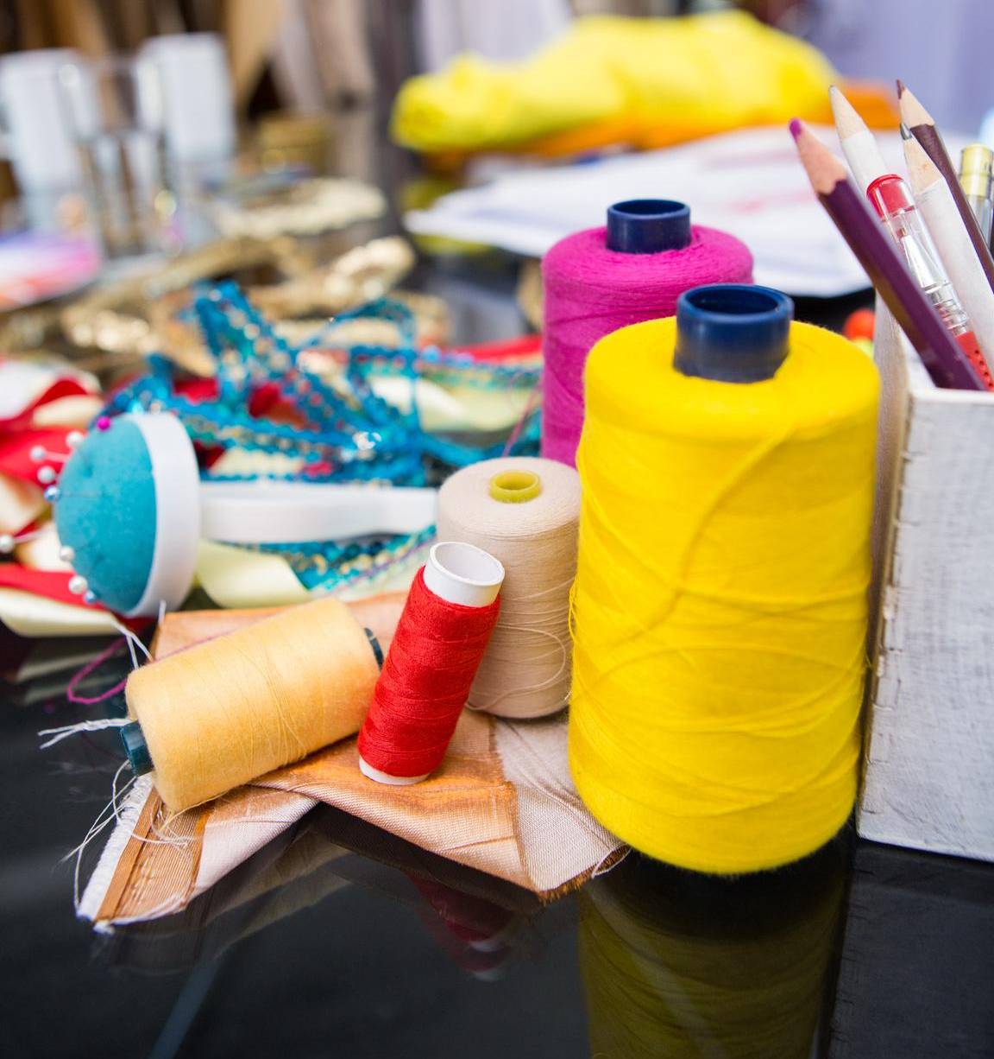
Module 4, THE UPCYCLING PROCESS: TECHNIQUES OF TAILORING
FOR RE-STYLING AND RENOVATION
UpTraK Training Programme
Module 4
Learning Objectives
Learn how to use tailoring techniques as tool for upcycling garments:
concepts, materials and techniques of tailoring
garment’s potential for restyling
use tailoring tools and equipment safely and effectively
Learn basic and advanced tailoring skills specific to upcycling:
garment alterations (hemming, resizing, and repairing)
hand sewing techniques and basic stitches
various seam finishing techniques
pattern cutting, fitting, and garment alterations
customization techniques
planning, designing, and executing the upcycling of a structured garment
www.fashionupproject.com

Slide 4
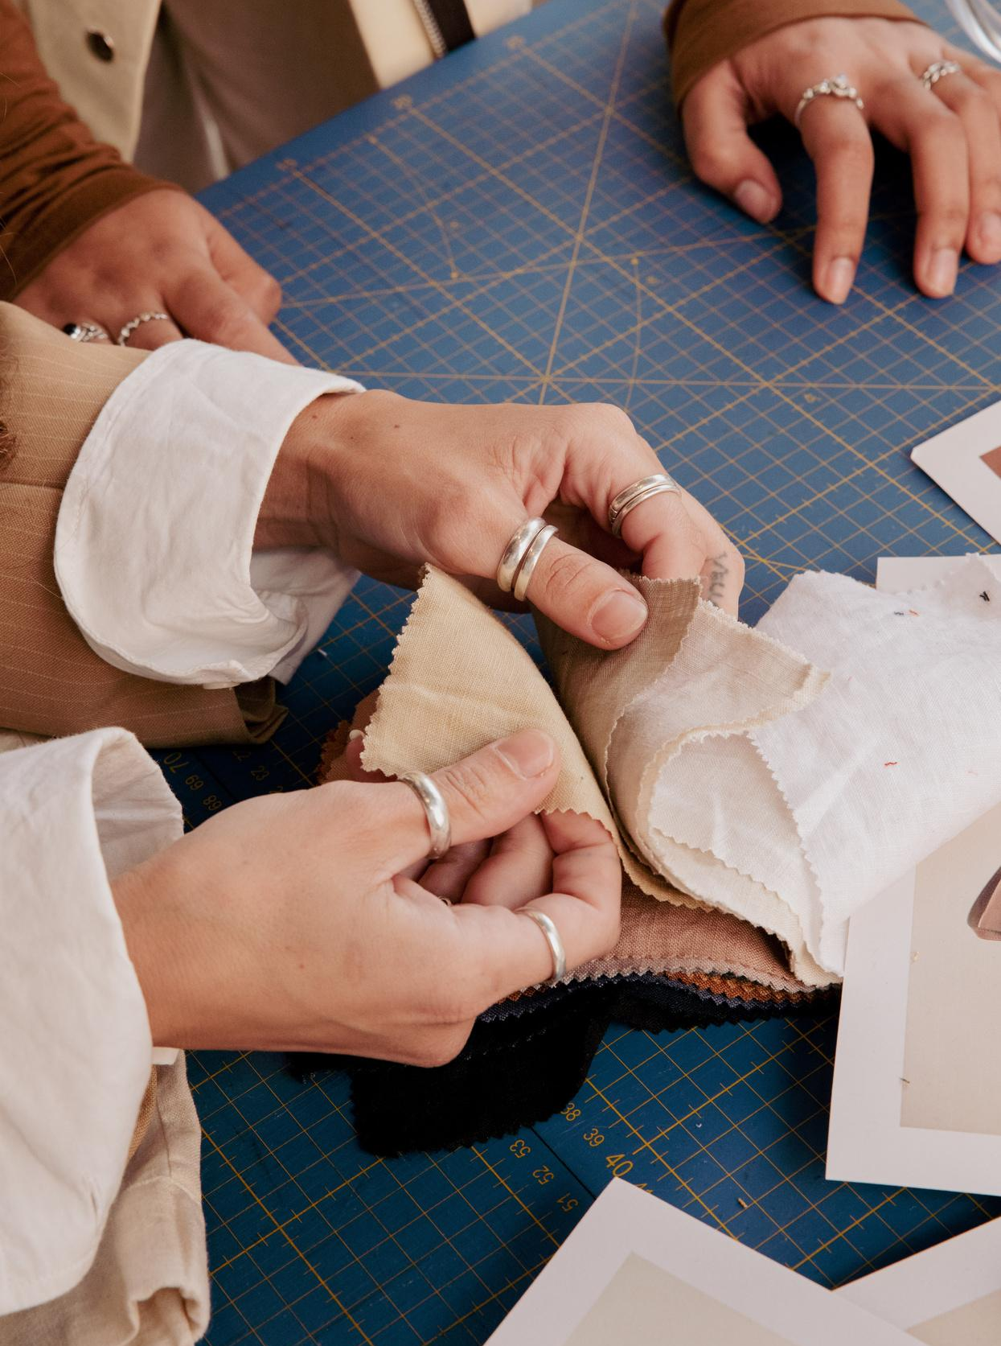
Module 4, THE UPCYCLING PROCESS: TECHNIQUES OF TAILORING
FOR RE-STYLING AND RENOVATION
UpTraK Training Programme
Expected
Learning Outcomes
By the end of this Module, learners will have developed the ability to identify and use correctly, in the upcycling process, tailoring tools and techniques. They will be able to identify the potential of a garment and creatively re-style it, with a strong emphasis on sustainability, craftsmanship, and innovation in upcycling. Being able to perform various garment alterations , they will have learned the skill to apply different sewing techniques (by hand and using the machine) in a customization process. Furthermore, they will be prepared to develop the entire process of constructing a garment, from cutting a pattern, to fitting and alterations, as well as planning, designing, and executing the upcycling of a structured garment.
This knowledge will empower them to approach fashion with an eco-conscious mindset, turning discarded or outdated items into valuable, personalized, and environmentally friendly pieces.
www.fashionupproject.com

Slide 5
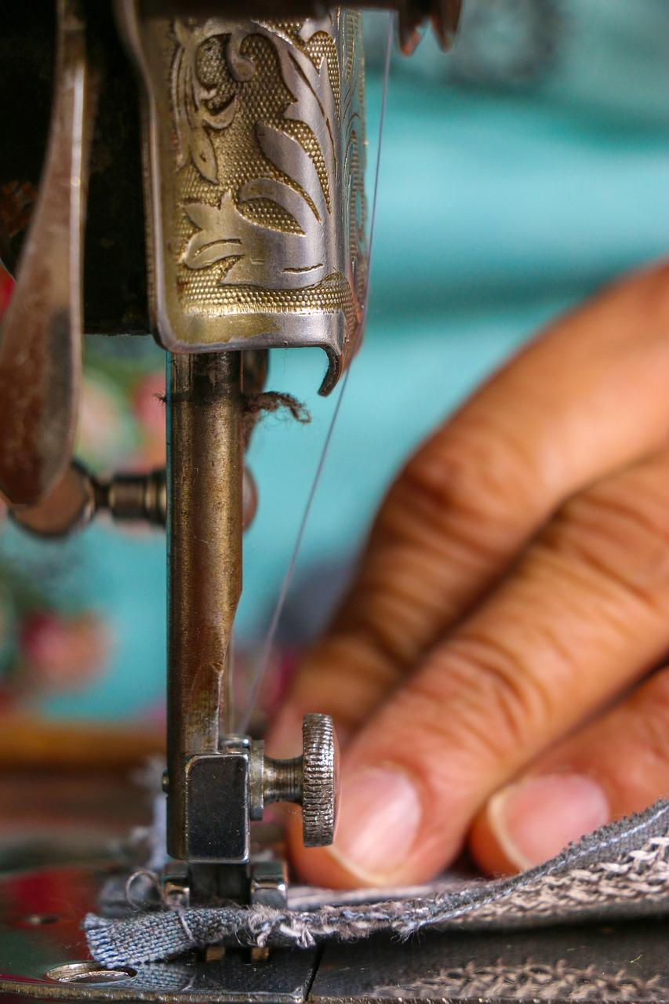
Module 4, THE UPCYCLING PROCESS: TECHNIQUES OF TAILORING
FOR RE-STYLING AND RENOVATION
UpTraK Training Programme
Methodology
The methodology will be a blend of theoretical instruction, hands-on practice, and critical reflection.
A design thinking approach will be used to teach the learners how to rethink and redesign a secondhand garment and discarded material, giving it additional value and purpose.
In parallel all tailoring, sewing, customization and finishing techniques, as well as fitting of a garment and its alterations, will be always demonstrated by the instructor as an example, to realize the design process and to be replicated by the learners afterwords .
A step-by-step instruction guide will be presented for the design of each garment’s pattern, and its execution.
The aim, of this combined methodology, is to provide students with a comprehensive understanding of the entire design process while fostering creativity, sustainability awareness and idea generation within the upcycling activity.
www.fashionupproject.com

Slide 6

Module 4, THE UPCYCLING PROCESS: TECHNIQUES OF TAILORING
FOR RE-STYLING AND RENOVATION
UpTraK Training Programme
Necessary equipment
laptop
projector
sewing machine
pins
chalk or similar
fabric scissors
pattern paper
measuring tape
french rulers
deadstock fabric and second-hand garments
tread for sewing and embroidery
machine and hand needles
variety of trims, like ribbons, buttons, etc …
Module 4 Duration
128 hours
Assessment Criteria
www.fashionupproject.com
A 5 closed questions quiz with 3 possible options, will be submitted to learners to ascertain the reaching of learning goals set for this Module

Slide 7
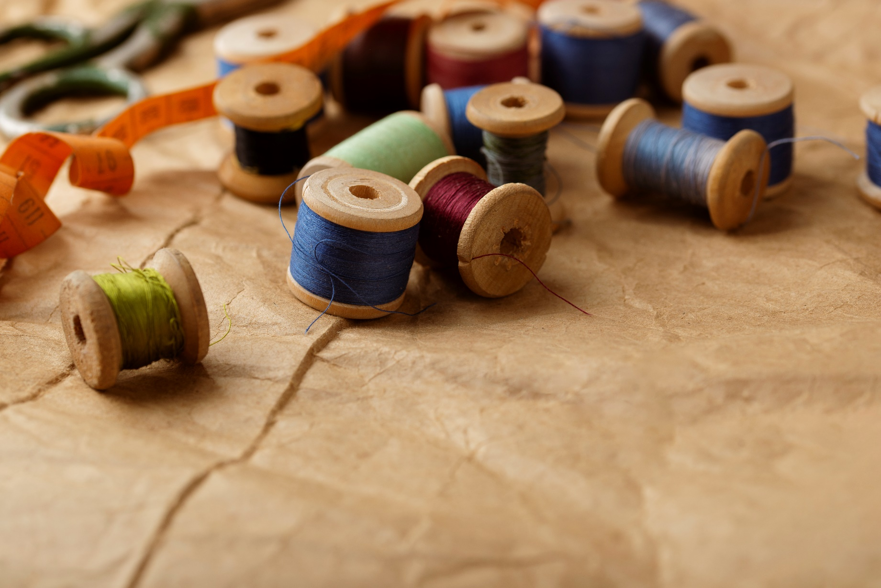
Module 4, THE UPCYCLING PROCESS: TECHNIQUES OF TAILORING
FOR RE-STYLING AND RENOVATION
UpTraK Training Programme
This Module includes theoretical Training Materials on PPT or Canva format and, because of its high performative-practical learning contents, is complemented by 3 video tutorials.
Theoretical materials are available for each Training Unit constituting the Module.
The available video-tutorials concern:
Different styles of visible mending
Upcycling from already existing vintage/used clothes
Upcycling from deadstock fabrics/ fabrics destined for waste/not used or not fit for sale fabrics/defective fabrics
Training Materials & Video-Tutorials
www.fashionupproject.com

Slide 8
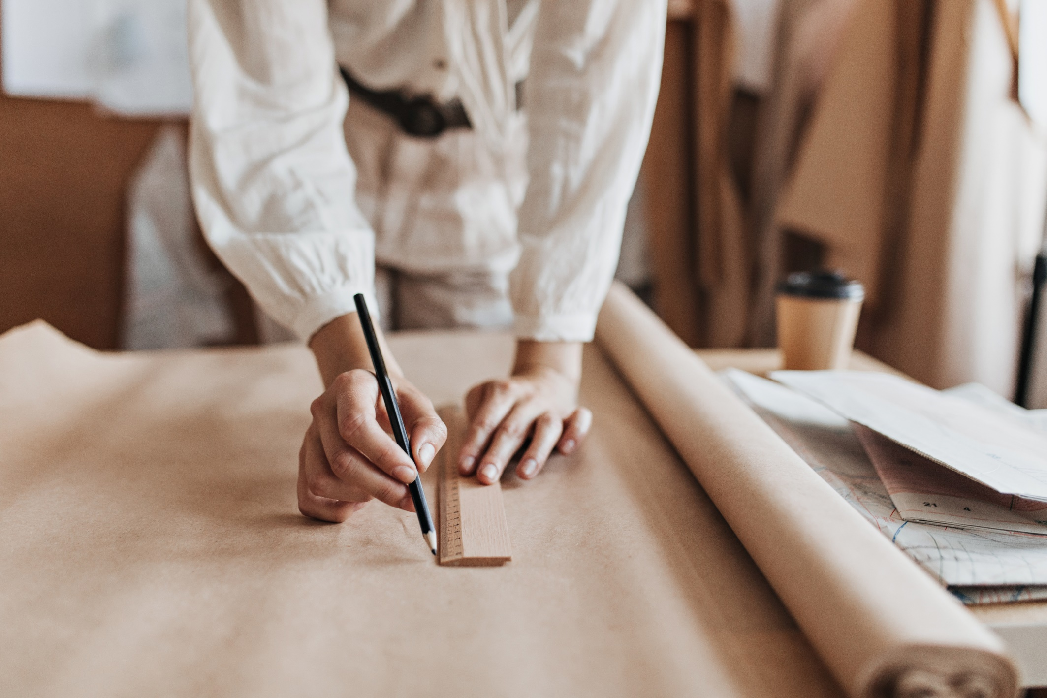
Module 4, THE UPCYCLING PROCESS: TECHNIQUES OF TAILORING
FOR RE-STYLING AND RENOVATION
UpTraK Training Programme
Pedagogical competences:
Experience in teaching adult learners and understanding their learning styles
Strong communication and presentation skills to engage learners
Technical competences:
Fundamentals of tailoring + knowledge about the upcycling process and conscious fashion / Introductory
Mastery in sewing techniques (both machine and hand) + knowledge of garment construction and pattern modification
Expertise in advanced tailoring techniques + Specialized skills in working with different fabric types .
www.fashionupproject.com
Trainer(s) competence profile

Slide 9
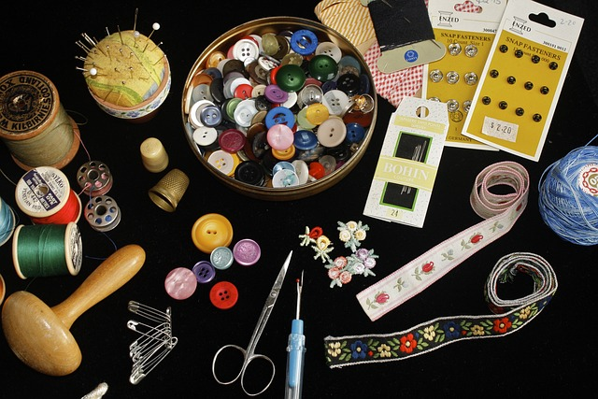
Module 4, THE UPCYCLING PROCESS: TECHNIQUES OF TAILORING
FOR RE-STYLING AND RENOVATION
UpTraK Training Programme
Module 4
www.fashionupproject.com
TRAINING UNITS

Slide 10
Module 4, THE UPCYCLING PROCESS: TECHNIQUES OF TAILORING
FOR RE-STYLING AND RENOVATION
UpTraK Training Programme
Module 4 Training Units
These Training Units compose Module 4
01
02
03
0
02
Introduction to Tailoring Concepts, Materials and Process in Upcycling
Basic Tailoring Techniques for Upcycling
Advanced Tailoring Techniques for Re-Styling Garments
content
www.fashionupproject.com
Duration 8 h.
Duration 28h.
Duration 28h.

Slide 11
Module 4, THE UPCYCLING PROCESS: TECHNIQUES OF TAILORING
FOR RE-STYLING AND RENOVATION
UpTraK Training Programme
Module 4 Training Units
04
05
0
02
Creative Tailoring Applications
Re-Styling Structured Garments: Coats, Jackets, and Blazers
TITLE
content
www.fashionupproject.com
Duration 32h.
Duration 32h.
Duration.

Slide 12
Module 4, THE UPCYCLING PROCESS: TECHNIQUES OF TAILORING
FOR RE-STYLING AND RENOVATION
UpTraK Training Programme
Aldrich, W. (2008) Metric pattern cutting for women’s wear. Oxford: Blackwell Publishing.
Aldrich, W. (2011) Metric pattern cutting for menswear: Including unisex clothes and Computer Aided Design. Hoboken, N.J, Chichester: Wiley ; John Wiley distributor.
Educator space (no date) Redress Design Award. Available at: https://www.redressdesignaward.com/academy/educator (Accessed: 11 October 2024).
Lewallen, C.B. (2024) Clothing alterations and repairs: Maintaining a sustainable wardrobe. London: Bloomsbury Visual Arts.
Maynard, L. (2010) Couture sewing techniques: The Dressmaker’s Handbook of Couture Sewing Techniques. Loveland, CO: Interweave Press.
Reader’s Digest Grande Livro da Costura (1979). Porto: Ambar.
Reader’s Digest Grande Livro dos Lavores (1985). Porto: Ambar
Thompson, H. and Whittington, N. (2012) Remake it clothes: The Essential Guide to Resourceful Fashion: With over 500 tricks, tips and inspirational designs. London: Thames & Hudson.
References
www.fashionupproject.com

