Slide 1

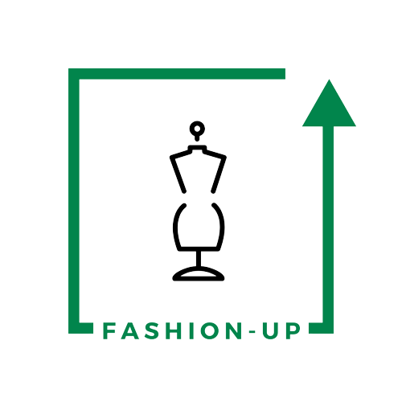

UpTraK Training Programme
Module 6
UNIT 2
THE MOST USED 3D PROGRAMS FOR FASHION DESIGN: SOME EXAMPLES
www.fashionupproject.com
Duration: 1 hour

Slide 2
UpTraK Training Programme
Funded by the European Union. Views and opinions expressed are however those of the author(s) only and do not necessarily reflect those of the European Union or the European Education and Culture Executive Agency (EACEA). Neither the European Union nor EACEA can be held responsible for them.
www.fashionupproject.com

Slide 3
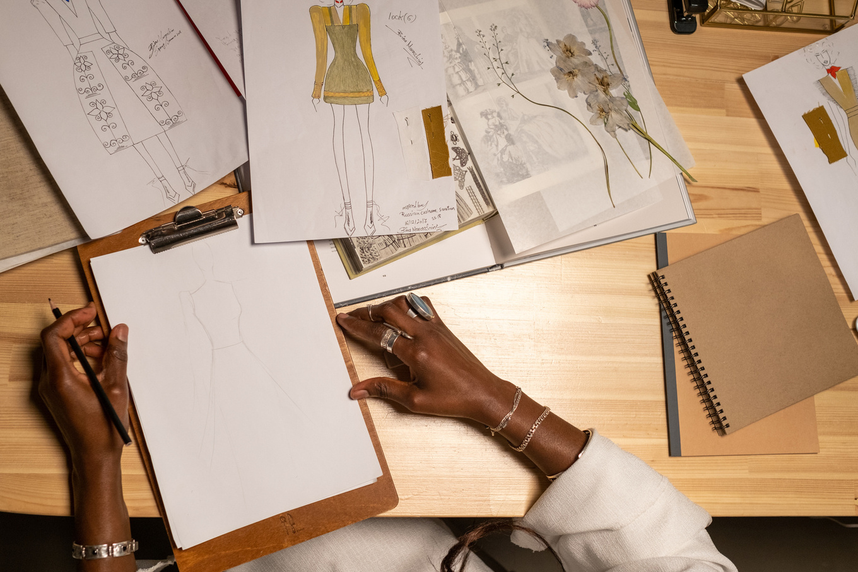

UpTraK Training Programme
Module 6, Unit 2
Overview of the Unit
This unit explores the most commonly used 3D design programs in fashion, both free and paid. ICT tools enhance digital modeling, fit simulation, patternmaking, and waste reduction, making fashion design more efficient and sustainable. You will learn about their main features, benefits, and differences, helping you choose the right software for various design needs. By the end of this unit, you will have a clear understanding of how 3D programs optimize the fashion design process.
www.fashionupproject.com

Slide 4
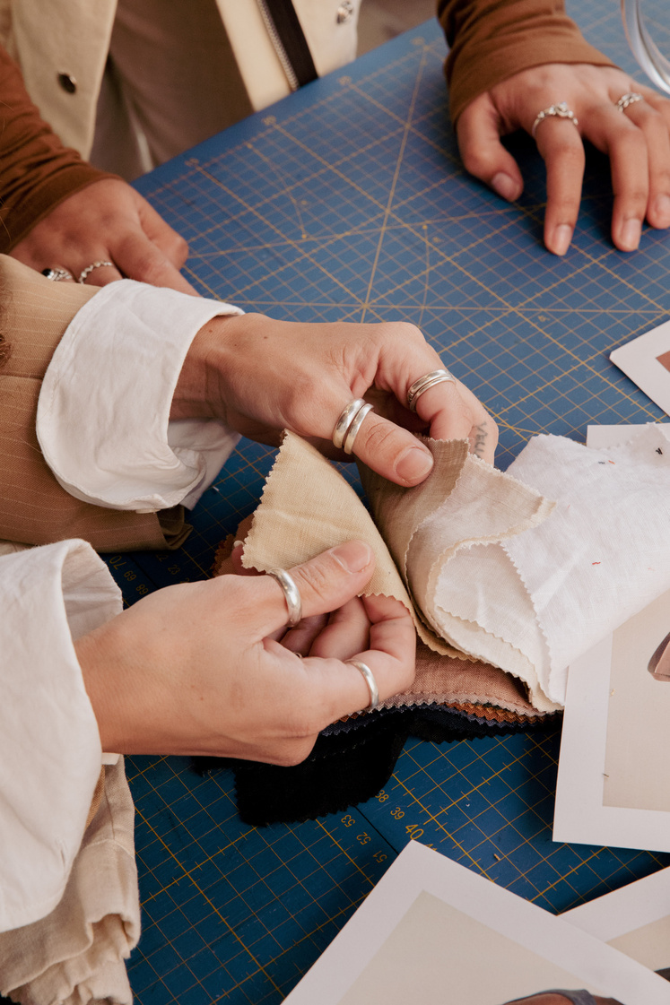

UpTraK Training Programme
Module 6, Unit 2
Expected
Learning Outcomes
By the end of this Unit, you will be able to:
    Identify the most commonly used 3D fashion design programs and their applications.
    Understand the features, strengths, and limitations of both free and paid 3D design software.
    Recognize how 3D tools improve precision, time efficiency, and sustainability in the design process.
    Evaluate which software best fits different design needs, from patternmaking to garment visualization.
Pre-requisite knowledge
www.fashionupproject.com
This unit assumes a basic understanding of fashion design principles, including garment construction and patternmaking. Familiarity with digital tools and an interest in technology-driven design will be helpful but not essential.
Estimated Reading Time
10 minutes

Slide 5


UpTraK Training Programme
Module 6, Unit 2
Target Audience
This Unit targets learners who are seeking basic knowledge on the different 3D software (free or for fee) available for fashion design, with a focus on the most used or common ones
Learning
Objective
The goal of the Unit is to equip learners with the knowledge and skills to navigate the most used 3D fashion design programs, understanding their features, functions, and benefits in digital garment creation, patternmaking, and fit simulation.
Key concepts
3D Fashion Design Software, Precision & Efficiency in Measurements, Sustainability in Fashion, Free vs. Paid Software, Overview of Key Programs (Blender, Tinkercad, SketchUp, OpenSCAD, CLO 3D, Marvelous Designer, Optitex, and Tailornova)
www.fashionupproject.com

Slide 6
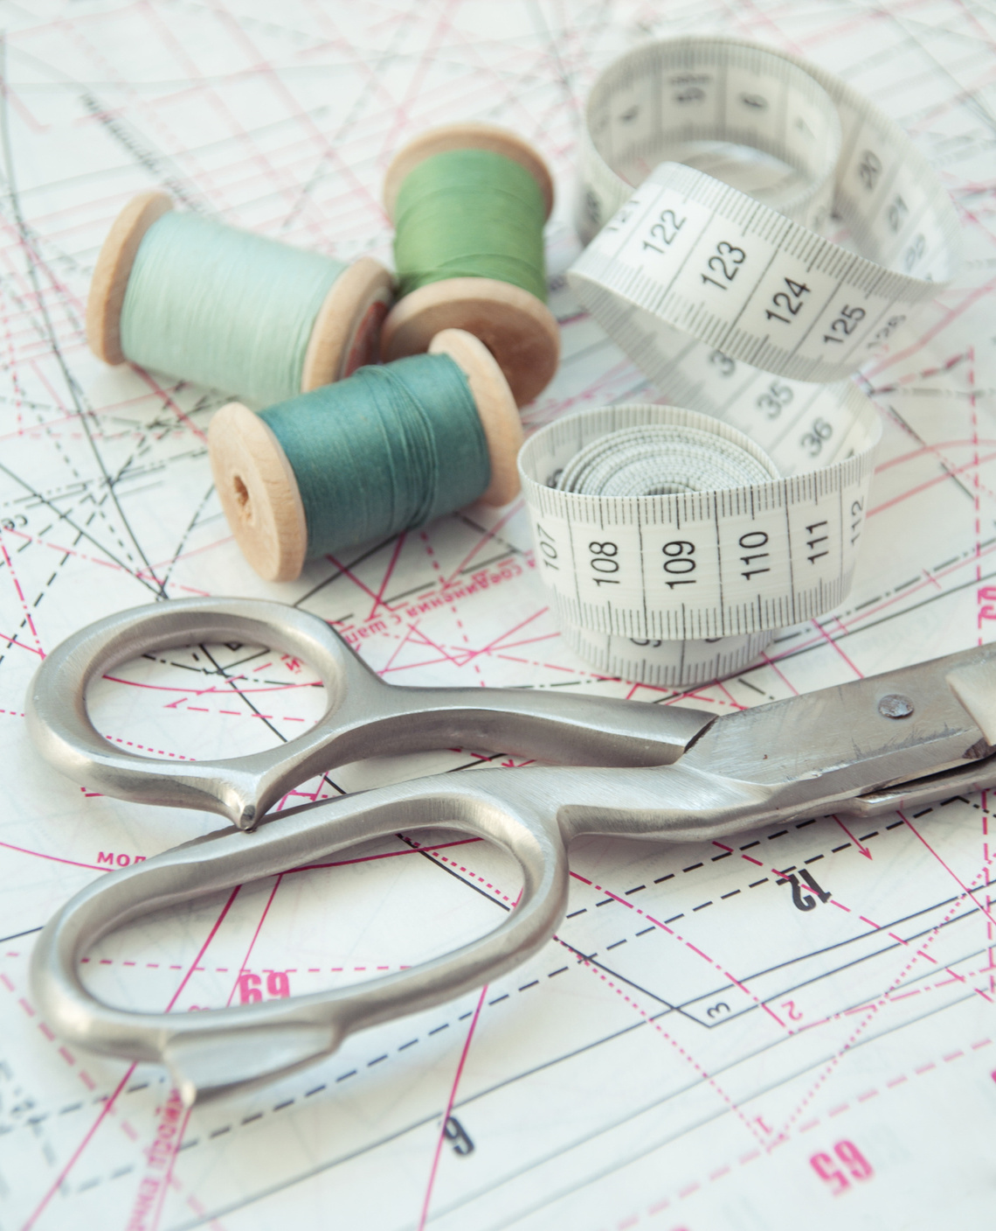

UpTraK Training Programme
Module 6, Unit 2
This is a theoretical Unit with no practical part, so no specific equipment is necessary other than that needed to deliver face-to-face traditional lessons (pc, internet connection, projector, ecc.)
Necessary
equipment
www.fashionupproject.com

Slide 7




UpTraK Training Programme
Module 6, Unit 2
01
Teacher's Profile
PROFESSIONAL FASHION DESIGNER EXPERT IN 3D DESIGN
or
TRAINER FOR FASHION DESIGN & MODELING EXPERT IN 3D DESIGN
02
Methodology
Traditional face-to-face teaching (Formal Learning)
www.fashionupproject.com

Slide 8


UpTraK Training Programme
Module 6, Unit 2
But why fashion designers should learn 3D fashion clothing design software?
Watch
https://www.youtube.com/watch?v=xhiRGiQlDbg
What is the role of 3D in fashion design ?
Watch
https://www.youtube.com/watch?v=63h-VqKSer4
www.fashionupproject.com

Slide 9

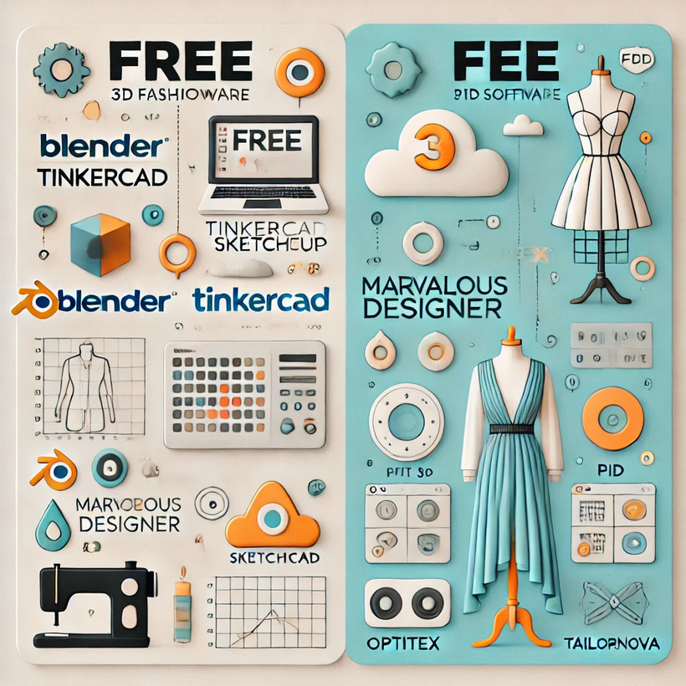
UpTraK Training Programme
Module 6, Unit 2
Introduction to Free vs Paid 3D Programmes
3D design software for fashion can be categorized into free and paid programs, each with distinct features and capabilities.
Free software offers accessible tools for learning and experimenting but may have limitations in advanced garment construction and fit simulation.
Paid software used by professionals provides precise patternmaking, fabric simulation, and industry-standard workflows.
In this unit, you will explore four free programs (Blender, Tinkercad, SketchUp, OpenSCAD) and four paid programs (CLO 3D, Marvelous Designer, Optitex, Tailornova), understanding how each contributes to digital fashion design. By comparing their features, strengths, and use cases, we will see how these tools impact sustainability, efficiency, and garment production.
www.fashionupproject.com

Slide 10
UpTraK Training Programme
Module 6, Unit 2
  Blender – https://www.blender.org
  Tinkercad – https://www.tinkercad.com
  SketchUp – https://www.sketchup.com/
  OpenSCAD – https://openscad.org
FREE
  CLO 3D – https://www.clo3d.com
  Marvelous Designer – https://www.marvelousdesigner.com
  Optitex – https://optitex.com
  Tailornova – https://www.tailornova.com
FOR Α FEE
www.fashionupproject.com

Slide 11

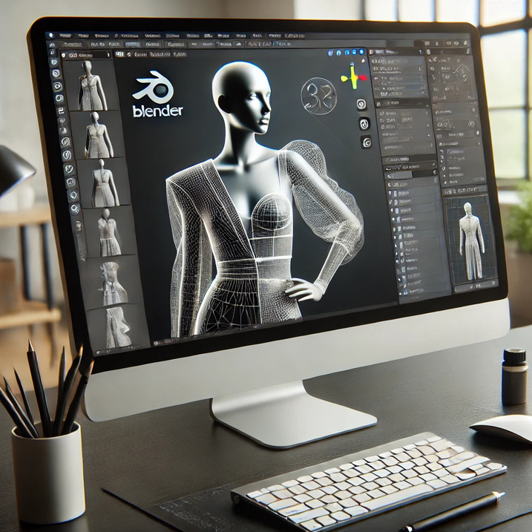

UpTraK Training Programme
Module 6, Unit 2
Blender (Free Program)
Blender is a powerful open-source 3D modeling and animation software widely used in various industries, including fashion.
While not specifically designed for garment construction, it offers advanced modeling tools, fabric simulation, and rendering capabilities, making it a great choice for digital fashion visualization.
Main Features:
  3D Modeling & Sculpting: Create highly detailed clothing designs from scratch.
  Physics-Based Fabric Simulation: Simulate garment draping, folds, and movement realistically.
  High-Quality Rendering: Produce professional-quality images and animations of garments.
  Open-Source & Free: No licensing costs, with a strong community providing tutorials and plugins.
www.fashionupproject.com

Slide 12
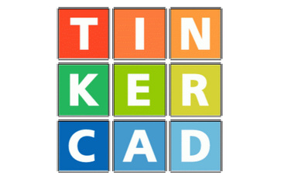
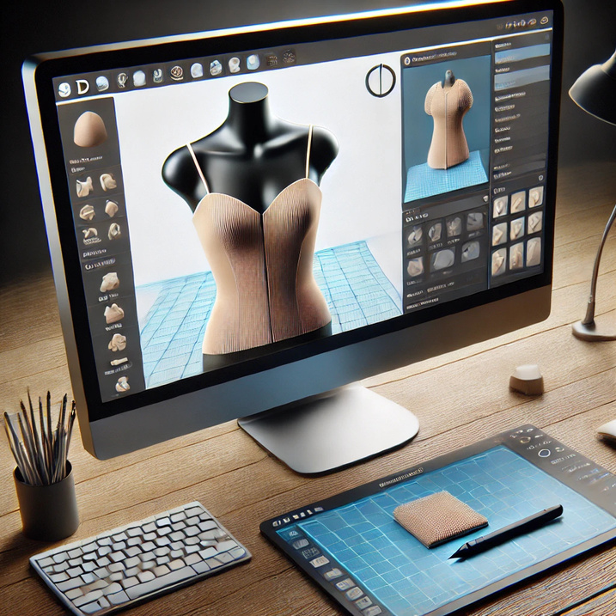
UpTraK Training Programme
Module 6, Unit 2
Tinkercad (Free Program)
Tinkercad is an easy-to-use browser-based 3D modeling tool, ideal for beginners exploring digital design. While not designed specifically for fashion, it provides a simple and accessible way to understand 3D modeling concepts.
Main Features:
  Drag-and-Drop Modeling: No advanced knowledge needed, making it great for beginners.
  Web-Based: No downloads required; runs entirely online.
  Basic 3D Prototyping: Can be used to create simple accessories or garment components.
Best For:
  Beginners wanting a basic introduction to 3D modeling.
  Quick concept visualization before using more advanced software.
www.fashionupproject.com

Slide 13
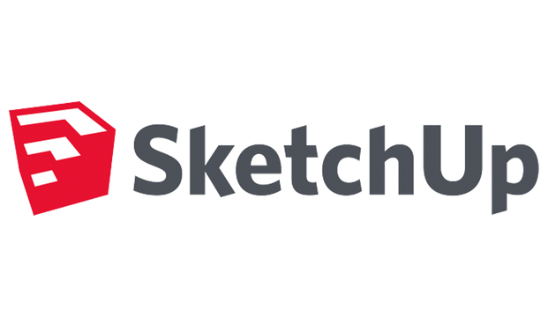
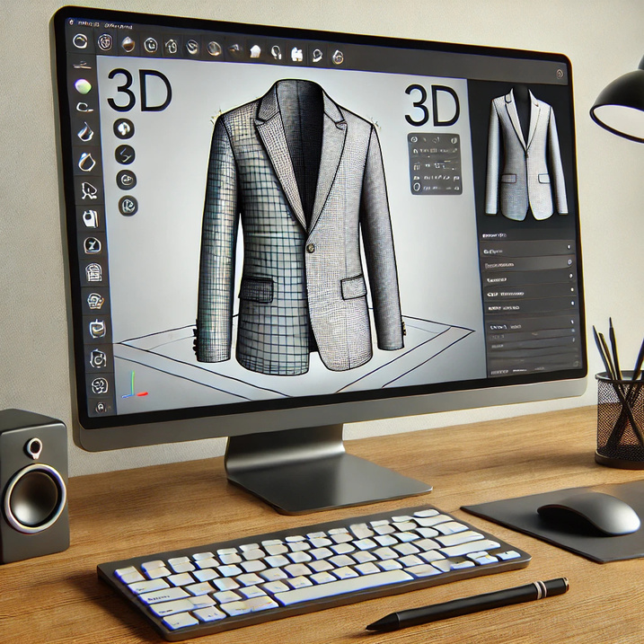
UpTraK Training Programme
Module 6, Unit 2
SketchUp (Free Program)
SketchUp is a versatile 3D modeling software known for its user-friendly interface and precision tools. While it’s not specifically for fashion, designers can use it to create basic garment structures, accessories, and fashion-related projects.
Main Features:
  Easy-to-Use Interface: Intuitive drag-and-drop modeling with minimal learning curve.
  3D Warehouse: Access to a large library of pre-made 3D models.
  Precision Measurement Tools: Ensures accurate design proportions.
Best For:
  Fashion designers working on basic 3D prototypes.
  Quick sketching of fashion concepts before moving to more advanced tools.
www.fashionupproject.com

Slide 14
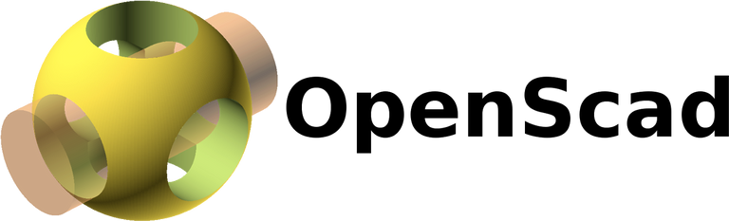
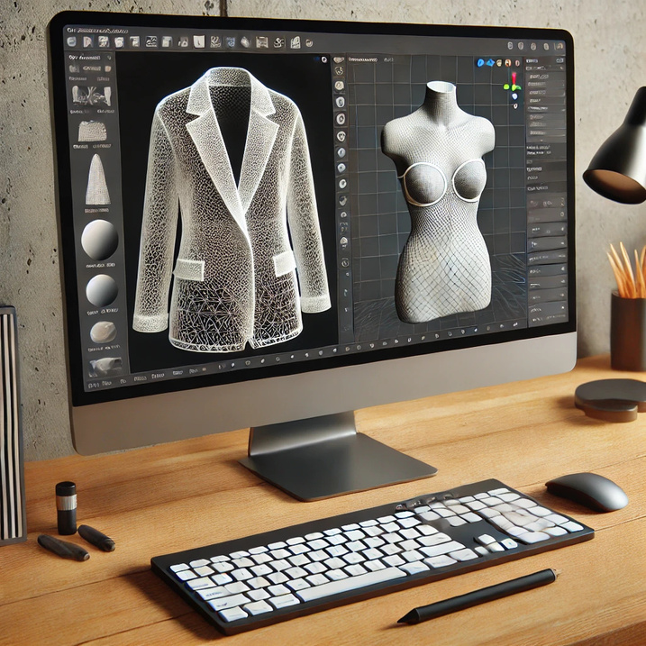
UpTraK Training Programme
Module 6, Unit 2
OpenSCAD (Free Program)
OpenSCAD is a script-based modeling software that allows designers to create precise 3D models through coding. It’s useful for those who want to generate parametric fashion components with mathematical accuracy.
Main Features:
  Code-Based Modeling: Designs are created using scripts instead of graphical tools.
  Highly Precise Measurements: Perfect for technical pattern designs.
  Customizable Parametric Models: Users can create reusable templates for garment components.
Best For:
  Designers with coding knowledge who need precision-based garment components.
  Technical fashion designers working on structured or geometric designs.
www.fashionupproject.com

Slide 15
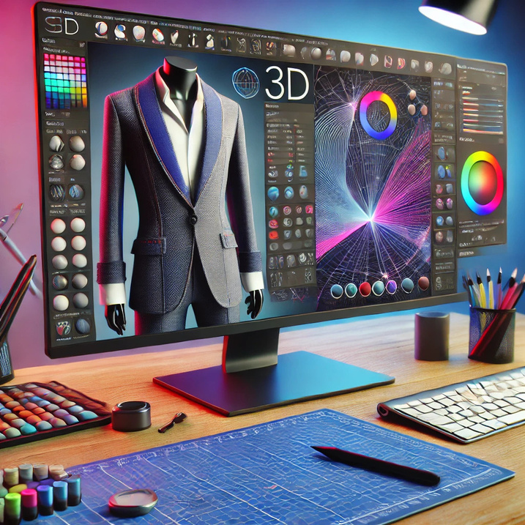
UpTraK Training Programme
Module 6, Unit 2
CLO 3D (Paid Program)
CLO 3D is one of the most advanced 3D fashion design tools, used by professionals for patternmaking, virtual prototyping, and realistic fabric simulation. It helps designers create, test, and refine garments before physical production.
Main Features:
  Realistic Fabric Simulation: Accurately replicates garment draping and movement.
  2D to 3D Pattern Integration: Convert traditional patterns into 3D garments instantly.
  Virtual Fit Testing: Allows designers to assess fit and adjust before production.
Best For:
  Professional fashion designers focusing on virtual prototyping.
  Brands looking to reduce sample production costs and waste.
www.fashionupproject.com

Slide 16

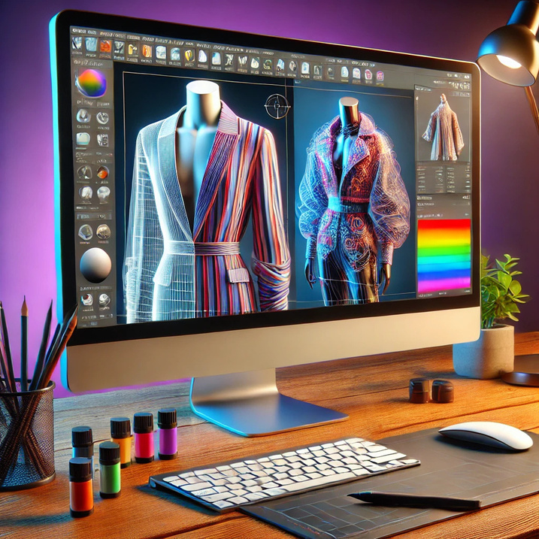
UpTraK Training Programme
Module 6, Unit 2
Marvelous Designer (Paid Program)
Marvelous Designer is a powerful tool for 3D garment simulation, widely used in digital fashion, gaming, and animation. It focuses on realistic fabric physics and garment construction.
Main Features:
  Intuitive Pattern-Based Design: Users can create garments as if sewing real fabric.
  Advanced Fabric Physics: Realistic draping, folds, and stretching effects.
  High-Quality Export Options: Allows integration with other 3D software.
Best For:
  Designers creating digital fashion assets for gaming, animation, and virtual fashion shows.
  Users needing high-detail garment draping and motion simulation.
www.fashionupproject.com

Slide 17

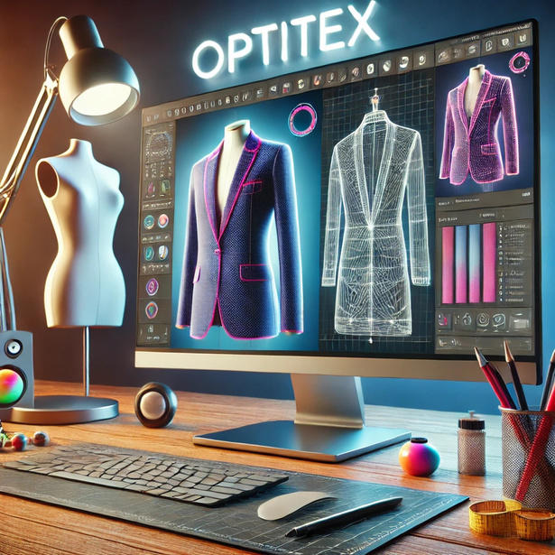
UpTraK Training Programme
Module 6, Unit 2
Optitex (Paid Program)
Optitex is a CAD-based software tailored for professional fashion designers and manufacturers. It provides advanced tools for pattern drafting, grading, and production workflows.
Main Features:
  Precise 2D to 3D Patternmaking: Seamlessly integrates flat patterns into 3D garments.
  Virtual Fitting & Draping: Helps designers perfect garment construction before production.
  Industry Integration: Used by major fashion brands for digital prototyping.
Best For:
  Professional patternmakers and manufacturers focused on accuracy.
  Brands looking for digital sampling to improve production efficiency.
www.fashionupproject.com

Slide 18

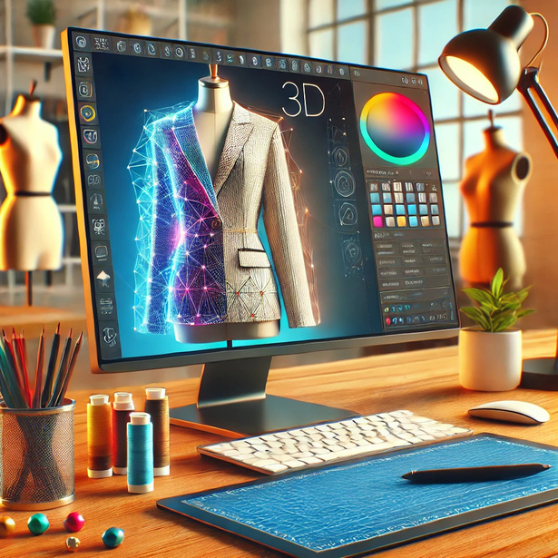
UpTraK Training Programme
Module 6, Unit 2
Tailornova (Paid Program)
Tailornova is an AI-driven fashion design platform that automates pattern generation and customization. It simplifies the process of creating well-fitted garments for various body shapes.
Main Features:
  Automated Custom Pattern Creation: Generates patterns based on input measurements.
  Cloud-Based Platform: No downloads required; runs entirely online.
  3D Garment Preview: Instant visualization of pattern adjustments.
Best For:
  Designers looking for fast and accurate pattern generation.
  Small businesses and startups needing quick digital prototyping.
www.fashionupproject.com

Slide 19



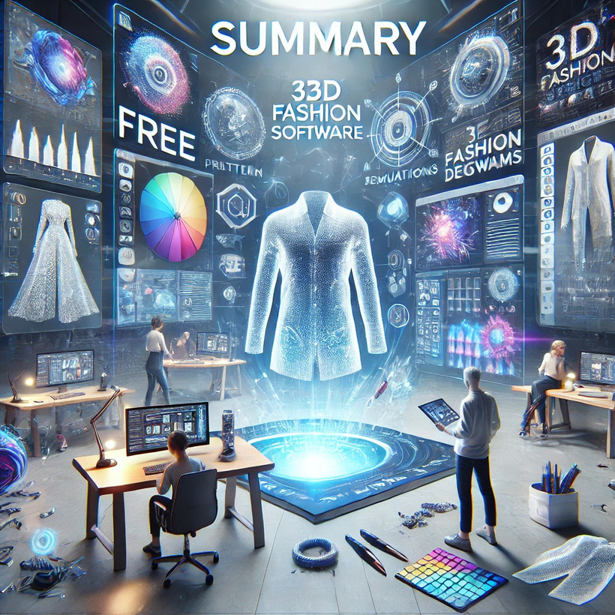

UpTraK Training Programme
Module 6, Unit 2
Unit
Summary
In this unit, you explored the most used 3D programs for fashion design, both free and paid, and their role in improving precision, efficiency, and sustainability. Free tools like Blender, Tinkercad, SketchUp, and OpenSCAD allow for basic 3D modeling, while professional programs like CLO 3D, Marvelous Designer, Optitex, and Tailornova offer advanced patternmaking and fit simulation. Mastering these tools helps designers optimize workflows, reduce waste, and innovate in the fashion industry.
www.fashionupproject.com

Slide 20


UpTraK Training Programme
Module 6, Unit 2
    Blender (Official Website) – https://www.blender.org
    Tinkercad (Official Website) – https://www.tinkercad.com
    SketchUp (Free Version) – https://www.sketchup.com/plans-and-pricing/sketchup-free
    OpenSCAD (Official Website) – https://openscad.org
    Professional (Paid) 3D Fashion Design Software
    CLO 3D (Official Website) – https://www.clo3d.com
    Marvelous Designer (Official Website) – https://www.marvelousdesigner.com
    Optitex (Official Website) – https://optitex.com
    Tailornova (Official Website) – https://www.tailornova.com
    Industry Insights & Reports on 3D Design in Fashion
    Business of Fashion – Digital Tools for Fashion Designers https://www.businessoffashion.com
    Ellen MacArthur Foundation – How 3D Design Supports Sustainability in Fashion https://ellenmacarthurfoundation.org/fashion
    Statista – Adoption of 3D Fashion Design Software in the Industry https://www.statista.com/topics/5091/sustainability-in-the-fashion-industry/
    WGSN – The Role of 3D Technology in Fashion’s Future
    https://www.wgsn.com
References
www.fashionupproject.com

