Slide 1

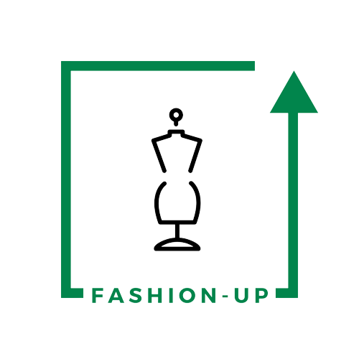
UpTraK Training Programme
Module 1
UNIT 1
Introduction to upcycling as new sustainable business model in sartorial craftsmanship
www.fashionupproject.com
Duration: 3 hours

Slide 2
UpTraK Training Programme
Funded by the European Union. Views and opinions expressed are however those of the author(s) only and do not necessarily reflect those of the European Union or the European Education and Culture Executive Agency (EACEA). Neither the European Union nor EACEA can be held responsible for them.
www.fashionupproject.com

Slide 3
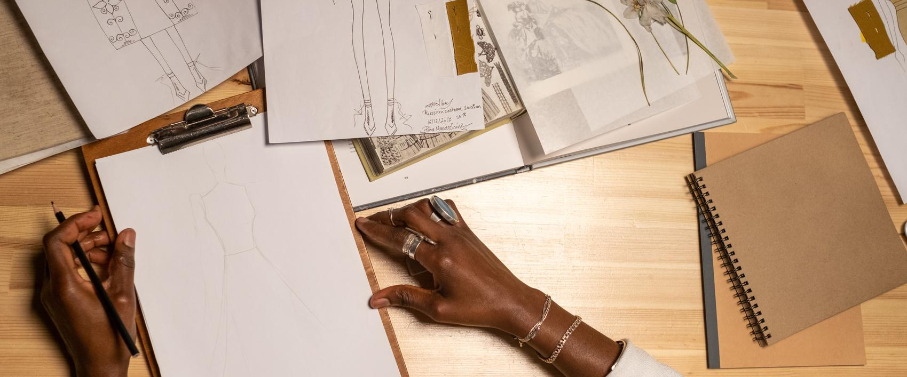
UpTraK Training Programme
Module 1, Unit 1
Overview of the Unit
This unit covers the concept of upcycling as a sustainable business model in sartorial craftsmanship, focusing on material sourcing and the business aspects of upcycled fashion.
In this unit, participants will learn about the environmental benefits of upcycling, methods for selecting and sourcing materials, and strategies for developing a business model in the upcycled fashion industry.​
www.fashionupproject.com

Slide 4
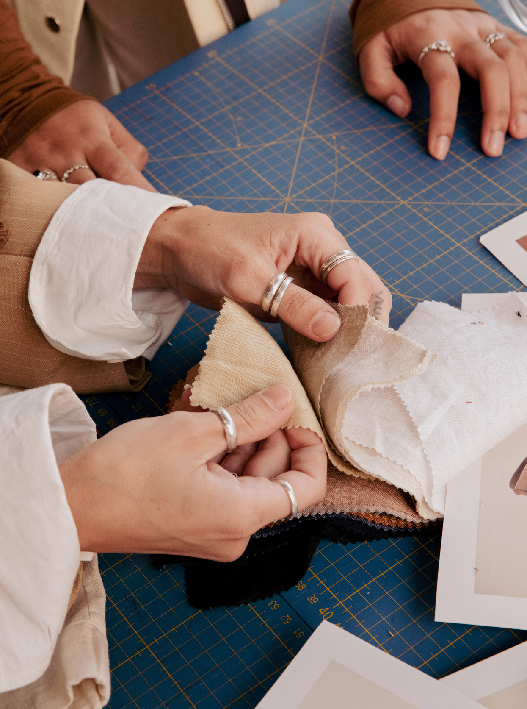
UpTraK Training Programme
Module 1, Unit 1
Expected
Learning Outcomes
By the end of this unit, you will be able to:
  Distinguish upcycling from other sustainable practices in fashion, such as recycling
  Identify and evaluate suitable materials for upcycling projects.
  Develop a basic business model and unique selling proposition for upcycled fashion items​
www.fashionupproject.com
Pre-requisite knowledge
No prior knowledge is required for this Unit.
Estimated Reading Time
15 minutes

Slide 5

UpTraK Training Programme
Module 1, Unit 1
Target Audience
Learning
Objective
This Unit targets young learners and students interested in sustainable fashion
The goal of the Unit is to equip learners with basic knowledge and understanding of recycling, upcycling, and downcycling concepts
Key concepts
www.fashionupproject.com
Definitions of recycling, upcycling, downcycling
Environmental and economic benefits of each method
Practical applications in sustainable fashion
Encouraging creative reuse and waste reduction

Slide 6
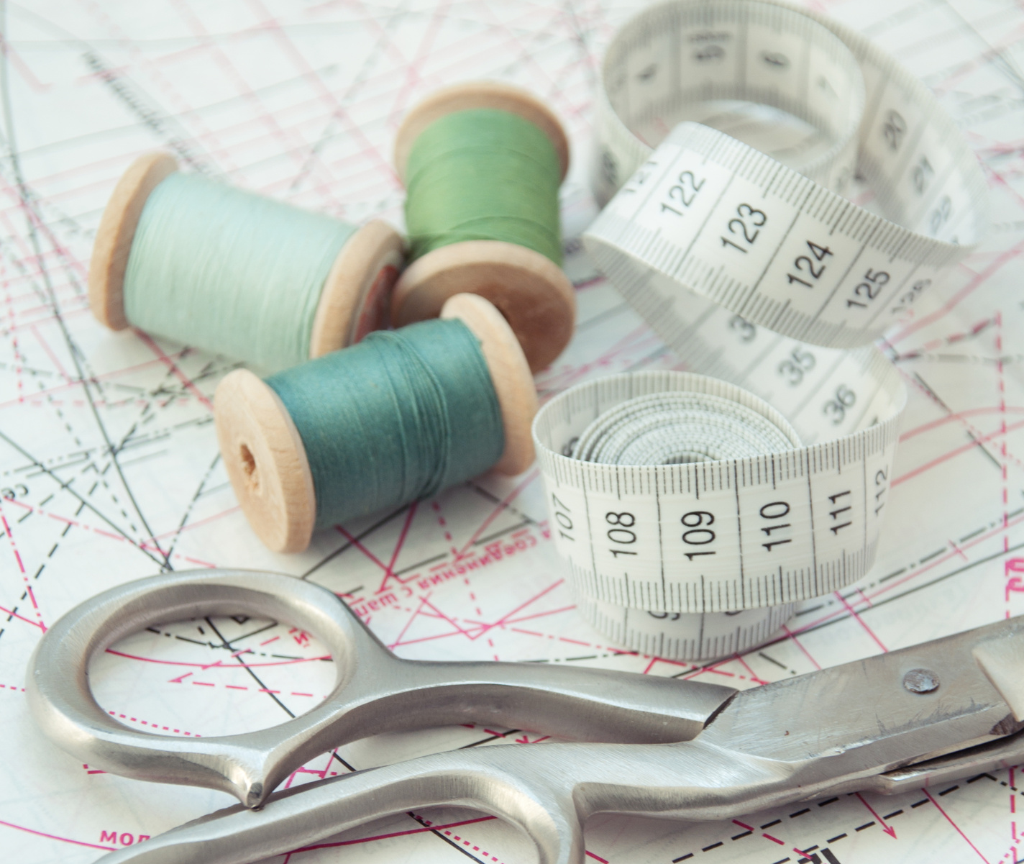
UpTraK Training Programme
Module 1, Unit 1
For this Unit’s practical part, you will need: Computer/laptop with internet for research,
Access to examples of business cases and upcycling brands,
Worksheets for drafting value propositions,
Flipchart/markers for brainstorming business strategies.
(Optional) Guest speaker or video on sustainable business models.
Necessary
equipment
www.fashionupproject.com

Slide 7
UpTraK Training Programme
Module 1, Unit 1
01
Teacher's Profile
Sustainable fashion expert
Skilled in textile recycling methods
Creative and hands-on approach
Inspires eco-conscious choices
01
Methodology
Desk research on recycling, upcycling, downcycling
Expert consultations
Case study analysis
Group discussion and synthesis
www.fashionupproject.com

Slide 8
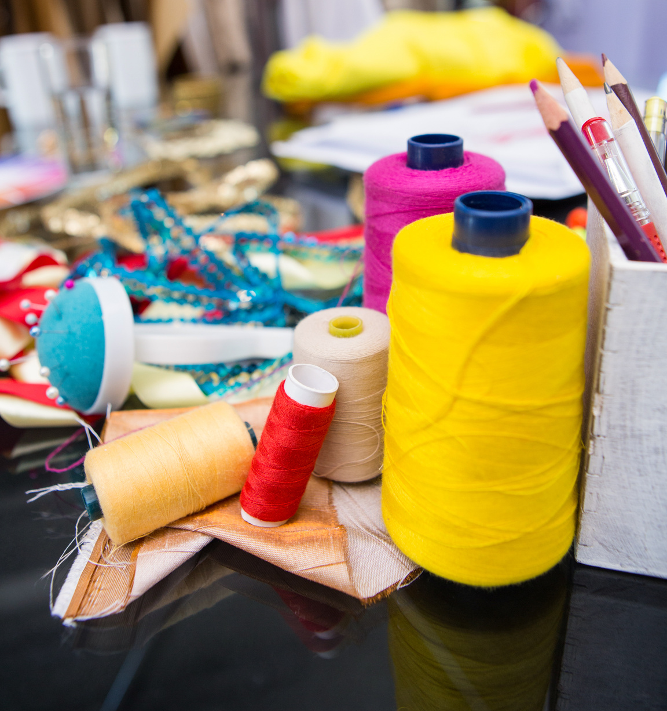
UpTraK Training Programme
Module 1, Unit 1
Let’s meet
Upcycling: Enhancing value – e.g., turning an old T-shirt into a trendy backpack.
Recycling: Processing materials into new products of the same or lower value – e.g., plastic bottles transformed into textile fibers.
Downcycling: Processing that leads to reduced quality or functionality – e.g., old clothes turned into cleaning rags.
www.fashionupproject.com

Slide 9

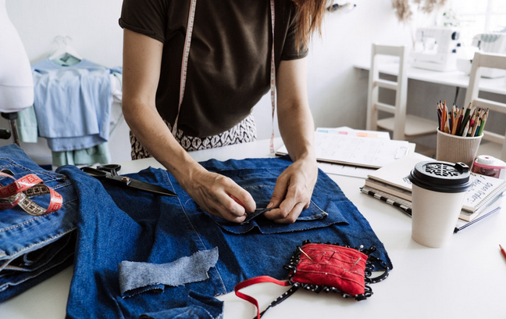
UpTraK Training Programme
Module 1, Unit 1
Upcycling
Upcycling:
Upcycling is the process of transforming waste materials, unwanted products, or discarded objects into new products with a higher value, often artistic or environmental.
Key aspects of upcycling:
Enhancing value: Upcycling goes beyond simply reusing items. It focuses on increasing the value of the original object by giving it a new purpose, improving its functionality, or adding aesthetic appeal.
Creativity and innovation: Upcycling often involves creative thinking and innovative approaches to transform discarded items into something new and desirable.
Sustainability: Upcycling contributes to sustainability by reducing waste, conserving resources, and minimizing the need for new materials.
www.fashionupproject.com

Slide 10
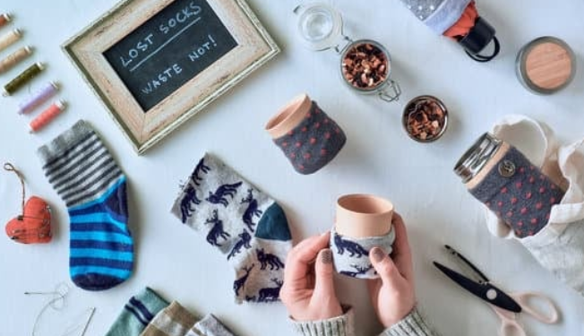
UpTraK Training Programme
Module 1, Unit 1
Upcycling
Examples of upcycling:
Fashion: Turning old clothes into new garments or accessories, such as a dress made from old ties or a bag from used denim jeans.
Furniture: Creating furniture from discarded materials like pallets, crates, or old tires, such as a coffee table from a repurposed pallet or a chair from an old tire.
Home decor: Making decorative items from waste materials like glass bottles, tin cans, or plastic containers, such as vases from painted bottles or candle holders from tin cans.
Art: Creating art pieces from discarded materials like scrap metal, plastic, or paper, such as sculptures from scrap metal or collages from recycled paper.
DIY projects: Engaging in do-it-yourself projects to upcycle items for personal use, such as making a bookshelf from old books or a lamp from a glass jar.
www.fashionupproject.com

Slide 11
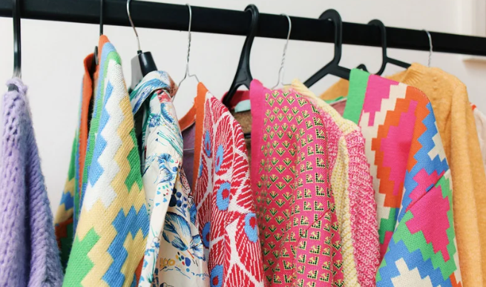
UpTraK Training Programme
Module 1, Unit 1
Upcycling
Benefits of upcycling:
Reduces waste: Upcycling diverts waste from landfills and reduces the amount of trash that needs to be disposed of.
Conserves resources: Upcycling reduces the need for new materials, which saves energy, water, and other resources used in manufacturing processes.
Promotes creativity: Upcycling encourages creativity and innovation by finding new and imaginative ways to use discarded items.
Adds value: Upcycling increases the value of discarded items by transforming them into something new and desirable.
Supports sustainability: Upcycling contributes to a more sustainable future by reducing waste, conserving resources, and promoting a circular economy.
www.fashionupproject.com

Slide 12
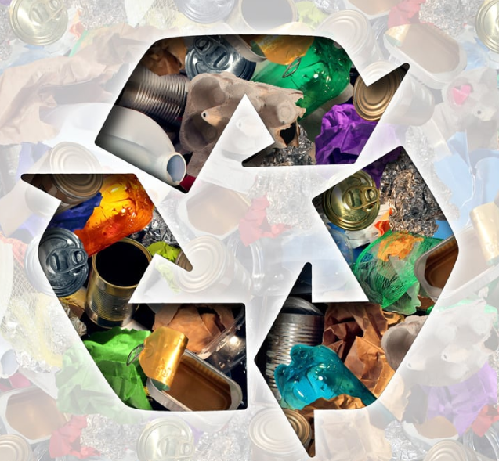
UpTraK Training Programme
Module 1, Unit 1
Recycling
Recycling:
Recycling is the process of collecting and processing waste materials and used products to create new products.
The goal of recycling is to reduce the consumption of raw materials, energy, and water, as well as to minimize pollution and greenhouse gas emissions.
Key aspects of recycling:
Collection and sorting: Recycling begins with the collection of recyclable materials, such as paper, plastic, glass, and metal. These materials are then sorted based on their type and composition.
Processing: Recyclable materials are processed in specialized facilities, where they are cleaned, shredded, melted, or otherwise transformed into raw materials.
Manufacturing: The recycled raw materials are used to manufacture new products, which can then be sold back to consumers.
www.fashionupproject.com

Slide 13
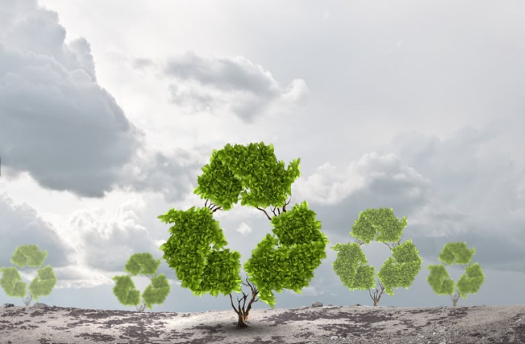
UpTraK Training Programme
Module 1, Unit 1
Recycling
Examples of recycling:
Paper recycling: Used paper is collected, pulped, and processed to create new paper products, such as newspapers, cardboard, and office paper.
Plastic recycling: Used plastic bottles, containers, and other items are collected, melted down, and reformed into new plastic products, such as bottles, packaging, and furniture.
Glass recycling: Used glass bottles and jars are collected, crushed, and melted down to create new glass products, such as bottles, jars, and construction materials.
Metal recycling: Used metal cans, foil, and other items are collected, melted down, and reformed into new metal products, such as cans, construction materials, and automotive parts.
Textile recycling: Used clothing and other textiles are collected, sorted, and processed to create new textile products, such as insulation, carpet padding, and wiping cloths.
www.fashionupproject.com

Slide 14
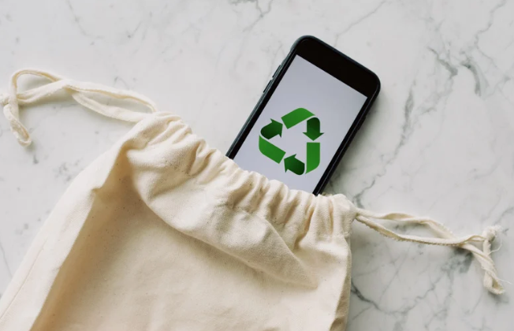
UpTraK Training Programme
Module 1, Unit 1
Recycling
Benefits of recycling:
Conserves resources: Recycling reduces the need for raw materials, which conserves natural resources such as trees, minerals, and fossil fuels.
Saves energy: Recycling requires less energy than producing new products from raw materials, which reduces greenhouse gas emissions and helps to combat climate change.
Reduces pollution: Recycling reduces pollution from manufacturing processes, such as air and water pollution.
Creates jobs: The recycling industry creates jobs in collection, processing, and manufacturing.
Promotes sustainability: Recycling contributes to a more sustainable future by reducing waste, conserving resources, and minimizing environmental impact.
www.fashionupproject.com

Slide 15
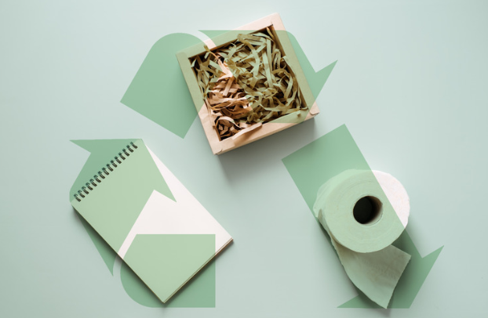
UpTraK Training Programme
Module 1, Unit 1
Downcycling
Downcycling:
Downcycling is the process of recycling materials into new products of lower quality or functionality than the original. This often happens because the materials degrade or become contaminated during the recycling process, making them unsuitable for higher-quality applications.
Key aspects of downcycling:
Degradation of materials: Some materials, such as plastics and paper, can only be recycled a limited number of times before their quality degrades. This is because the recycling process can break down the molecular structure of the materials, making them weaker and less durable.
Contamination: Recyclable materials can become contaminated with other substances, such as food waste, dirt, or other types of materials. This contamination can make it difficult or impossible to recycle the materials into high-quality products.
Technological limitations: In some cases, there may be technological limitations that prevent the recycling of materials into high-quality products. For example, it may be difficult to remove certain types of inks or coatings from paper, making it impossible to recycle the paper into high-quality printing paper.
www.fashionupproject.com

Slide 16

UpTraK Training Programme
Module 1, Unit 1
Downcycling
Examples of downcycling:
Plastic downcycling: Plastic bottles that are recycled multiple times may be downcycled into lower-quality products, such as plastic lumber, park benches, or carpet padding.
Paper downcycling: Paper that is recycled multiple times may be downcycled into lower-quality products, such as cardboard, paper towels, or toilet paper.
Textile downcycling: Used clothing that is recycled may be downcycled into lower-quality products, such as rags, insulation, or carpet fibers.
www.fashionupproject.com

Slide 17
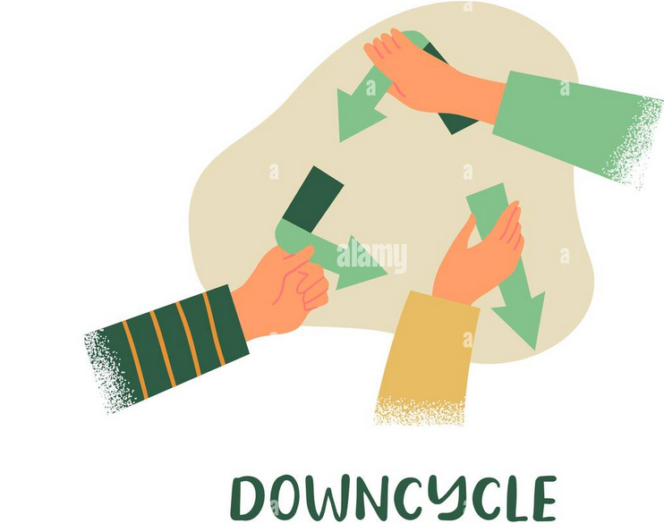
UpTraK Training Programme
Module 1, Unit 1
Downcycling
Limitations of downcycling:
Lower quality products: Downcycling results in products of lower quality or functionality than the original materials. This means that the downcycled products may not be as durable, long-lasting, or aesthetically pleasing as products made from virgin materials.
Limited recyclability: Downcycled materials may not be recyclable again, or they may only be recyclable a limited number of times. This means that downcycling can delay, but not eliminate, the need for disposal.
Importance of downcycling:
Despite its limitations, downcycling can still be a valuable part of the recycling process. It can help to reduce waste and conserve resources, even if the resulting products are not of the same quality as the original materials.
Downcycling can also be a way to use materials that would otherwise be difficult or impossible to recycle.
www.fashionupproject.com

Slide 18

UpTraK Training Programme
Module 1, Unit 1
Resource efficiency:
Less energy consumption compared to recycling.
Creativity:
Creating unique, personalized products.
Sustainability:
Reduces waste and minimizes environmental impact.
Why Upcycling?
www.fashionupproject.com

Slide 19




UpTraK Training Programme
Module 1, Unit 1
Environmental Impact of the Fashion Industry – Key Statistics
01
02
03
04
Global Emissions
Water Usage
Textile Waste
Chemical Pollution
The fashion industry is responsible for approximately 10% of global carbon dioxide emissions annually, making it one of the most polluting industries, surpassing international flights and maritime shipping combined
Producing one kilogram of cotton requires 20,000 liters of water, which is equivalent to producing a single
T-shirt and a pair of jeans
Globally, an estimated 92 million tons of textile waste is generated each year. It is projected to increase to 134 million tons by 2030.
In Europe > 50% of used clothes are collected for reuse or recycling,
and only 1% is recycled into new garments due to technological limitations
The textile dyeing process is the second-largest polluter of clean water globally, after agriculture. It accounts for approximately 20% of global industrial water pollution.
www.fashionupproject.com

Slide 20
UpTraK Training Programme
Module 1, Unit 1
Environmental Impact of the Fashion Industry – Key Statistics
05
06
07
04
Synthetic Fibers and Microplastics
Production Overload
Energy Use
Productin Overload
Energy Use
The fashion industry produces 100 billion garments annually, which is more than 10 times the global population. This overproduction leads to massive surplus and waste
The production of synthetic fibers (e.g., polyester) uses 70 million barrels of oil annually, contributing heavily to non-renewable resource depletion
Around 60% of clothing materials are made of synthetic fibers like polyester, which release half a million tons of microplastics into oceans annually during washing
www.fashionupproject.com

Slide 21

UpTraK Training Programme
Module 1, Unit 1
Benefits of Upcycling for Sustainability
Waste Reduction:
Diverts textiles and materials from landfills.
Reduces the volume of waste generated by the fashion industry.
Resource Conservation:
Saves natural resources such as water, energy, and raw materials.
Minimizes reliance on virgin resources like cotton or synthetic fibers.
Lower Environmental Impact:
Decreases carbon emissions associated with new material production.
Reduces water and chemical use compared to traditional recycling or production.
Promotion of Circular Economy:
Encourages reuse and repurposing of existing materials.
Extends the lifecycle of products, aligning with sustainable consumption patterns.
Energy Efficiency:
Requires less energy than producing new garments or materials from scratch.
Avoids energy-intensive recycling processes like fiber breakdown.
www.fashionupproject.com

Slide 22
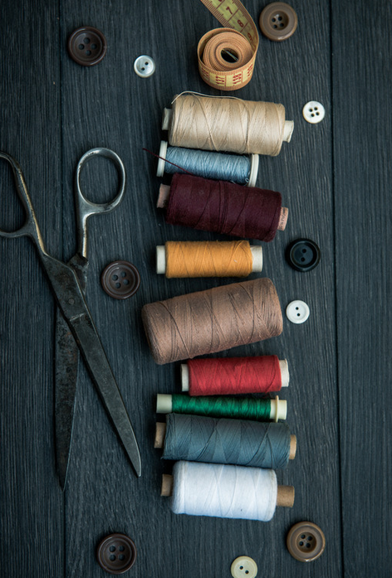
UpTraK Training Programme
Module 1, Unit 1
Benefits of Upcycling for Sustainability
Inspiration for Innovation:
Promotes creativity in design, enabling unique and personalized products.
Encourages businesses to rethink production and material use strategies.
Economic Opportunities:
Opens new markets for sustainable and ethical fashion products.
Creates jobs in small-scale production and craftsmanship.
Consumer Awareness:
Educates consumers about sustainability and the impact of their purchasing decisions.
Fosters a culture of mindfulness toward consumption and waste.
Reduction in Microplastics:
Upcycling avoids reliance on synthetic materials that release microplastics during washing.
Support for Local Communities:
Encourages local sourcing and production, benefiting small businesses and artisans.
www.fashionupproject.com

Slide 23
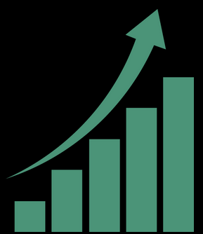
UpTraK Training Programme
Module 1, Unit 1
Successful Upcycling Brands
Patagonia (USA)
Focus: Outdoor apparel made with upcycled and recycled materials.
Notable Projects: Worn Wear initiative that repairs and upcycles damaged gear.
Impact: Promotes the circular economy by reducing textile waste and extending product life.
Looptworks (USA)
Focus: Bags, accessories, and apparel made from excess materials and deadstock fabrics.
Notable Products: Upcycled laptop sleeves made from wetsuit scraps.
Impact: Prevents waste by using pre-consumer and post-consumer materials.
Website: Looptworks
Elvis & Kresse (UK)
Focus: Luxury accessories made from upcycled fire hoses, leather scraps, and other materials.
Notable Products: Bags, wallets, and belts crafted from decommissioned fire hoses.
Impact: Diverts non-recyclable materials from landfills and donates 50% of profits to charities.
Website: Elvis & Kresse
Tonlé (Cambodia)
Focus: Zero-waste fashion using scraps from garment factories.
Notable Products: Handmade garments from leftover fabrics (deadstock).
Impact: Reduces textile waste while empowering local artisans.
Website: Tonlé
UpFuse (Egypt)
Focus: Bags and accessories made from upcycled plastic bags and packaging materials.
Notable Products: Stylish backpacks, totes, and wallets.
Impact: Reduces plastic pollution while providing fair-trade employment opportunities.
Website: UpFuse
www.fashionupproject.com

Slide 24
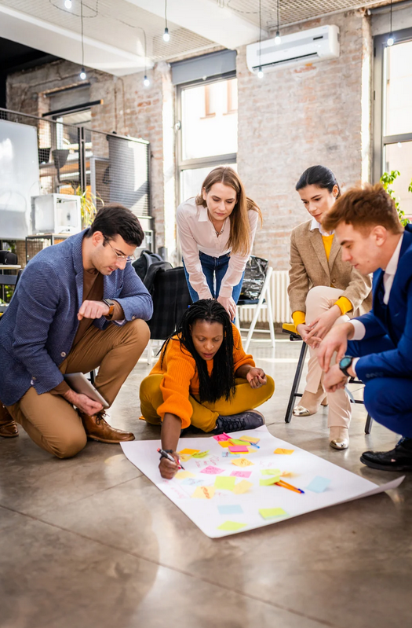
UpTraK Training Programme
Module 1, Unit 1
Group Task
Find examples in your local area of companies or non-governmental organizations that deal with upcycling, recycling and downcycling?
Is there anything that connects these businesses? Analyze how they reach their target groups.
This task will introduce us to the next unit.
www.fashionupproject.com

Slide 25
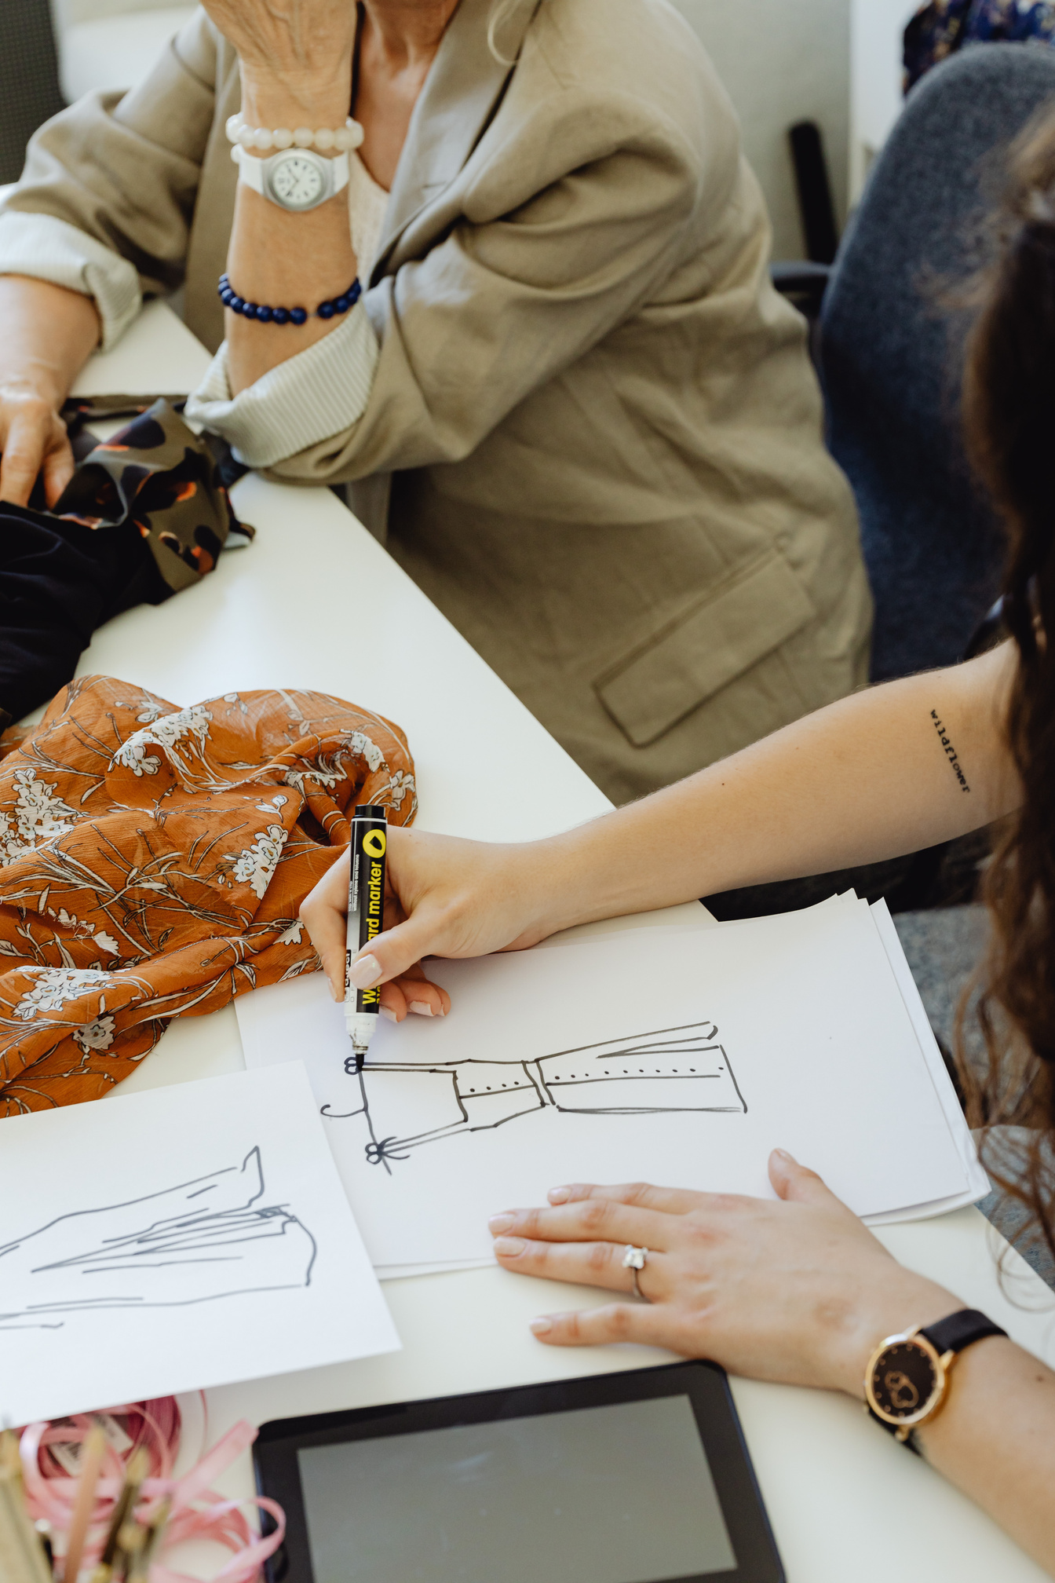
UpTraK Training Programme
Module 1, Unit 1
Unit
Summary
This unit introduces key definitions of recycling, upcycling, and downcycling. It includes a short group exercise and serves as a theoretical introduction before practical modules.
www.fashionupproject.com

Slide 26
UpTraK Training Programme
Module 1, Unit 1
  Fashion Revolution - "Why We Need to Reuse and Upcycle Clothing"
    Website: www.fashionrevolution.org
  The Ellen MacArthur Foundation - "A New Textiles Economy: Redesigning Fashion’s Future"
    Website: www.ellenmacarthurfoundation.org
  Greenpeace International - "The Environmental Impact of Fast Fashion"
    Website: www.greenpeace.org
  Textile Exchange - "Preferred Fiber & Materials Market Report"
    Website: www.textileexchange.org
  Sustainable Apparel Coalition - "Higg Index: Sustainable Materials"
    Website: www.apparelcoalition.org
  The Upcycle Movement - Resources and guides on upcycling practices
    Website: www.theupcyclemovement.com
  British Fashion Council - "Circular Fashion and Upcycling Initiatives"
    Website: www.britishfashioncouncil.co.uk
  Eco-Age - "Guide to Sustainable Fashion: Understanding Upcycling"
    Website: www.eco-age.com
References
www.fashionupproject.com

