Slide 1



UpTraK Training Programme
Module 6
UNIT 4
TECHNICAL FOCUS ON BLENDER
www.fashionupproject.com
Duration: 4 hours

Slide 2
UpTraK Training Programme
Funded by the European Union. Views and opinions expressed are however those of the author(s) only and do not necessarily reflect those of the European Union or the European Education and Culture Executive Agency (EACEA). Neither the European Union nor EACEA can be held responsible for them.
www.fashionupproject.com

Slide 3
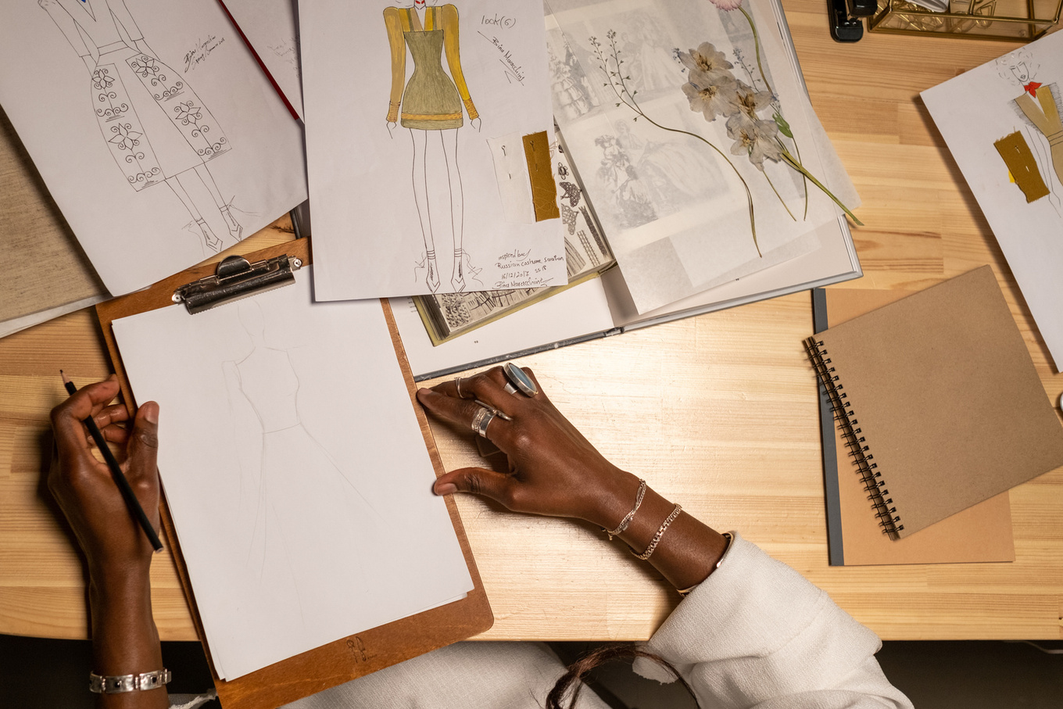

UpTraK Training Programme
Module 6, Unit 4
Overview of the Unit
This unit introduces Blender as a 3D fashion design tool, focusing on garment creation, texturing, avatar customization, and fabric simulation.
You will learn how to:
  Navigate Blender’s interface and key tools.
  Convert 2D designs into 3D garments.
  Apply materials and textures for realistic visualization.
  Customize avatars for digital fitting.
  Simulate fabric movement and physics.
This unit builds on previous units by using 2D patterns digitized in Unit 3 to create 3D garments, preparing for further applications in digital fashion workflows.
www.fashionupproject.com

Slide 4
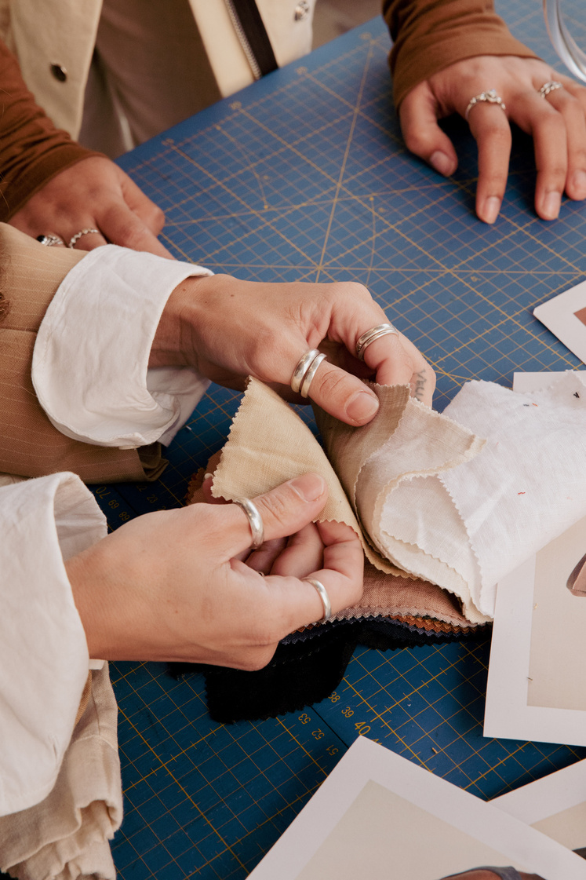

UpTraK Training Programme
Module 6, Unit 4
Expected
Learning Outcomes
By the end of this unit, you will be able to:
Model and sculpt 3D garments in Blender.
Apply materials, textures, and lighting to create realistic digital fashion.
Customize avatars and fittings for garment testing.
Simulate fabric movement using Blender’s physics engine.
Understand how Blender enhances sustainable fashion workflows.
Pre-requisite knowledge
  Basic familiarity with fashion patternmaking and garment construction.
  Completion of previous units, especially Unit 3 (Digitizing 2D Patterns).
  General experience with computer-based design tools is recommended.
www.fashionupproject.com
Estimated Reading Time
6 minutes

Slide 5


UpTraK Training Programme
Module 6, Unit 4
Target Audience
This Unit targets learners who are seeking basic knowledge on how to realize simple simulations to create a 3D fashion design project using Blender
Learning
Objective
The goal of the Unit is to equip learners with technical skills in Blender for 3D fashion design, covering garment modeling, material customization, avatar fitting, and fabric simulation.
Key concepts
Blender Interface & Tools, 3D Garment Creation, Texturing & Material Customization, Avatar Customization & Fitting, Fabric Physics & Draping Simulation, Digital Fashion Workflow
www.fashionupproject.com

Slide 6
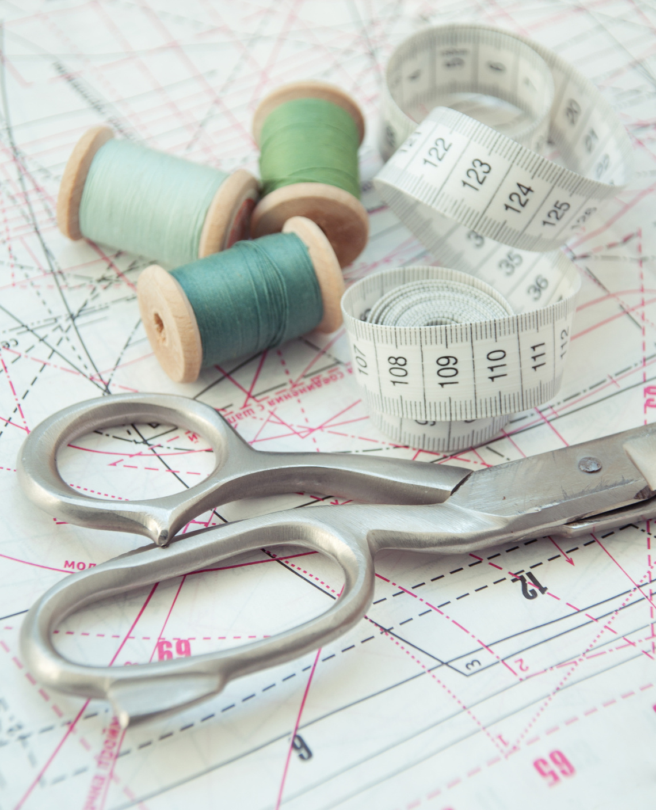
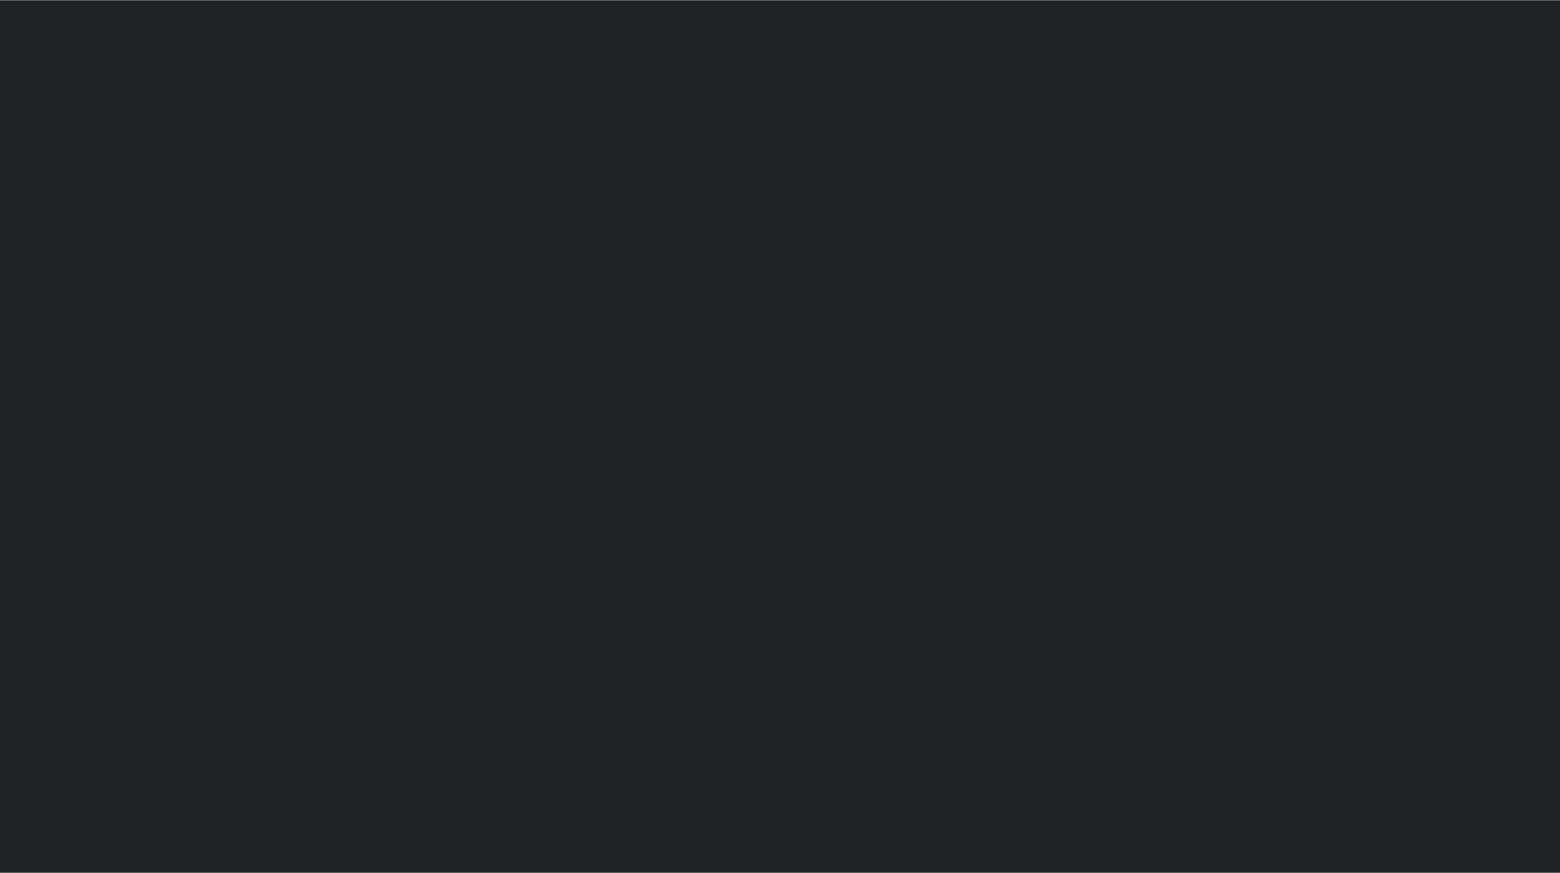
UpTraK Training Programme
Module 6, Unit 4
To complete this unit, you will need:
  Blender software (latest version installed).
  A computer with good processing power for 3D modeling.
  Stylus or mouse for precise modeling control.
  Texture images and fabric references for realistic material application.
  Previously digitized 2D patterns from Unit 3.
Necessary
equipment
www.fashionupproject.com

Slide 7




UpTraK Training Programme
Module 6, Unit 4
01
Teacher's Profile
PROFESSIONAL FASHION DESIGNER EXPERT IN 3D DESIGN
or
TRAINER FOR FASHION DESIGN
01
Methodology
Learning by doing – simulations and practice exercises
www.fashionupproject.com

Slide 8

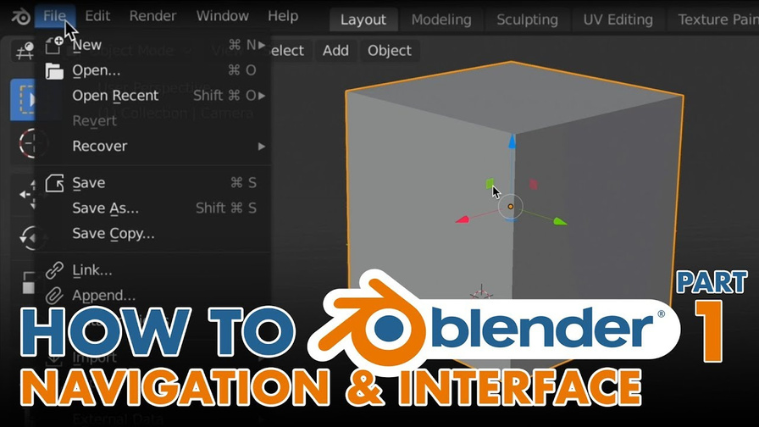
UpTraK Training Programme
Module 6, Unit 4
Introduction to Blender interface & navigation
Understanding Blender’s interface:
  Workspaces & Layouts – Overview of the 3D viewport, properties panel, and outliner.
  Navigation & View Controls – Rotating, zooming, and switching camera views.
  Essential Commands – Selection, transformation (scale, rotate, move), and shortcuts.
www.fashionupproject.com
Watch
https://www.youtube.com/watch?v=bnRjybA35Zg

Slide 9
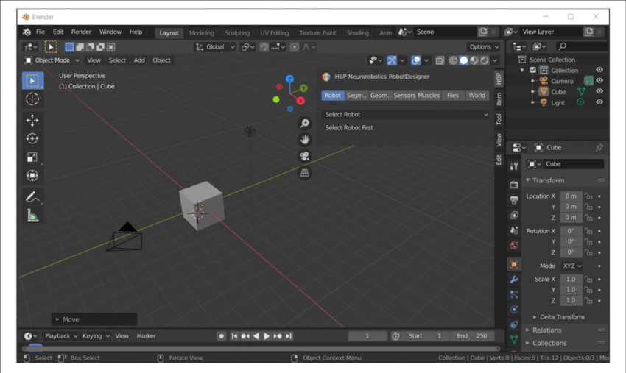
UpTraK Training Programme
Module 6, Unit 4
Essential commands for 3D fashion design
Core tools for garment modeling:
  Extrusion & Scaling – Creating volume and shaping garments.
  Subdivision & Smooth Tools – Refining garment surfaces.
  Mirror Modifier – Ensuring garment symmetry.
www.fashionupproject.com
Watch
https://www.youtube.com/watch?v=-O52Js1c5D4

Slide 10


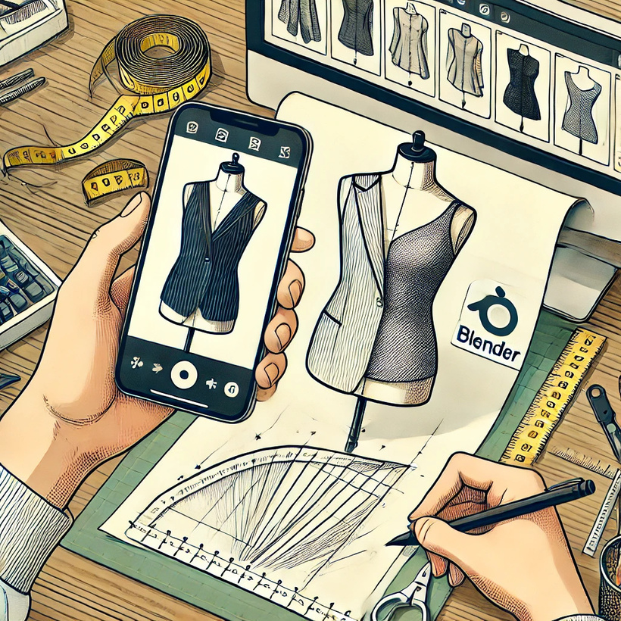

UpTraK Training Programme
Module 6, Unit 4
Exercise 1 - Sketching a basic 3D garment
📌 Objective: Use Blender’s drawing tools to outline a garment shape in 3D.
Instructions:
  Open Blender and create a new project.
  Use the Grease Pencil Tool to sketch a simple garment outline.
  Convert the sketch into a 3D form using extrusion.
www.fashionupproject.com
Watch
https://www.youtube.com/watch?v=vN6z7-EChIw

Slide 11
UpTraK Training Programme
Module 6, Unit 4
Exercise 1 - part 2 Converting sketches into 3D Models
📌 Objective: Transform a 2D sketch into a 3D garment using modeling tools.
  Extrude and shape the sketch to create a 3D object.
  Adjust edges and proportions for garment accuracy.
  Apply mirror symmetry for balanced design.
www.fashionupproject.com
Watch
https://www.youtube.com/watch?v=suB0S6IdrLg

Slide 12
UpTraK Training Programme
Module 6, Unit 4
Exercise 2 - Adding details & refinements
📌 Objective: Enhance the 3D garment with seams, folds, and structure.
Instructions:
  Add stitching lines using Blender’s sculpting tools.
  Create fabric folds by manipulating mesh details.
  Smooth edges and refine proportions for realism.
www.fashionupproject.com

Slide 13
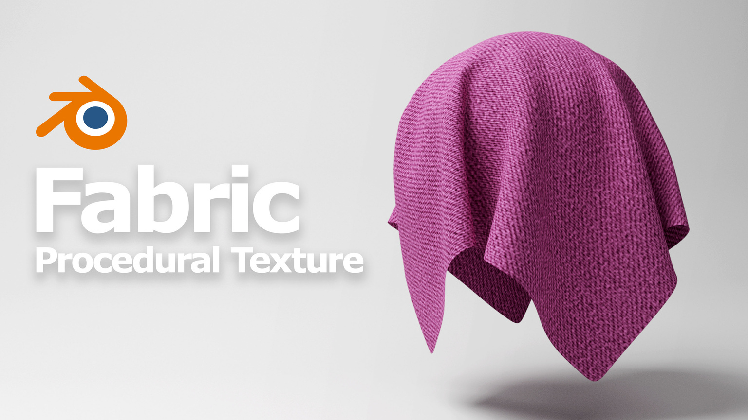
UpTraK Training Programme
Module 6, Unit 4
Customizing materials & textures
📌 Objective: Apply realistic fabric textures to the garment.
  Import and apply fabric textures (cotton, silk, denim, etc.).
  Adjust material color, transparency, and shine.
www.fashionupproject.com
Watch
https://www.youtube.com/watch?v=muvIS5_sXQo

Slide 14
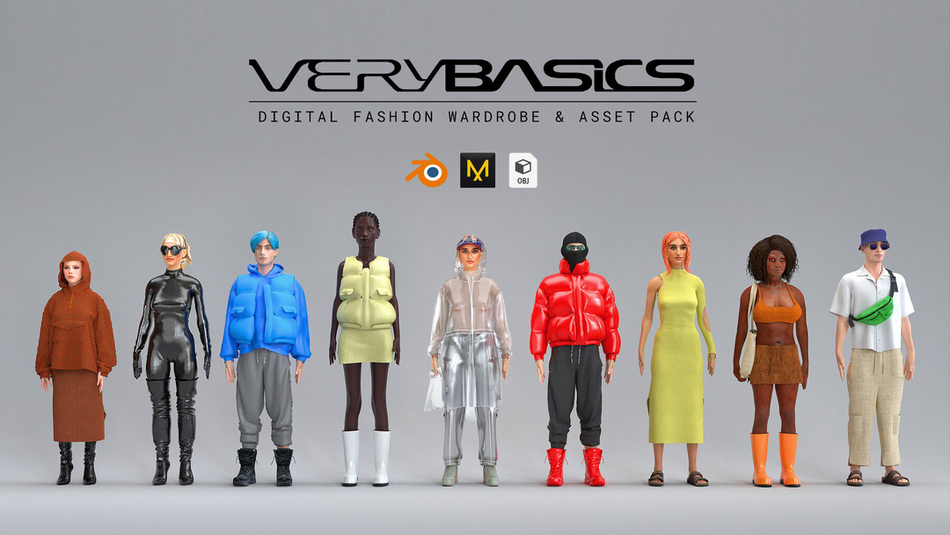
UpTraK Training Programme
Module 6, Unit 4
Importing & customizing avatars for fitting
📌 Objective: Dress 3D avatars with garments and adjust fit.
  Import an avatar mannequin into Blender.
  Align the garment to the avatar’s shape.
  Adjust fit for realistic drape and movement.
  Simulate a fashion show on Blender, making all your dresses catwalking.
www.fashionupproject.com
https://www.youtube.com/watch?v=tDLOhAgrZTM
Watch
https://www.youtube.com/watch?v=BjlJF-aGrlE

Slide 15
UpTraK Training Programme
Module 6, Unit 4
Exercise 3 - Applying fabric physics & draping simulation
📌 Objective: Simulate real fabric movement and draping.
  Assign cloth physics to the garment.
  Adjust gravity, weight, and elasticity settings.
  Test how the fabric reacts when animated.
www.fashionupproject.com
Watch
https://www.youtube.com/watch?v=_hNFZ0v__no

Slide 16
UpTraK Training Programme
Module 6, Unit 4
Exercise 3 - part 2 Testing and adjusting the final garment
📌 Objective: Make final refinements to textures, draping, and fitting.
  Fine-tune stitching, movement, and details.
  Test the garment’s behavior in different poses
PREVIOUS VIDEOS OFFER AN INSIGHTS ON HOW TO TESTING THE FINAL GARMENT.
www.fashionupproject.com

Slide 17


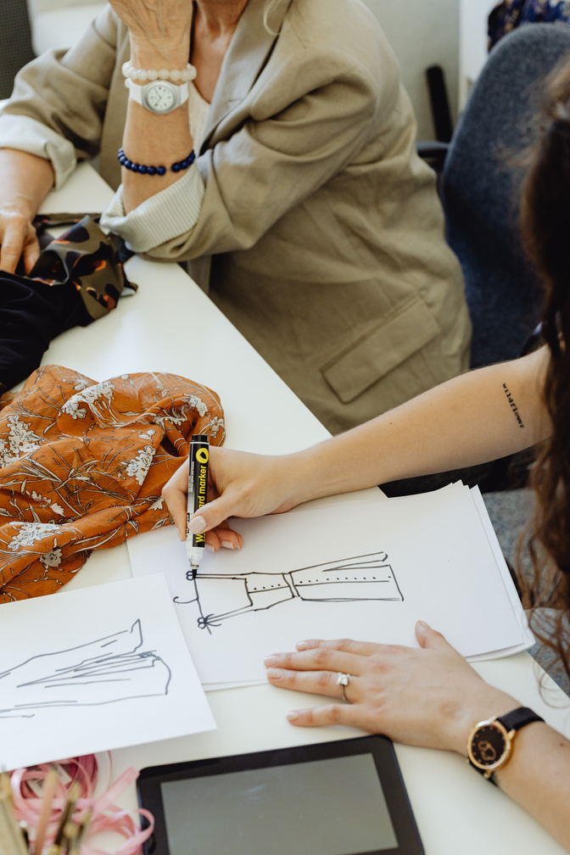

UpTraK Training Programme
Module 6, Unit 4
Unit
Summary
In this Unit, you learned:
  How to navigate Blender’s interface and use essential 3D modeling tools for fashion design.
  The process of sketching, modeling, and refining garments in Blender.
  How to apply materials, textures, and lighting to create realistic digital fabrics.
  Methods for importing and customizing avatars to test garment fitting.
  Techniques for simulating fabric movement using Blender’s physics engine.
www.fashionupproject.com

Slide 18


UpTraK Training Programme
Module 6, Unit 4
References
    Blender Documentation – www.blender.org
    Sustainable Fashion & Digital Design – www.businessoffashion.com
www.fashionupproject.com

