Slide 1


UpTraK Training Programme
Module 6
Approaching 3D design for tailoring
A MEANS TO AVOID WASTING OF MATERIALS
www.fashionupproject.com

Slide 2
UpTraK Training Programme
Funded by the European Union. Views and opinions expressed are however those of the author(s) only and do not necessarily reflect those of the European Union or the European Education and Culture Executive Agency (EACEA). Neither the European Union nor EACEA can be held responsible for them.
www.fashionupproject.com

Slide 3

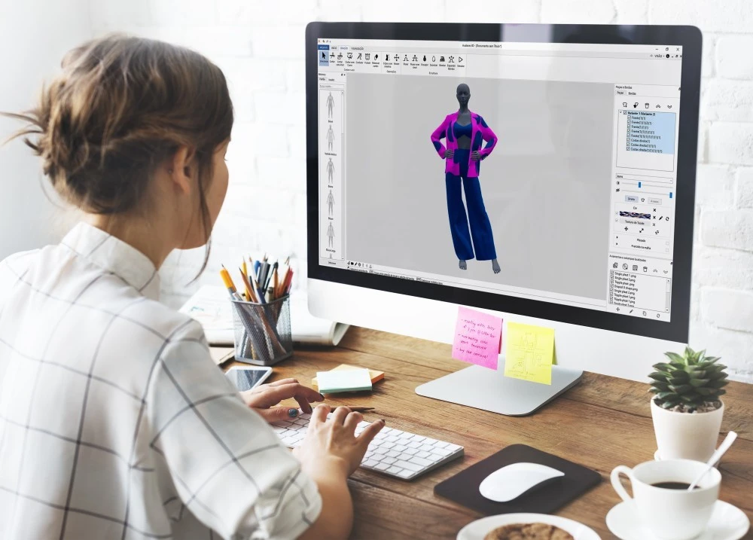
UpTraK Training Programme
Module 6, APPROACHING 3D DESIGN FOR TAILORING
Module 6 Learning Objectives
It will aim to introduce learners to 3D design as complement to the traditional modeling for supporting a more sustainable approach to the design process.
Learners will observe the process from the 2D model to the 3D design to realize simple pattern making and garment construction
Through the training focus (Unit 4), learners will acquire the basic skills on how to use a specific software to create three-dimensional prototypes, personalize garments and render them on avatars, testing different fabrics and simulating the fit of clothes on different body types before producing them physically.
www.fashionupproject.com

Slide 4
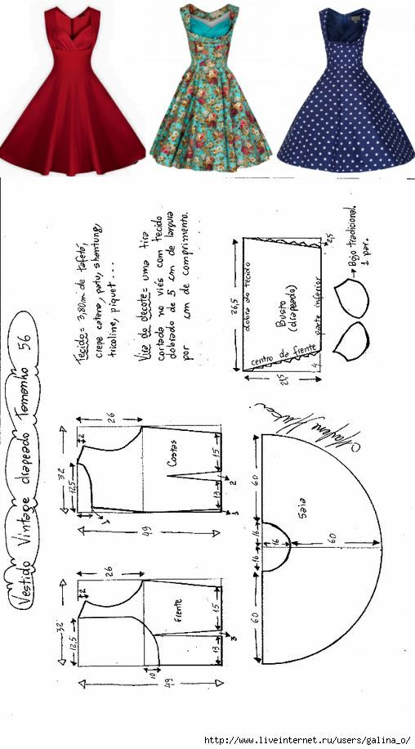
UpTraK Training Programme
Module 6, APPROACHING 3D DESIGN FOR TAILORING
Expected
Learning Outcomes
Module 6 is mainly demonstrative as learners will be introduced to key features and operational aspects of 3D design as support to a more sustainable fashion designing process.
By the end of this Module learners will:
Strength knowledge about 3D programs for patternmaking and garment construction
Be more conscious of the main features, functions and benefits for the design process entailed by 3D programs such as precision measurements, time optimization, waste reduction, fit simulation, cost reduction, etc.
Acquire basic technical skills to pass from a 2D model into a 3D project managing the digital functions/commands of a certain program (e.g. to sketch a project, transform it into 3D modeling, customize materials, textures and avatar, applying fabric simulation techniques, etc.)
www.fashionupproject.com

Slide 5
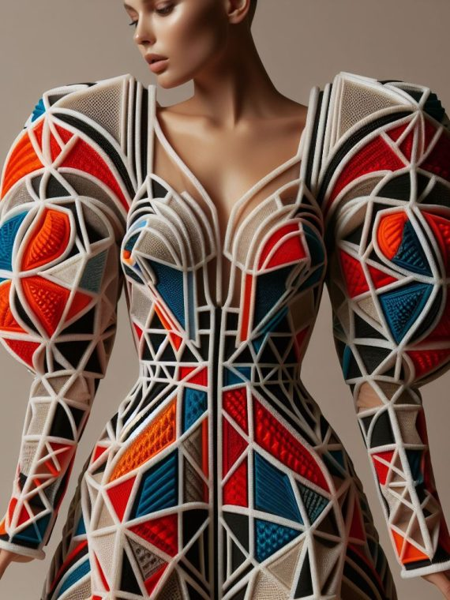
UpTraK Training Programme
Module 6, APPROACHING 3D DESIGN FOR TAILORING
Methodology
Module 6 entails a mixed methodology combining traditional formal lessons and learning by doing.
The formal approach will be applied to treat theoretical introductive contents, and it will be mainly used in UNITS 1-2.
Simulations, guided trials and group work will be used in the demonstrative Units for simple pattern making practice exercise and garment construction through 3D modeling.
Also, the pragmatic contents for UNITS 3-4 will be faced adopting the cooperative learning approach: learners will work in small group with the trainer's guidance to accomplish a common learning goal represented by simple 3D modeling project (e.g. a garment)
www.fashionupproject.com

Slide 6

UpTraK Training Programme
Module 6, APPROACHING 3D DESIGN FOR TAILORING
Necessary equipment
For this Module is necessary:
Internet connection, widescreen for theoretical lessons, 2D modeling materials, Personal computers and related accessories.
At least 4 pc are required to effectively group the learners to work on their 3D modeling project
The ICT assets must be capable of running the 3D design program selected for the practical focus on simulation and exercises.
Module 6 Duration
8 hours
Assessment Criteria
www.fashionupproject.com
A 5 closed questions quiz will be submitted to learners to ascertain the reaching of learning goals set for this Module

Slide 7
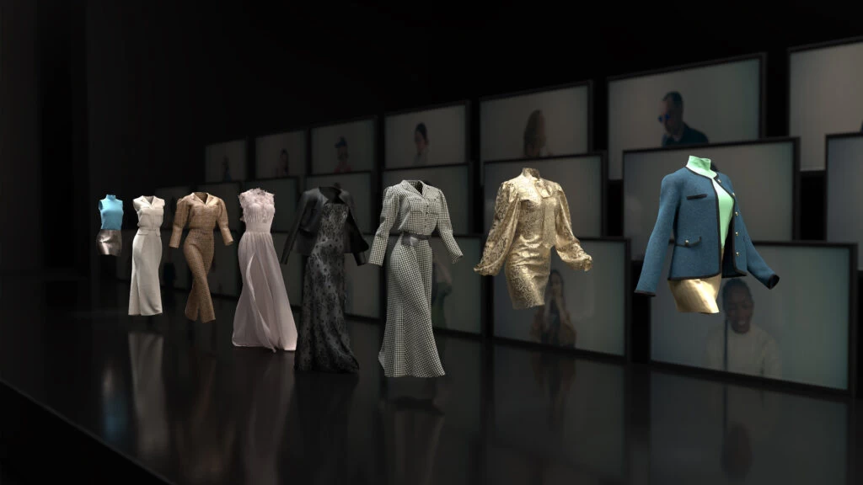
UpTraK Training Programme
Module 6, APPROACHING 3D DESIGN FOR TAILORING
This Module includes theoretical Training Materials on PPT or Canva format.
Theoretical materials are available for each Training Unit constituting the Module.
Video tutorials are available only for Modules with high performative-practical learning contents.
Training Materials & Video-Tutorials
www.fashionupproject.com

Slide 8
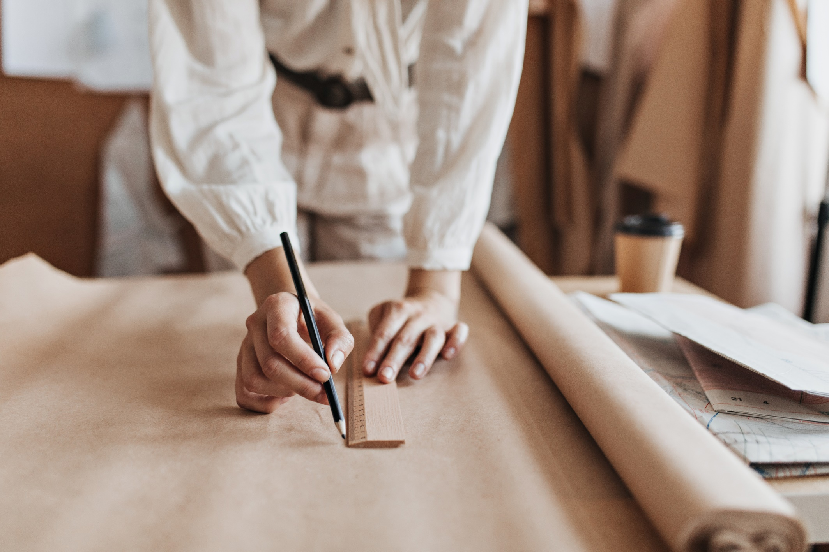
UpTraK Training Programme
Module 6, APPROACHING 3D DESIGN FOR TAILORING
Trainer(s) competence profile
Technical competences
Understanding of sewing, pattern making, textile manipulation, and garment construction techniques
Familiarity with various textiles, and their properties and suitability for upcycling
Mastering knowledge and techniques for garment construction through 3D design programs
Pedagogical competences
Experience in teaching adult learners and understanding their learning styles
Strong communication and presentation skills to engage learners
www.fashionupproject.com
PROFESSIONAL FASHION DESIGNER EXPERT IN 3D DESIGN or
TRAINER FOR FASHION DESIGN & MODELING EXPERT IN 3D DESIGN

Slide 9
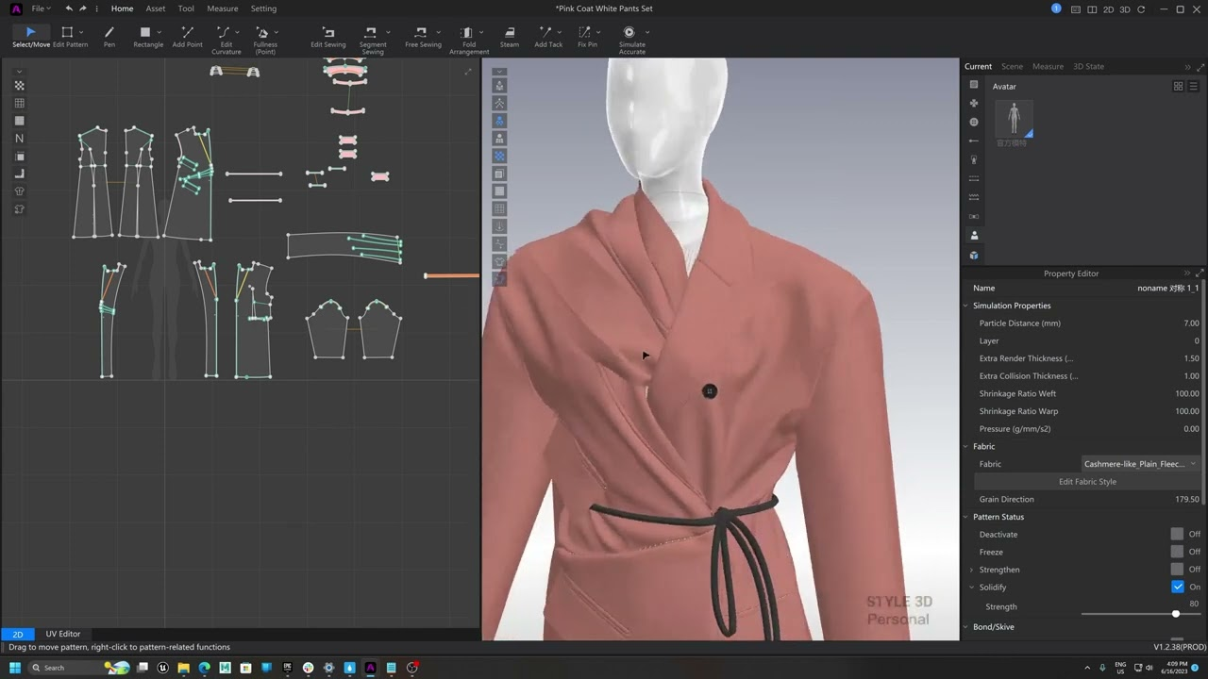
UpTraK Training Programme
Module 6, APPROACHING 3D DESIGN FOR TAILORING
Module 6
www.fashionupproject.com
TRAINING UNITS

Slide 10
UpTraK Training Programme
Module 6, APPROACHING 3D DESIGN FOR TAILORING
Module 6 Training Units
These Training Units compose Module 6
01
02
3D as valid support for a sustainable and eco-responsive model of fashion design
The most used 3D programs for fashion design: some examples
0
02
Providing learners a general overview on the most used 3D programs for patternmaking and garment construction showing their main features, functions and benefits for the design process and strengths in the view of the projects to be realized (e.g. precision measurements, time optimization, waste reduction, fit simulation, cost reduction, etc.).
TITLE
Briefly introducing learners to main features and operational aspects of 3D design as support to a more sustainable fashion designing process. Clarifying the meaning of adopting 3D in design and prototyping to promote the reduction of waste and consequently the reduction of the environmental footprint.
content
www.fashionupproject.com
Duration.
Duration
1 HOUR
Duration
1 HOUR

Slide 11
UpTraK Training Programme
Module 6, APPROACHING 3D DESIGN FOR TAILORING
Module 6 Training Units
These Training Units compose Module 6
03
04
Sustainable design as a hybrid 2D/3D activity
Technical Focus on BLENDER
0
02
Introducing learners to a specific free software for 3D design suitable to be applied also to fashion, enabling them to use its fundamental commands to sketch the project and to transform it into 3D by customizing the materials, textures and avatar, also applying 3D modeling and fabric simulation techniques.
TITLE
Enabling learners to translate a 2D model into a 3D project and practically test how to complement traditional modeling made on paper with 3D technique.
content
www.fashionupproject.com
Duration.
Duration
2 HOURS
Duration
4 HOURS

Slide 12
UpTraK Training Programme
Module 6, APPROACHING 3D DESIGN FOR TAILORING
  Here are listed the links related to the most known –popular- used 3DPrograms for fashion design, including open-source programs and programs for fee (for download)
  FREE PROGRAMS
  https://www.blender.org/
  https://www.tinkercad.com/
  https://www.sketchupitalia.it/prodotti/sketchup-free
  https://openscad.org/
  PROFESSIONAL PROGRAMS FOR FEE
  https://www.clo3d.com/en/
  https://www.marvelousdesigner.com/
  https://optitex.com/
  https://tailornova.com/
  Programs for Windows/macOS
  Adobe Illustrator https://www.adobe.com/it/products/illustrator.html
  Vstitcher https://browzwear.com/products/v-stitcher
  Tuka3D https://tukatech.com/tuka3d/
  SHOWCASE FOR 3D PROGRAMS
www.fashionupproject.com

