Slide 1

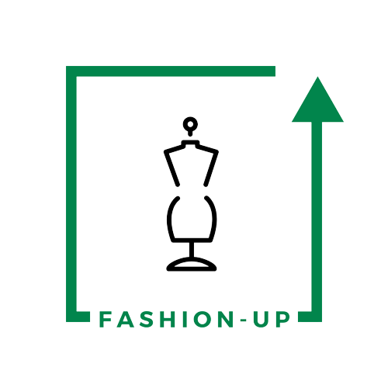

UpTraK Training Programme
Module 1
GLOSSARY
www.fashionupproject.com

Slide 2
UpTraK Training Programme
Upcycling
is the process of creatively transforming waste or unwanted materials into new items of higher utility or aesthetic value.
Recycling
is the process of collecting and processing waste materials and used products to create new products. The goal of recycling is to reduce the consumption of raw materials, energy, and water, as well as to minimize pollution and greenhouse gas emissions.
Downcycling
is the process of recycling materials into new products of lower quality or functionality than the original. This often happens because the materials degrade or become contaminated during the recycling process, making them unsuitable for higher-quality applications.
Sustainability
refers to the ability to meet the needs of the present without compromising the ability of future generations to meet their own needs. It emphasizes a balance among the exploitation of resources, directions of social development, investments, and environmental aspects, as well as the preservation of the environment. Sustainability involves responsibility and a long-term perspective aimed at integrating economic, social, and ecological considerations into decision-making processes at all levels.
Glossary
www.fashionupproject.com

Slide 3
UpTraK Training Programme
Circular boutiques
are stores that operate on a closed-loop system. This means that clothing and other items that come into these stores are not treated as waste, but as resources that can be reused.
Second-hand stores
are retail outlets that sell pre-owned clothing and accessories, offering an affordable and sustainable alternative to fast fashion. These stores are excellent sources for upcycling materials, providing unique and diverse pieces that can be repurposed into new designs while reducing textile waste.
Textile scraps
are leftover fabric pieces from garment production or other textile-related processes, often discarded as waste. These scraps are ideal for upcycling projects, as they can be transformed into patchwork designs, accessories, or other creative products, contributing to a zero-waste approach in fashion.
Deadstock fabrics
are unused textile materials that were produced in excess or deemed unfit for sale, often stored by manufacturers or designers. Upcycling these fabrics helps prevent them from going to waste, offering an eco-friendly option to create unique, limited-edition garments or accessories.
Glossary
www.fashionupproject.com

Slide 4
UpTraK Training Programme
Pricing strategy
the method a company uses to price its products or services. It is a critical component of marketing and sales management that considers factors such as market conditions, competitor pricing, production costs, and consumer demand to determine the optimal price to maximize profit while maintaining competitive advantage.
Scalability
this concept describes the capability of a system, network, or process to handle a growing amount of work, or its potential to be enlarged to accommodate that growth. In business, scalability often refers to a company's ability to increase its production and manage increased demand without compromising performance or quality.
Marketing channel
a marketing channel is a set of practices or activities necessary to transfer the ownership of goods, and to move goods, from the point of production to the point of consumption. It includes organizations such as distributors, wholesalers, and retailers that facilitate the distribution and sale of goods to the final buyer.
Glossary
www.fashionupproject.com

