Slide 1

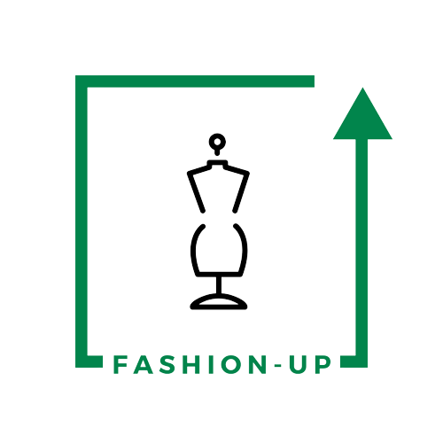

UpTraK Training Programme
Module 6
GLOSSARY
www.fashionupproject.com

Slide 2


UpTraK Training Programme
Module 6, Unit 1
  Sustainable Fashion - A design philosophy that minimizes environmental impact through eco-friendly materials, ethical labor, and waste reduction.
  3D Prototyping - The process of creating digital samples of garments, eliminating the need for physical prototypes.
  Virtual Sampling - Using 3D models to test garment designs without creating actual fabric samples, reducing waste.
  Digital Rendering - The process of adding realistic lighting, textures, and colors to a 3D model to visualize the final design.
  Fabric Simulation - A feature in 3D design software that mimics how fabrics drape, stretch, and react to movement.
  Circular Fashion - A sustainable approach that promotes recycling, upcycling, and designing garments for extended lifespans.
  Digital Fashion - Clothing created exclusively in virtual environments for use in gaming, social media, or augmented reality.
  Augmented Reality (AR) Try-On - A technology that allows consumers to virtually try on digital garments before purchasing.
  Parametric Design - A digital method that adjusts garment proportions automatically based on pre-set rules.
  Metaverse Fashion - A growing trend where designers create and sell digital clothing for avatars in virtual spaces.
Important key-words
www.fashionupproject.com

Slide 3
UpTraK Training Programme
Module 6, Unit 2
  3D Modeling – The process of creating a digital representation of a garment or object.
  Virtual Prototyping – The use of 3D simulations to test designs before physical production.
  Garment Simulation – Digitally replicating how fabrics drape, fold, and move.
  Patternmaking – The creation of digital garment patterns for accurate construction.
  Fit Testing – Using 3D software to assess and refine garment fit.
  Rendering – Producing high-quality digital visuals of 3D-designed garments.
  Digital Textures – Applying realistic fabric textures to virtual clothing.
  Fabric Physics – Simulating fabric properties like elasticity, weight, and drape.
  Sustainability – Designing with minimal waste and reduced environmental impact.
  Waste Reduction – Using 3D technology to eliminate unnecessary fabric waste.
  Augmented Reality (AR) Fitting – Virtual garment try-ons using AR technology.
  CAD (Computer-Aided Design) – Software used for precision-based garment design.
  Parametric Design – Using algorithms to generate adaptable fashion patterns.
  Automation in Fashion – The use of AI and digital tools to streamline design and production.
  Virtual Fashion Shows – Digital presentations of fashion collections without physical models.
Important key-words
www.fashionupproject.com

Slide 4
UpTraK Training Programme
Module 6, Unit 3
  2D-to-3D Workflow – Understanding how to digitize a traditional paper pattern and transform it into a 3D model for virtual garment development.
  Digital Patternmaking – Exploring how patterns can be digitally traced, adjusted, and structured in Blender to mirror traditional garment construction.
  Virtual Garment Prototyping – Using 3D modeling and visualization to test garment fit, structure, and design before creating a physical sample.
  Sustainable Fashion Design – Learning how digital fashion reduces material waste, speeds up design iterations, and minimizes production costs.
  Seam Alignment & Fit Testing – Ensuring that digital garments maintain accurate proportions, correct stitching placement, and realistic fabric behavior.
  Blender for Fashion Design – Leveraging open-source software to integrate 3D technology into traditional fashion design workflows, making the process more accessible and industry-relevant.
Important key-words
www.fashionupproject.com

Slide 5
UpTraK Training Programme
Module 6, Unit 4
  Blender Interface & Tools – The workspace layout, panels, and essential shortcuts that help navigate Blender efficiently.
  3D Garment Modeling – The process of creating digital fashion pieces using Blender’s extrusion, sculpting, and mirroring tools.
  Material & Texture Customization – Applying fabric textures, colors, and transparency settings to create realistic clothing materials.
  Avatar Customization & Fitting – Importing and adjusting digital mannequins to test garment fit and proportions.
  Fabric Physics & Draping Simulation – Using Blender’s cloth simulation engine to mimic real-world fabric movement and behavior.
  Virtual Prototyping – Designing and testing garments digitally before physical production, reducing material waste.
  Sustainable Digital Fashion – Using 3D modeling and simulation to create fashion designs efficiently and sustainably without physical samples.
  Digital Fashion Workflow – The step-by-step process of designing, testing, and presenting garments in a fully digital environment.
Important key-words
www.fashionupproject.com

