Slide 1

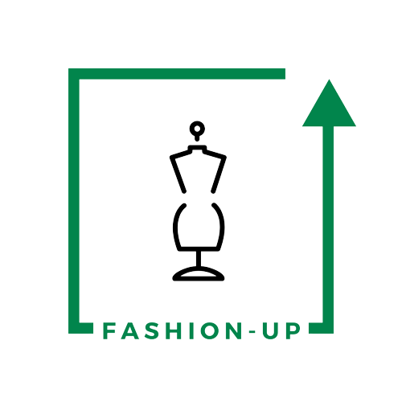

UpTraK Training Programme
Module 6
UNIT 1
3D AS VALID SUPPORT FOR SUSTAINABLE AND
ECO-RESPONSIVE MODEL OF
FASHION DESIGN
www.fashionupproject.com
Duration: 1 hour

Slide 2
UpTraK Training Programme
Funded by the European Union. Views and opinions expressed are however those of the author(s) only and do not necessarily reflect those of the European Union or the European Education and Culture Executive Agency (EACEA). Neither the European Union nor EACEA can be held responsible for them.
www.fashionupproject.com

Slide 3
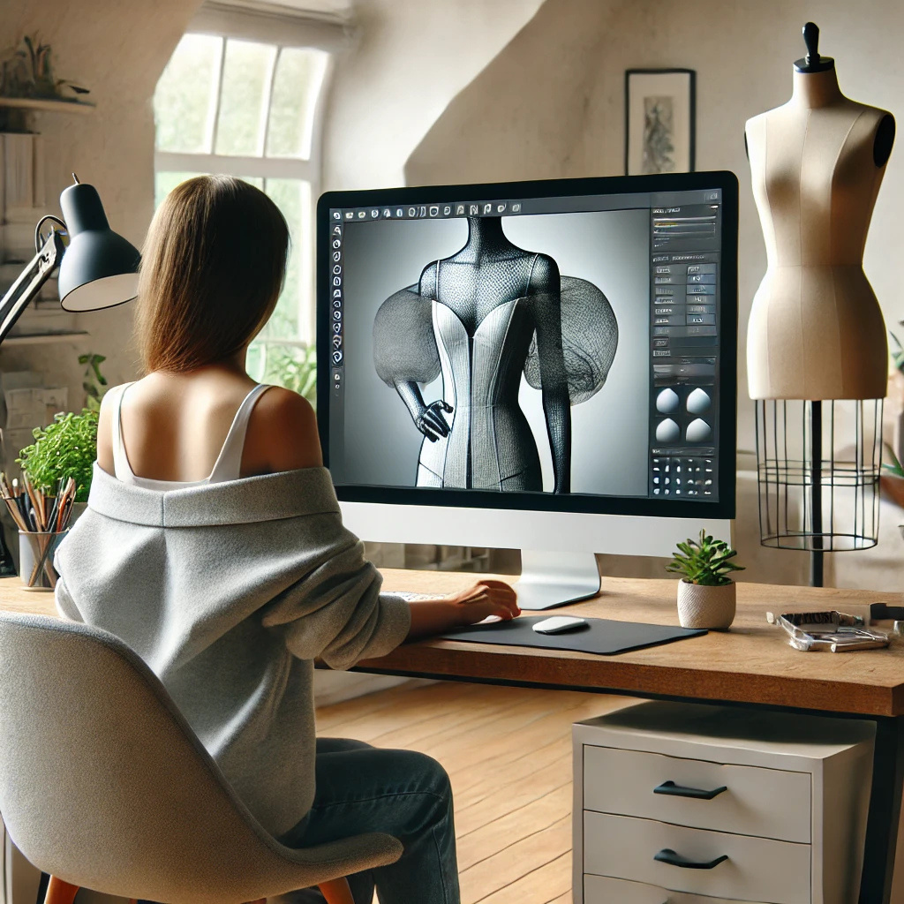

UpTraK Training Programme
Module 6, Unit 1
Overview of the Unit
In this unit, you will learn how 3D design supports sustainable fashion by reducing waste, minimising resource use, and streamlining the design process. You will explore its environmental benefits, key tools and skills, and how it aligns with modern trends like virtual fashion and eco-friendly practices.
www.fashionupproject.com

Slide 4
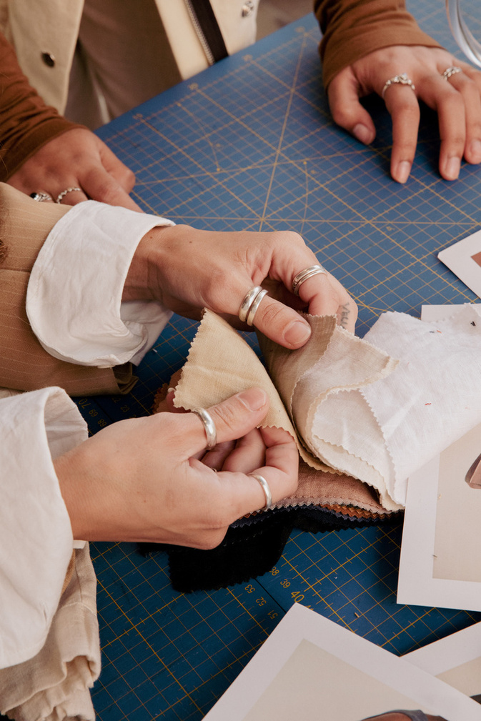

UpTraK Training Programme
Module 6, Unit 1
Expected
Learning Outcomes
By the end of this Unit, you will be able to:
      Explain the principles of sustainable fashion.
      Describe how 3D design supports sustainability.
      Identify the benefits of 3D prototyping over traditional methods.
      Outline the stages of the 3D prototyping process.
      Compare the environmental impact of 3D vs. traditional workflows.
      Recognize key skills and tools for 3D fashion design.
      Discuss challenges and opportunities in adopting 3D design.
Pre-requisite knowledge
www.fashionupproject.com
This Unit assumes a basic understanding of fashion design principles, including garment construction and design processes, familiarity with basic computer skills and an interest in sustainability.
Estimated Reading Time
10 minutes

Slide 5


UpTraK Training Programme
Module 6, Unit 1
Target Audience
Learning
Objective
This Unit targets learners who are seeking basic knowledge on how 3D design softwares can contribute to make fashion design more sustainable
The goal of the Unit is to equip learners with the knowledge and skills to use 3D design tools for creating sustainable and eco-responsive fashion prototypes.
Key concepts
Sustainable fashion principles, 3D design tools and technologies, Waste reduction through 3D prototyping, Key stages of 3D workflows, Environmental impact of 3D vs. traditional methods, Future trends in digital fashion
www.fashionupproject.com

Slide 6
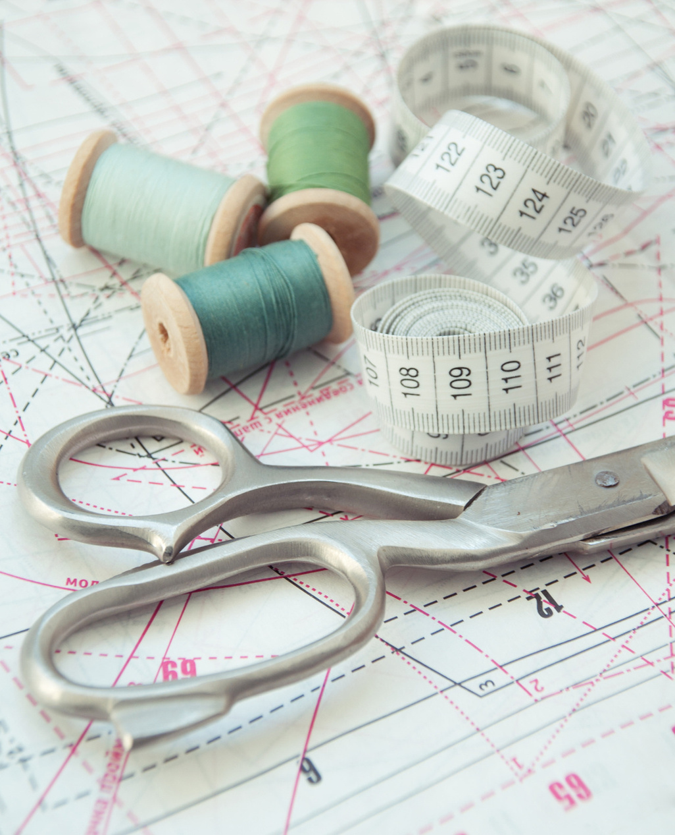

UpTraK Training Programme
Module 6, Unit 1
This is a theoretical Unit with no practical part, so no specific equipment is necessary other than that needed to deliver face-to-face traditional lessons (pc, internet connection, projector, etc.)
Necessary
equipment
www.fashionupproject.com

Slide 7




UpTraK Training Programme
Module 6, Unit 1
01
Teacher's Profile
PROFESSIONAL FASHION DESIGNER EXPERT IN 3D DESIGN
or
TRAINER FOR FASHION DESIGN & MODELING EXPERT IN 3D DESIGN
02
Methodology
Traditional face-to-face teaching (Formal Learning)
www.fashionupproject.com

Slide 8

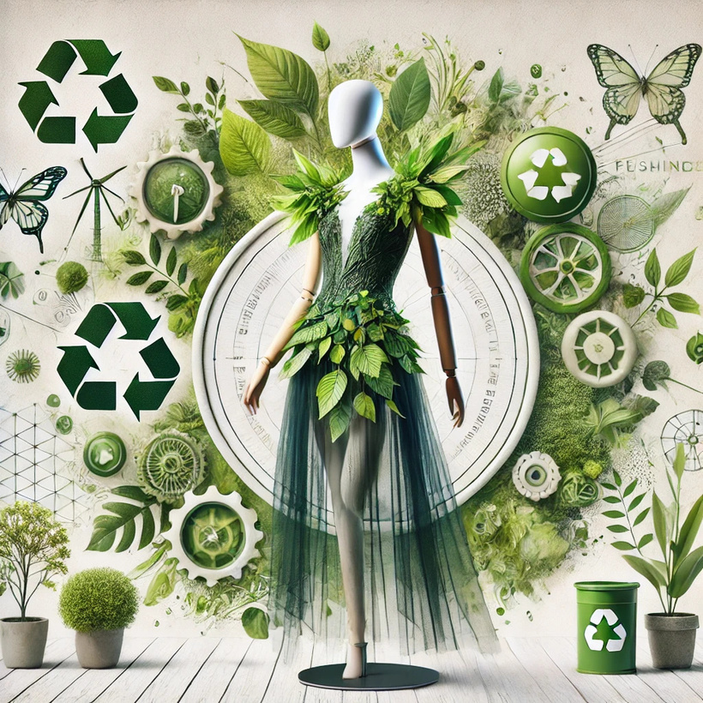
UpTraK Training Programme
Module 6, Unit 1
WHAT IS SUSTAINABLE FASHION?
Sustainable fashion refers to the movement and process of creating clothing, accessories, and textiles in ways that minimize their impact on the environment and support ethical practices. It focuses on reducing waste, conserving resources, re-using old clothes and fostering eco-friendly production methods throughout the lifecycle of a product.
Key principles of sustainable fashion:
    Eco-friendly materials: Use of organic, recycled, or biodegradable fabrics to reduce environmental impact.
    Waste reduction: Encouraging minimal fabric waste through innovative design and production methods.
    Ethical labor practices: Ensuring fair wages, safe working conditions, and respect for workers' rights.
    Circular fashion: Promoting recycling, upcycling, and designing for extended product life cycles.
    Energy efficiency: Implementing renewable energy and low-impact processes in manufacturing.
    Sustainable fashion seeks to balance creativity with responsibility, aiming to meet today’s needs without compromising the planet’s future.
    For more insights see MODULE 1.
www.fashionupproject.com

Slide 9

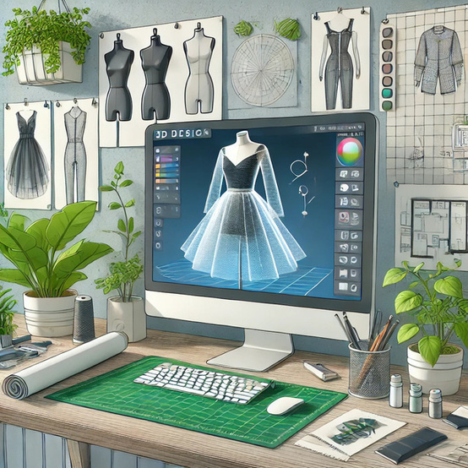
UpTraK Training Programme
Module 6, Unit 1
3D design in fashion refers to the use of digital tools and software to create, visualize, and test garments in a virtual environment. It allows designers to create realistic prototypes without the need for physical materials, streamlining the entire design process.
Key Roles of 3D Design:
    Visualization: Enables designers to see detailed, lifelike models of garments, including textures, draping, and fit.
    Prototyping: Allows creation of virtual samples for review, eliminating the need for multiple physical prototypes.
    Testing: Facilitates experimentation with designs, patterns, and alterations without wasting resources.
What is 3D Design in Fashion?
www.fashionupproject.com
https://www.youtube.com/watch?v=IhHaOnNoa6Y
Watch

Slide 10

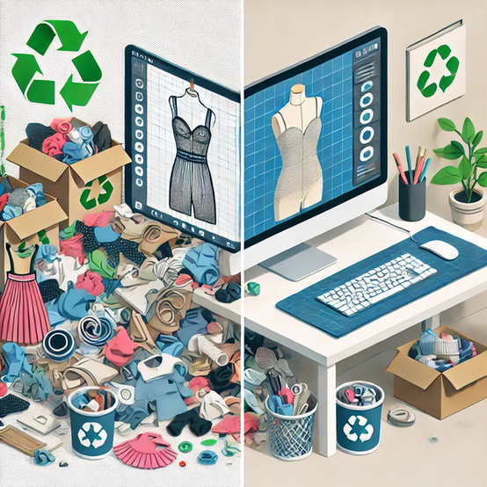
UpTraK Training Programme
Module 6, Unit 1
    No fabric waste: Unlike classical design, which often discards fabric during prototyping, 3D design eliminates this step.
    Fewer samples: Traditional methods require multiple physical prototypes for feedback and approval. 3D samples replace these entirely, reducing production waste.
    Streamlined adjustments: Changes to designs, patterns, or colors can be made instantly in software, avoiding the time and materials spent on reworking physical samples.
    Reduced shipping footprint: Digital prototypes can be shared globally without the need to transport physical samples.
    3D design accelerates production timelines, enhances collaboration across teams, and reduces errors, all while promoting sustainability by limiting resource use.
Examples of waste reduction and improvements
www.fashionupproject.com

Slide 11
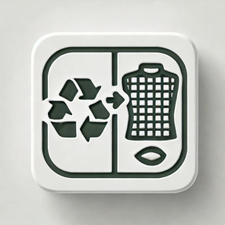
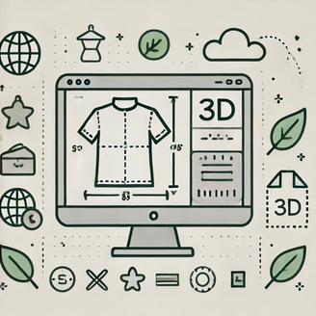



UpTraK Training Programme
Module 6, Unit 1
Benefits of 3D Design
01
02
03
04
Faster design iterations
Enhanced precision
Streamlined collaboration
Innovative recycling opportunities
Digital tools allow for immediate alterations, speeding up the creative process without physical waste.
3D tools make it easier to take accurate measurements and visualize garment fit, reducing errors and unnecessary revisions.
Teams can work on the same digital prototype remotely, eliminating the need for transporting samples.
Digital designs can be reused, repurposed, or modified for future projects without creating new waste.
www.fashionupproject.com
These benefits help achieve eco-friendly objectives by optimizing resources, reducing environmental strain, and fostering innovation in fashion design.

Slide 12
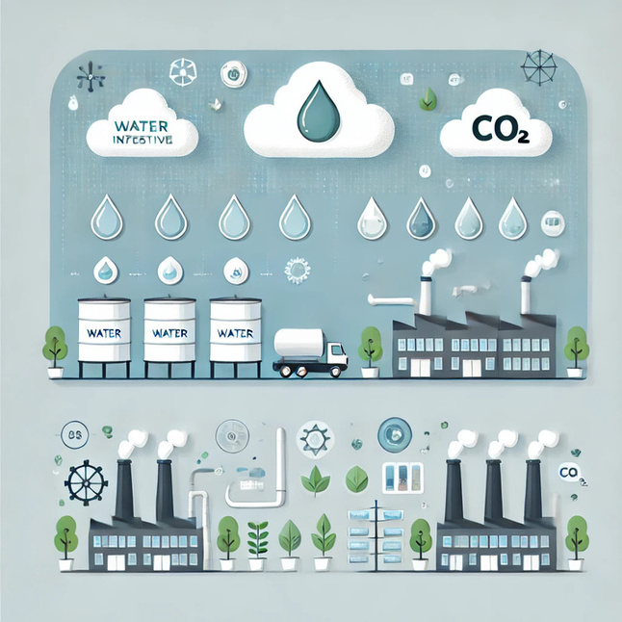

UpTraK Training Programme
Module 6, Unit 1
Environmental impact of 3D Design vs Traditional Methods
Traditional fashion prototyping often involves multiple physical samples, leading to significant fabric waste. In contrast, 3D design allows for virtual sampling, eliminating the need for physical prototypes and thereby reducing material waste.
The traditional manufacturing process consumes substantial energy due to the production and transportation of physical samples. 3D design minimizes this by enabling digital prototyping, which requires less energy.
Conventional textile production is water-intensive, contributing to 20% of global wastewater. By reducing the need for physical samples, 3D design helps decrease water usage in the prototyping phase.
The fashion industry is responsible for 10% of human-caused greenhouse gas emissions. Implementing 3D design can lower these emissions by reducing the need for physical samples and associated transportation.
www.fashionupproject.com
SOURCE: Columbia Climate School. Climate, Earth, Society. https://news.climate.columbia.edu/2021/06/10/why-fashion-needs-to-be-more-sustainable/

Slide 13


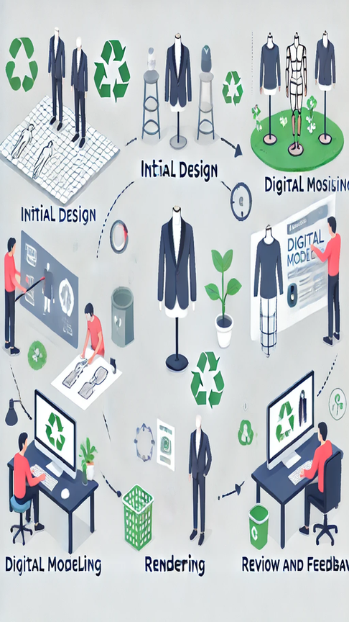

UpTraK Training Programme
Module 6, Unit 1
Main stages of the 3D prototyping Process
Initial design:
    Start with a concept or sketch, defining the garment's structure, materials, and purpose.
    Use 2D sketches or directly start with digital drafting in design software.
    Digital modeling:
    Create a 3D representation of the garment using specialized software.
    Add details like stitching, textures, and realistic dimensions to simulate the final product.
    Rendering:
    Apply lighting, materials, and textures to create a photorealistic visual of the design.
    Rendering helps identify how the garment will look under various conditions.
    Review and feedback:
    Collaborate with the team to refine and improve the design.
    Make necessary adjustments in the digital environment, eliminating physical trial-and-error.
www.fashionupproject.com

Slide 14
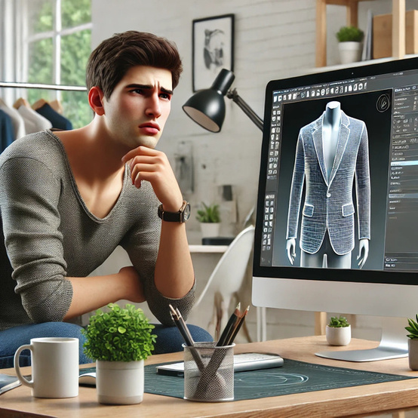
UpTraK Training Programme
Module 6, Unit 1
    Basic garment construction knowledge:
      Understanding garment structure, pattern-making, and draping is crucial to creating accurate 3D representations of clothing.
    Proficiency in 3D software:
      Familiarity with tools like CLO 3D, Marvelous Designer, and Blender to create, manipulate, and visualize digital garments.
    Understanding digital textures:
      Ability to apply and manipulate textures, fabrics, and materials in a virtual space to simulate real-world garments.
      Importance of digital literacy in modern fashion:
    The shift to digital tools requires designers to be comfortable with software interfaces and digital workflows.
    Digital literacy enables efficient collaboration, remote working, and faster prototyping, which are critical in the modern, fast-paced fashion industry.
    As virtual fashion grows in popularity, designers with digital skills are better positioned to innovate and thrive in a competitive market.
Skills needed for 3D fashion design
www.fashionupproject.com

Slide 15
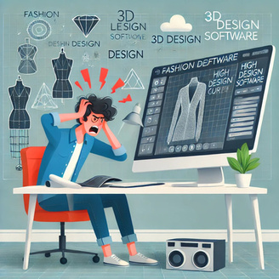
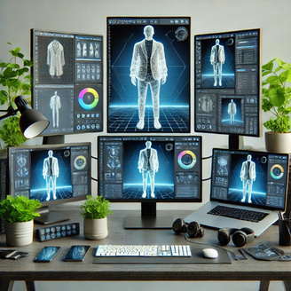
UpTraK Training Programme
Module 6, Unit 1
Key challenges in 3D fashion design
01
02
03
04
05
High learning curve
Software costs
Hardware requirements
Resistance to digital prototyping
Limited hands-on experience:
    Mastering 3D design software like CLO 3D, Marvelous Designer, or Blender requires time, training, and patience.
    Designers may struggle to transition from traditional methods to digital workflows.
Many 3D design tools come with expensive licenses or subscription fees, which can be a barrier for smaller design teams or independent designers.
Running 3D design software often requires high-performance computers, which may not be accessible to all.
Some stakeholders in the fashion industry prefer physical samples, creating a challenge for adopting 3D as the standard.
Unlike physical prototyping, working exclusively in a virtual environment can make it harder to assess tactile aspects like fabric feel and movement.
www.fashionupproject.com
Overcoming the Challenges:
    Training programs and resources for designers to develop proficiency in 3D tools.
    Cost-efficient alternatives as open-source software or educational discounts.
    Demonstrating the benefits of 3D design to stakeholders through efficiency and sustainability metrics.
    3D design is not without its challenges, but overcoming these barriers is essential for a sustainable and innovative fashion future.

Slide 16
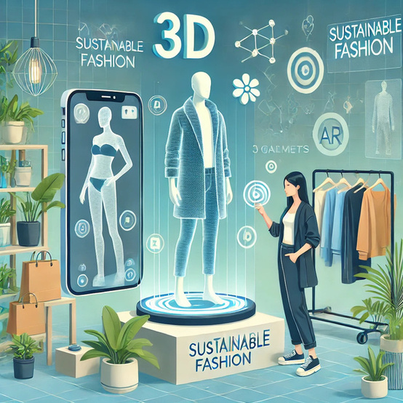
UpTraK Training Programme
Module 6, Unit 1
The Future of 3D in Sustainable Fashion
    Brands are increasingly using 3D technology to create fully digital runway shows, reducing the environmental impact of traditional events.
    Digital shows eliminate the need for physical sets, travel, and logistics while showcasing garments in innovative, immersive ways.
    Digital-only fashion is gaining traction for use in virtual spaces like social media, gaming, and the metaverse.
    This trend reduces textile production and waste while catering to a growing demand for virtual self-expression.
    AR allows customers to "try on" digital garments using their devices, enabling informed purchasing decisions without physical samples.
    It reduces return rates and the environmental cost of shipping unwanted items.
    3D technology empowers designers to experiment with sustainable materials, zero-waste patterns, and circular fashion models in a digital environment.
    By integrating 3D tools, the fashion industry can drive innovation while aligning with eco-conscious values and consumer expectations.
    The future of 3D design in fashion lies in its potential to revolutionise sustainability through innovation, reduced waste, and immersive customer experiences.
www.fashionupproject.com

Slide 17

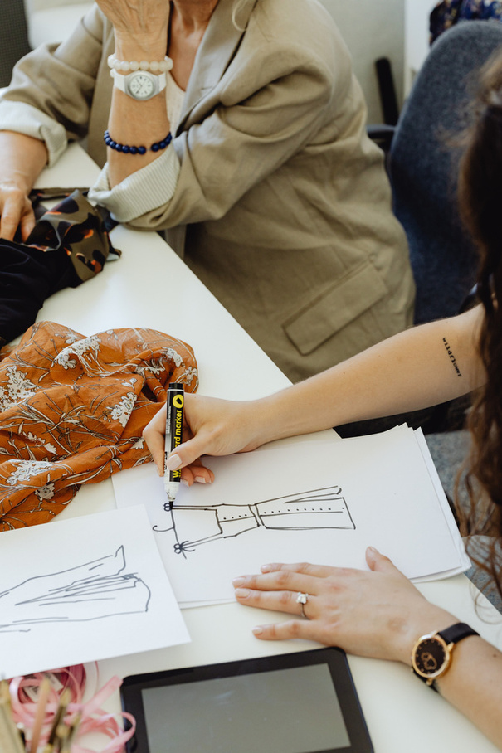

UpTraK Training Programme
Module 6, Unit 1
Unit
Summary
In this Unit, you explored how 3D design is revolutionizing sustainable fashion by reducing waste, conserving resources, and enhancing efficiency. You learned about the key features of 3D tools, their environmental benefits, and how they align with eco-conscious goals. The Unit highlighted emerging trends such as virtual fashion shows, digital clothing, and augmented reality, showcasing their potential to redefine the fashion industry. Additionally, the skills, challenges, and future opportunities of adopting 3D design were examined, emphasizing the importance of innovation and digital literacy in building a more sustainable and forward-thinking fashion ecosystem.
www.fashionupproject.com

Slide 18


UpTraK Training Programme
Module 6, Unit 1
      Columbia Climate School - Why Fashion Needs to Be More Sustainable
      https://news.climate.columbia.edu/2021/06/10/why-fashion-needs-to-be-more-sustainable/
      United Nations Environment Programme (UNEP) - Sustainability in Fashion
      https://www.unep.org/resources/report/sustainability-and-circularity-fashion
      CLO Virtual Fashion - CLO 3D Software for Sustainable Design
      https://www.clo3d.com
      Ellen MacArthur Foundation - The Circular Economy in Fashion
      https://ellenmacarthurfoundation.org/fashion
      Statista - Environmental Impact of the Fashion Industry
      https://www.statista.com/topics/5091/sustainability-in-the-fashion-industry/
      Business of Fashion - The Future of Digital Fashion
      https://www.businessoffashion.com
      The Fashion Industry and Sustainability - Report by Global Fashion Agenda
      https://globalfashionagenda.com
      Augmented Reality in Fashion - Case Studies and Industry Insights
      https://www.wgsn.com
References
www.fashionupproject.com

