Slide 1


UpTraK Training Programme
Module 1
Introduction to Upcycling
A NEW SUSTAINABLE BUSINESS MODEL IN SARTORIAL CRAFTSMANSHIP
www.fashionupproject.com

Slide 2
UpTraK Training Programme
Funded by the European Union. Views and opinions expressed are however those of the author(s) only and do not necessarily reflect those of the European Union or the European Education and Culture Executive Agency (EACEA). Neither the European Union nor EACEA can be held responsible for them.
www.fashionupproject.com

Slide 3

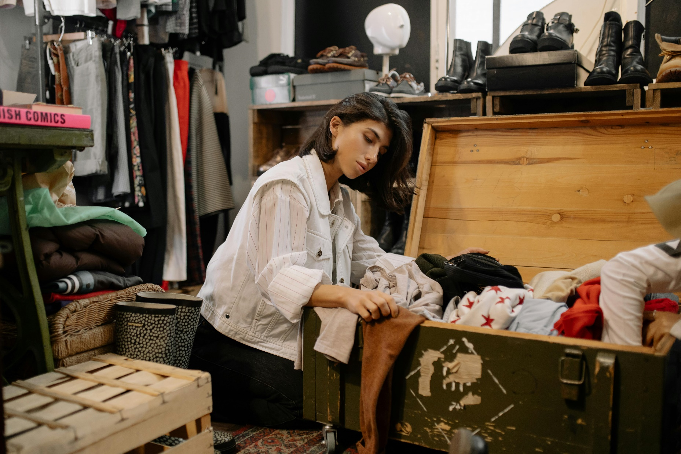
UpTraK Training Programme
Module 1, INTRODUCTION TO UPCYCLING
Modul 1 Learning Objectives
By the end of this module, learners will understand the core principles of upcycling, downcycling, and recycling, and their impact on environmental sustainability.
They will learn how to source and select appropriate materials for creative projects, considering both technical suitability and ecological values.
Students will also explore how to identify and obtain materials from various secondary markets.
Finally, they will gain insights into starting and managing a small upcycling business — including market research, promotional strategies, and business models that support sustainable fashion.
www.fashionupproject.com

Slide 4
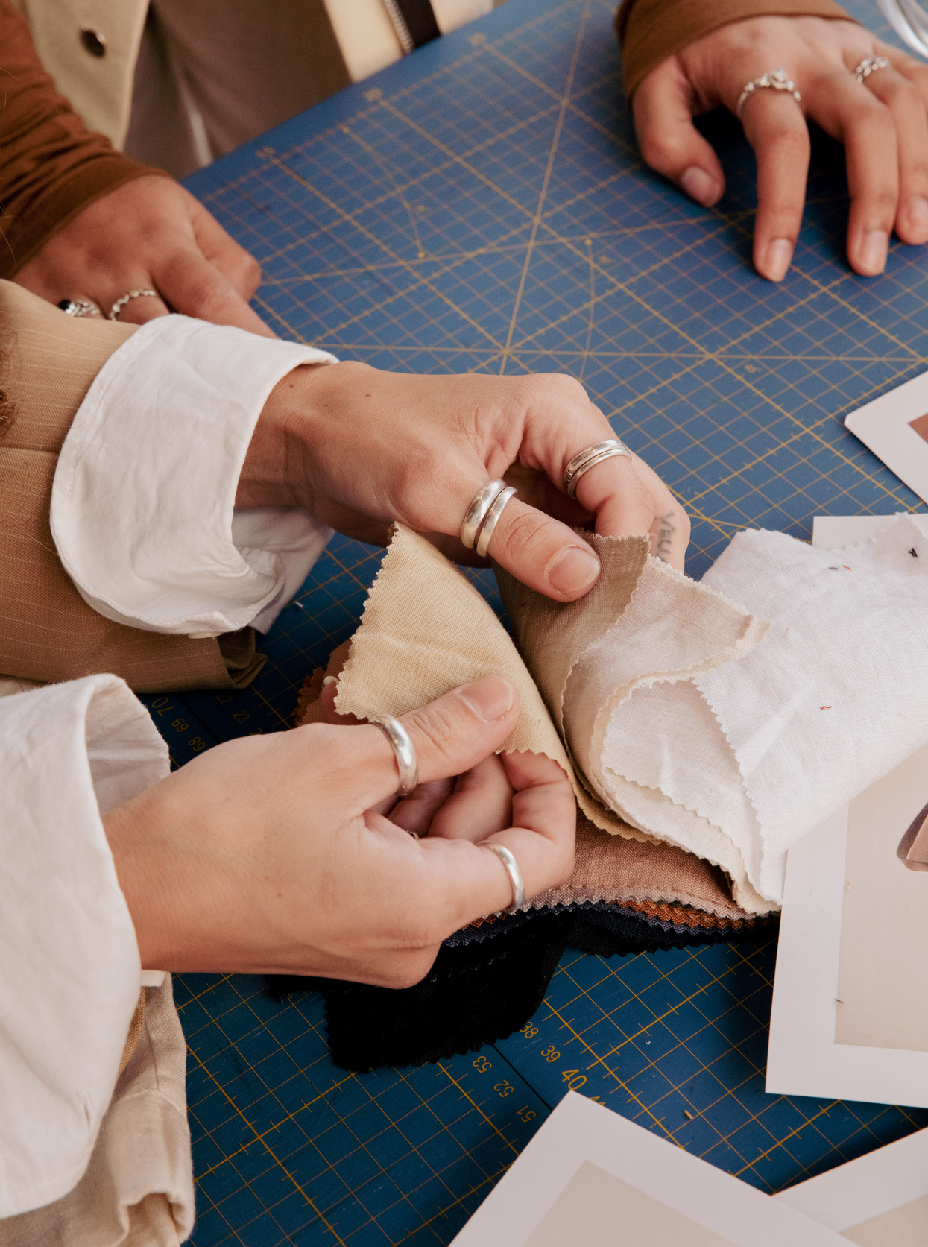
UpTraK Training Programme
Module 1, INTRODUCTION TO UPCYCLING
Expected
Learning Outcomes
Learners will gain the ability to distinguish upcycling from other sustainable practices such as downcycling and recycling.
They will be able to identify, evaluate, and select suitable materials for upcycling projects, balancing technical requirements with ecological considerations.
Students will also learn to develop basic business models and unique selling propositions for upcycled fashion items.
Furthermore, they will understand how to conduct market research, promote their products, and apply small-scale strategies to launch sustainable fashion initiatives.
www.fashionupproject.com

Slide 5
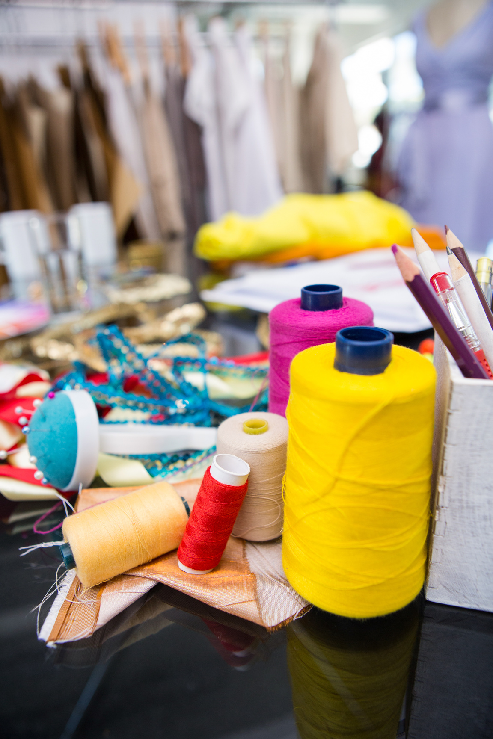
UpTraK Training Programme
Module 1, INTRODUCTION TO UPCYCLING
Methodology
This Unit will be based on both interactive and reflective learning methodologies.
Interactive methodology is a learner-centered approach that will allow participants to engage in discussions, case studies, and group activities related to the concept of upcycling. By comparing upcycling with recycling and downcycling, learners will actively explore real examples and challenges from the fashion sector. This will help them develop a deeper understanding of sustainability in practice.
Reflective learning methodology is an approach that emphasizes observation, analysis, and critical thinking. Learners will be encouraged to reflect on the environmental and economic benefits of upcycling, to share their own experiences with fashion consumption, and to consider how sustainable choices can influence consumer behavior and industry trends.
www.fashionupproject.com

Slide 6

UpTraK Training Programme
Module 1, INTRODUCTION TO UPCYCLING
Necessary equipment
For this Module is necessary:
Scissors and measuring tape
Checklist to inspect second-hand clothing
Textile scraps and deadstock fabrics
Computer/laptop with internet for research
Access to business case examples and upcycling brands
Worksheets for drafting value propositions
Flipchart/markers for brainstorming business strategies
(Optional) Guest speaker or video on sustainable business models
Module 1 Duration
6 hours
Assessment Criteria
www.fashionupproject.com
A 5 closed questions quiz will be submitted to learners to ascertain the reaching of learning goals set for this Module

Slide 7
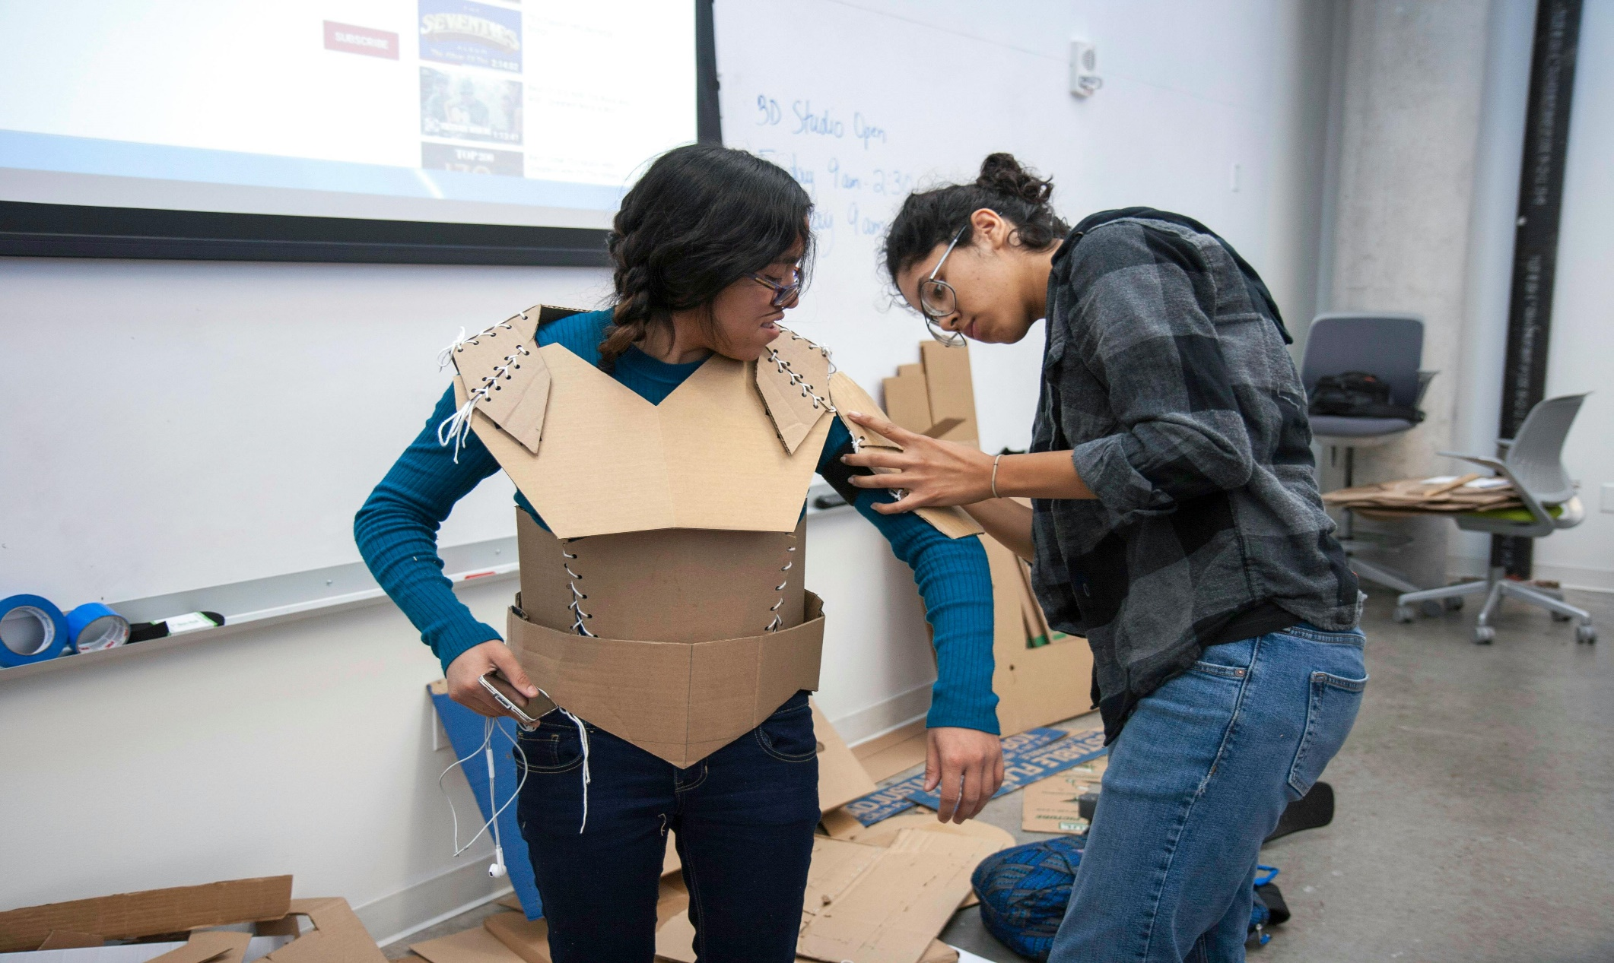
Programma di Formazione UpTraK
Module 1, INTRODUCTION TO UPCYCLING
This Module includes theoretical Training Materials on PPT or Canva format.
Theoretical materials are available for each Training Unit constituting the Module.
Video tutorials are available only for Modules with high performative-practical learning contents.
Training Materials & Video-Tutorials
www.fashionupproject.com

Slide 8
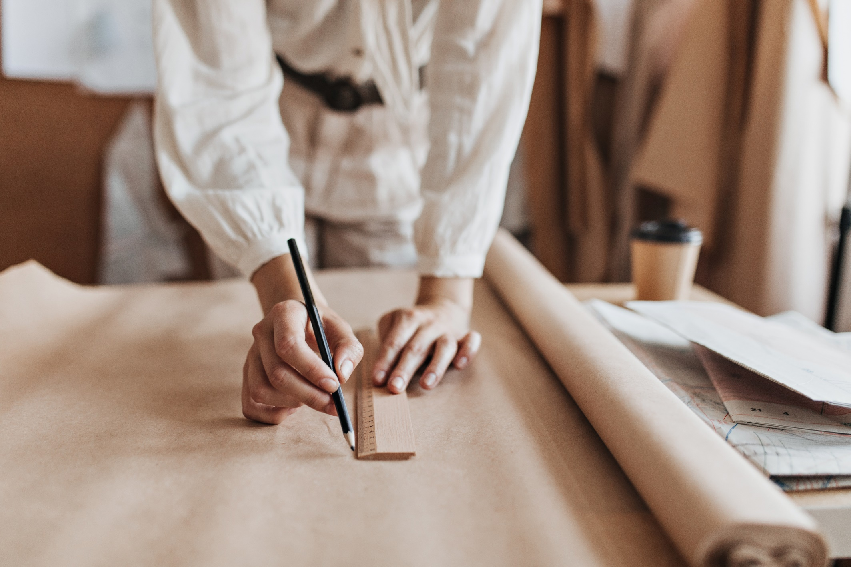
UpTraK Training Programme
Module 1, INTRODUCTION TO UPCYCLING
Trainer(s) competence profile
Technical competences
Experienced in sustainable business and entrepreneurship
Knowledgeable in fashion marketing and branding
Creative thinker with problem-solving skills
Skilled in textile recycling methods
Creative and hands-on approach
Inspires eco-conscious choices
Pedagogical competences
Experience in teaching adult learners and understanding their learning styles
Strong communication and presentation skills to engage learners
www.fashionupproject.com
PROFESSIONAL FASHION DESIGNER EXPERT IN UPCYCLING
TRAINER FOR FASHION DESIGN & MODELING EXPERT IN CIRCULAR ECONOMY

Slide 9
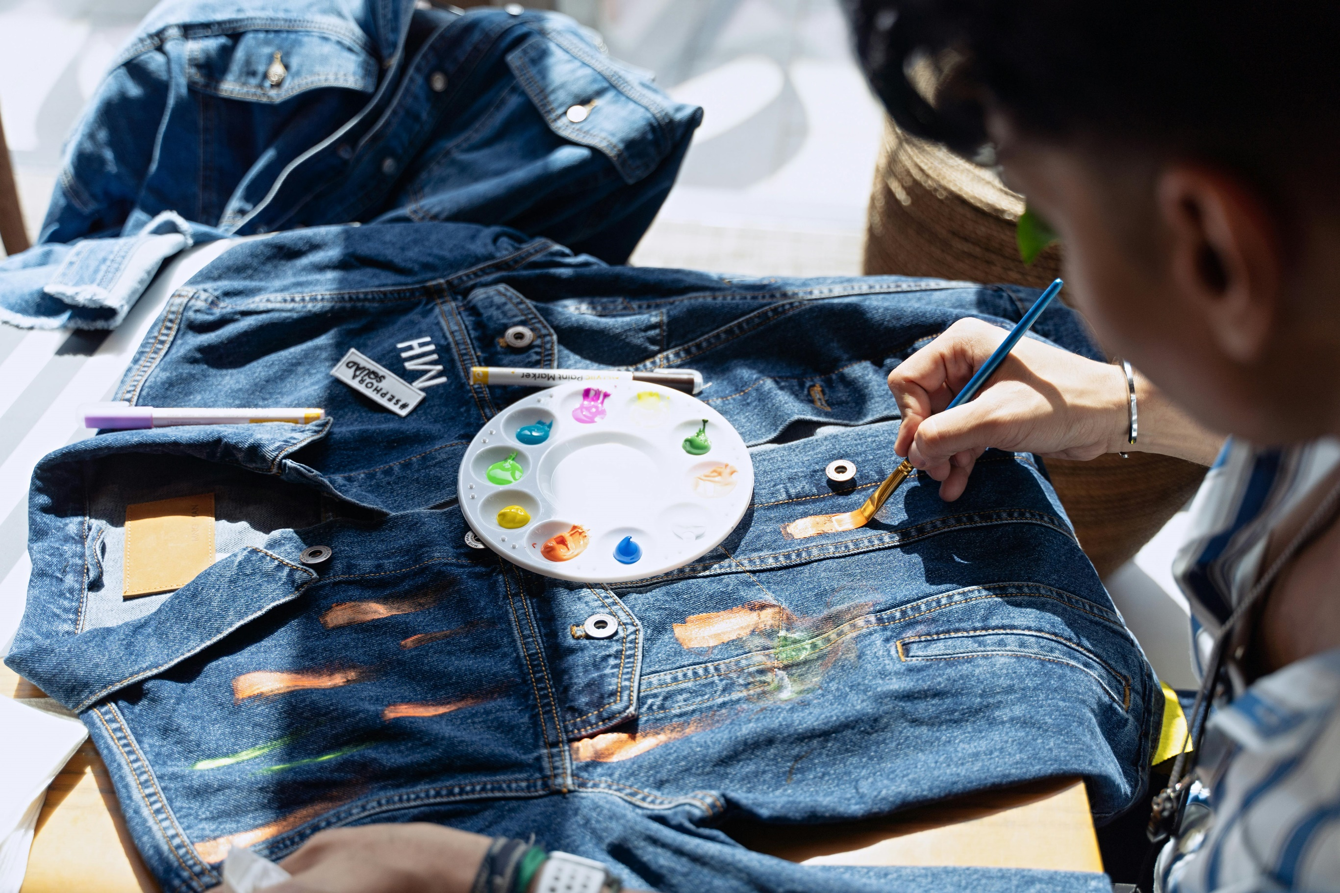
UpTraK Training Programme
Module 1, INTRODUCTION TO UPCYCLING
Module 1
www.fashionupproject.com
TRAINING UNITS

Slide 10
Module 1, INTRODUCTION TO UPCYCLING
Module 1 Training Units
These Training Units compose Module 1
01
02
Introduction to upcycling
Sourcing and Selecting Materials
0
02
This unit covers the concept of upcycling as a sustainable business model in sartorial craftsmanship, focusing on material sourcing and the business aspects of upcycled fashion.
In this unit, participants will learn about the environmental benefits of upcycling, methods for selecting and sourcing materials, and strategies for developing a business model in the upcycled fashion industry.​
TITLE
This Unit focuses on how to identify materials suitable for recycling, upcycling, and downcycling. Learners will explore criteria for material selection and discover the role of circular fashion boutiques as sources of reusable textiles.
content
www.fashionupproject.com
Duration.
Duration
3 HOUR
Duration
1 HOUR

Slide 11
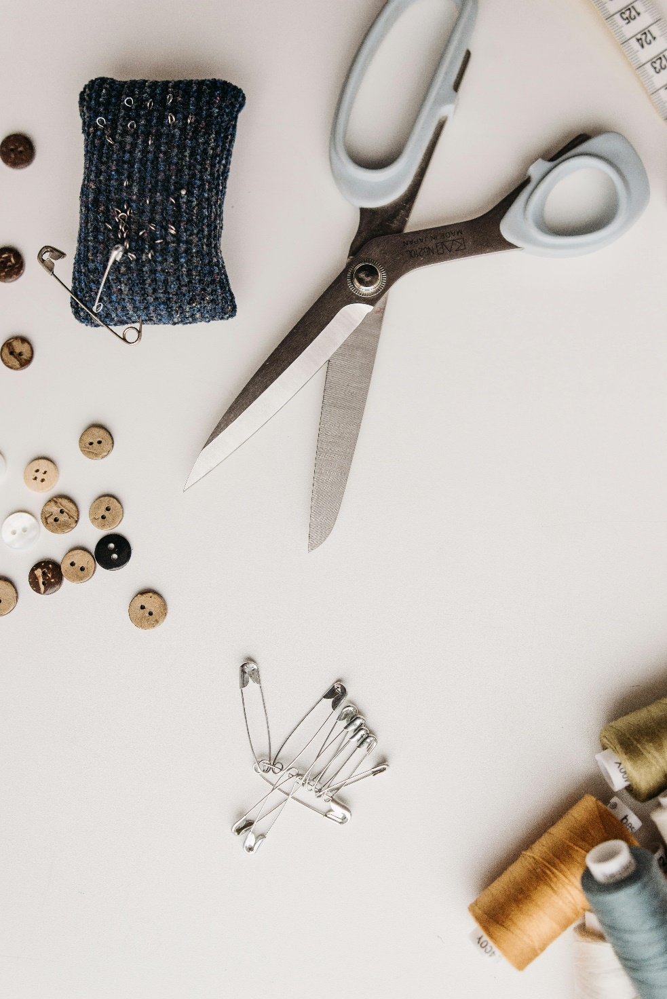
UpTraK Training Programme
Module 1, INTRODUCTION TO UPCYCLING
Module 1 Training Units
These Training Units compose Module1
03
Business of Upcycling
0
02
This unit explores upcycling as a sustainable approach within fashion craftsmanship, emphasizing material sourcing and the business potential of upcycled design. Learners gain insight into the environmental advantages of upcycling and key principles for building a sustainable fashion business model​.
TITLE
content
www.fashionupproject.com
Duration.
Duration
2 HOURS

Slide 12
UpTraK Training Programme
Module 1, INTRODUCTION TO UPCYCLING
  Fashion Revolution - "Why We Need to Reuse and Upcycle Clothing“ www.fashionrevolution.org
  The Ellen MacArthur Foundation - "A New Textiles Economy: Redesigning Fashion’s Future“
  www.ellenmacarthurfoundation.org
  Greenpeace International - "The Environmental Impact of Fast Fashion" www.greenpeace.org
  Textile Exchange - "Preferred Fiber & Materials Market Report“ www.textileexchange.org
  Sustainable Apparel Coalition - "Higg Index: Sustainable Materials“ www.apparelcoalition.org
  The Upcycle Movement - Resources and guides on upcycling practices www.theupcyclemovement.com
  British Fashion Council - "Circular Fashion and Upcycling Initiatives“
  www.britishfashioncouncil.co.uk
  Eco-Age - "Guide to Sustainable Fashion: Understanding Upcycling“
  www.eco-age.com
These resources provide information on sustainable fashion, the environmental impact of traditional fashion, material sourcing for upcycling, and case studies on successful upcycled brands. They can support both the theoretical and practical components of the module.
  References
www.fashionupproject.com

