Slide 1

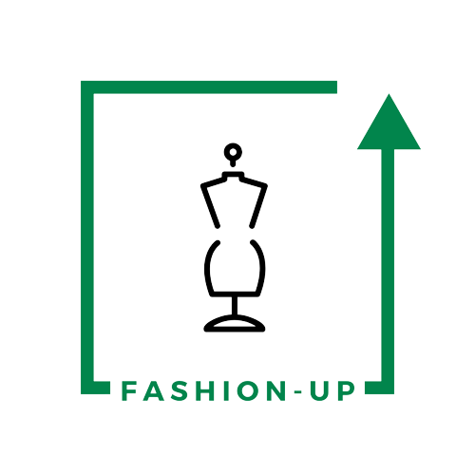
UpTraK Training Programme
Module 3
Textile product categories:
features, use methods and processing
www.fashionupproject.com

Slide 2
UpTraK Training Programme
Funded by the European Union. Views and opinions expressed are however those of the author(s) only and do not necessarily reflect those of the European Union or the European Education and Culture Executive Agency (EACEA). Neither the European Union nor EACEA can be held responsible for them.
www.fashionupproject.com

Slide 3
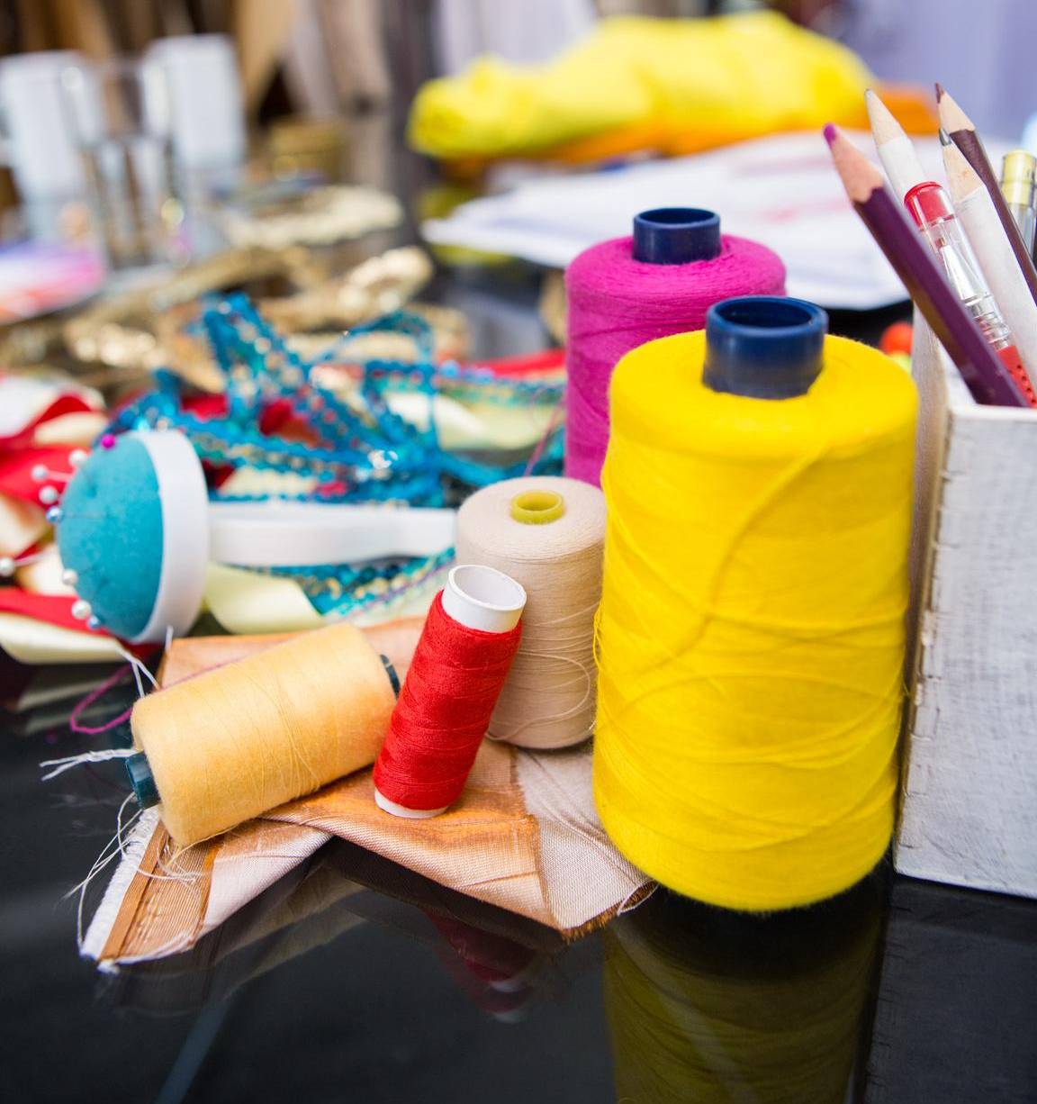
Module 3, TEXTILE PRODUCT CATEGORIES: FEATURES, USE METHODS AND PROCESSING
UpTraK Training Programme
Module 3 Learning Objectives
Learn about most common fibres and fabrics:
capacity to differentiate between the different types of fibers, their origins and production processes.
comprehensive understanding of various textile product categories and how fiber content affects the fabric's properties; their distinctive features, and the methods used in their processing and application
Learn about sustainable alternatives:
understanding of ethical manufacturing and the importance of ethical practices in textile processing; awareness of eco-friendly textile materials and innovative sustainable fibers
capacity to to evaluate and select textiles for specific upcycling projects
www.fashionupproject.com

Slide 4
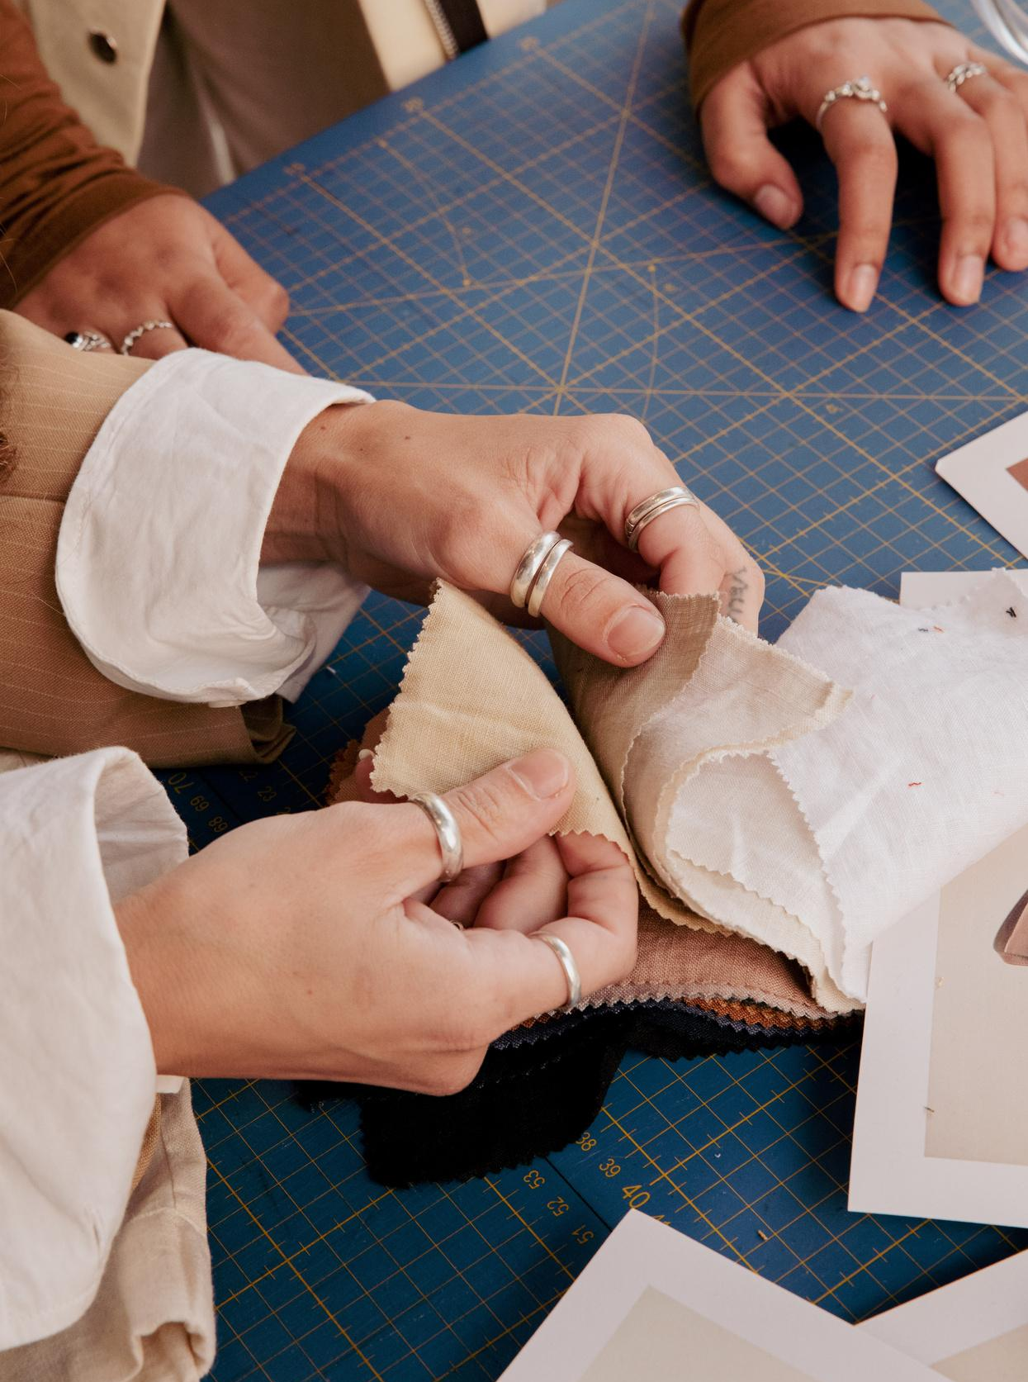
UpTraK Training Programme
Module 3, TEXTILE PRODUCT CATEGORIES: FEATURES, USE METHODS AND PROCESSING
Expected
Learning Outcomes
By the end of this Module, learners will be able to identify different fabric types and understand how fiber content affects the fabric's properties, including durability, comfort, and suitability for upcycling. They will understand how fabric construction impacts the fabric's behavior, texture, and suitability for various garment type. They will have a comprehensive overview of methods used to enhance the appearance, texture, and functionality of fabrics, detailing various finishing techniques in textile processing, such as dyeing, printing, coating, and special treatments. Through theoretical and practical exercises, learners will have in-depth knowledge on how to select and process textiles in a way that minimizes environmental impact - using low impact materials and processes. Finally, they will be able to choose textiles, design, and execute an upcycling project of their own, considering factors such as fabric durability, ease of manipulation, and the intended use of the upcycled garment.
www.fashionupproject.com

Slide 5
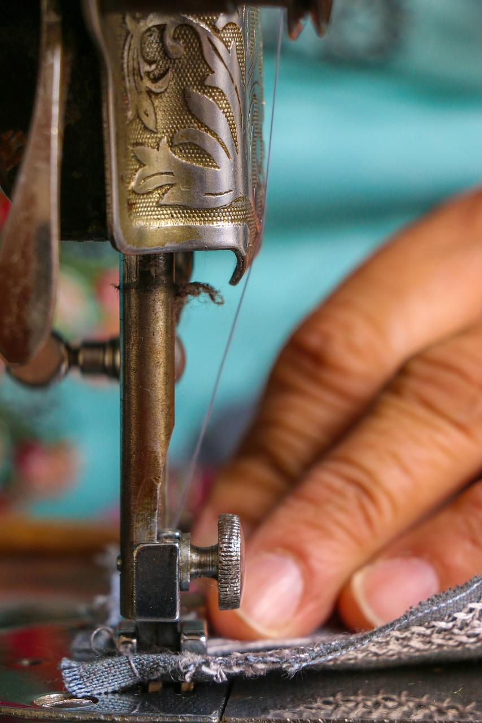
Module 3, TEXTILE PRODUCT CATEGORIES: FEATURES, USE METHODS AND PROCESSING
UpTraK Training Programme
Methodology
The module will employ a blend of theoretical instruction and hands-on exploration. Students will have access to documentation with information on textiles along with real fabric samples and conduct comparative analyses of the different types of textiles.
Using case-studies along with conceptual thinking, learners will be guided in practical exercises that involve processing and applying various textiles in upcycling projects.
This approach ensures that students not only learn the theoretical aspects but also gain practical experience in handling and working with different textile materials.
...
www.fashionupproject.com

Slide 6

UpTraK Training Programme
Module 3, TEXTILE PRODUCT CATEGORIES: FEATURES, USE METHODS AND PROCESSING
Necessary equipment
For this Module is necessary:
Notebook
Laptop
Projector
Fabric samples: natural, synthetic and blended
Sewing machine + Threads
Pins, chalk, scissors, measuring tape
Pattern making material: paper, technical rulers
Sustainable fabric processing materials and tools (materials for natural dyeing, printing, etc.)
Different material garments to be upcycled
Trimmings
Module 3 Duration
12 hours
www.fashionupproject.com
Assessment Criteria
A 5 closed questions quiz will be submitted to learners to ascertain the reaching of learning goals set for this Module
…

Slide 7
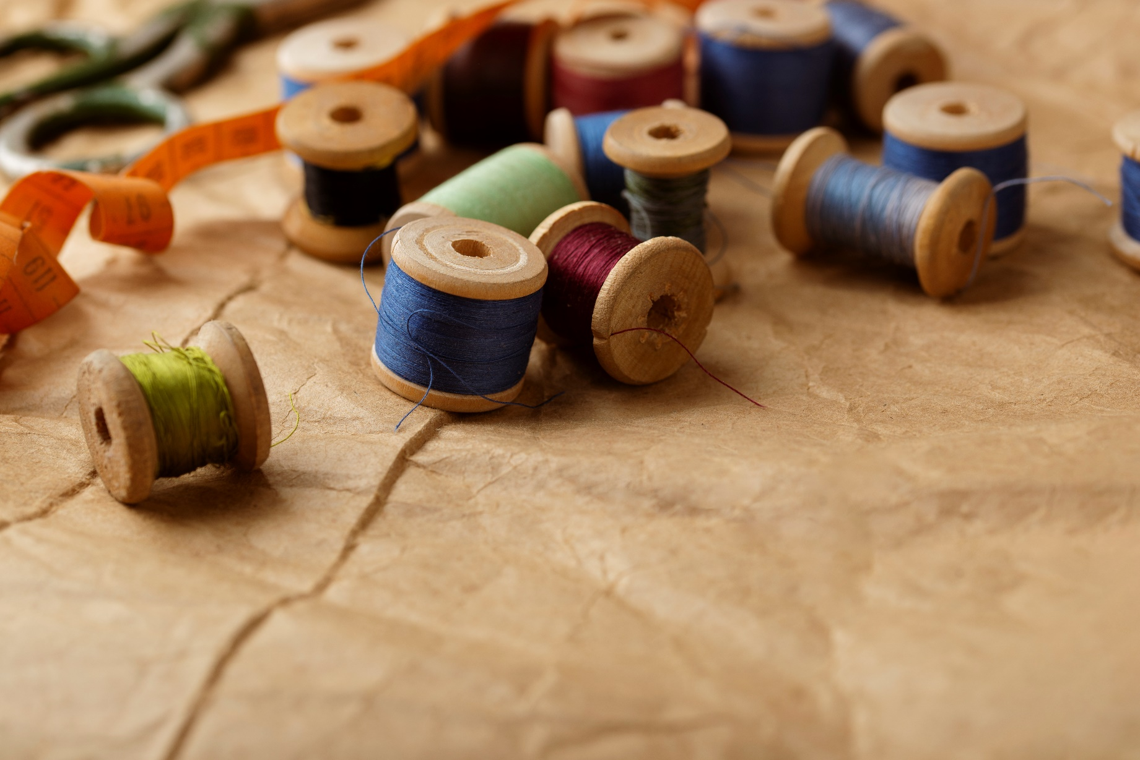
Module 3, TEXTILE PRODUCT CATEGORIES: FEATURES, USE METHODS AND PROCESSING
UpTraK Training Programme
This Module includes theoretical Training Materials on PPT or Canva format and is complemented by 2 video tutorials.
Theoretical materials are available for each Training Unit constituting the Module. The available video-tutorials concern:
1 - Basic Methods: types of fabrics - fibers and weaves and their behaviours, functionality and various finishing techniques in textile processing
2 - Processing: sustainable techniques - natural dyeing and printing and low impact manufacturing
Training Materials & Video-Tutorials
www.fashionupproject.com

Slide 8
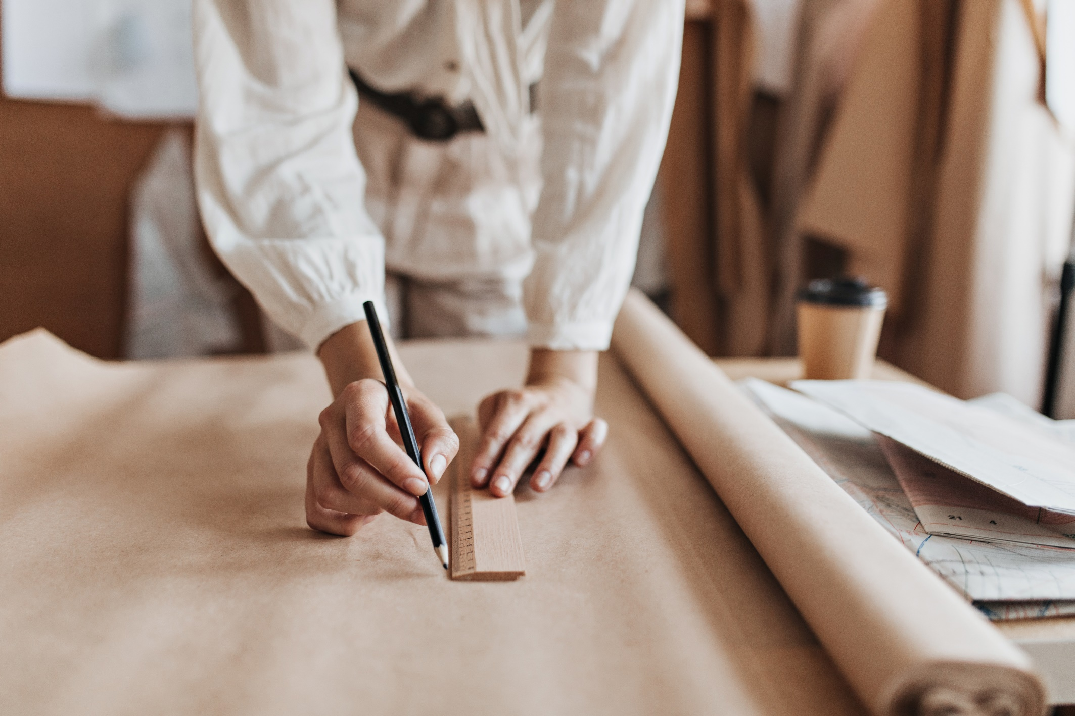
Module 3, TEXTILE PRODUCT CATEGORIES: FEATURES, USE METHODS AND PROCESSING
UpTraK Training Programme
Pedagogical competences:
Experience in teaching adult learners and understanding their learning styles
Strong communication and presentation skills to engage learners.
Technical competences:
In-depth knowledge of textile science (fiber properties, fabric construction, and finishing techniques) + experience in sustainable fashion practices and upcycling + Specialized skills on how different textiles behave in various processing and use scenarios
Knowledge in processing methods (including sustainable printing and dyeing) + experience in sustainable fashion practices and upcycling
www.fashionupproject.com
Trainer(s) competence profile

Slide 9
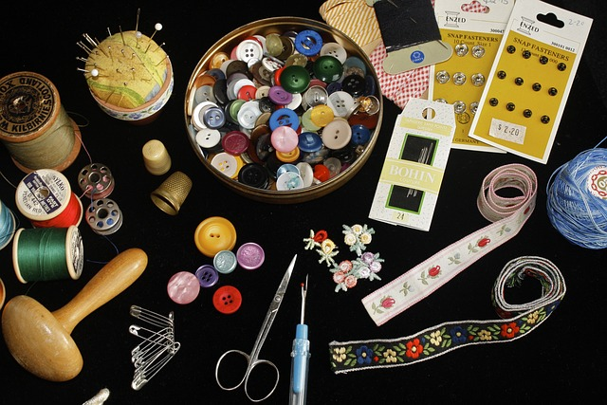
Module 3, TEXTILE PRODUCT CATEGORIES: FEATURES, USE METHODS AND PROCESSING
UpTraK Training Programme
Module 3
www.fashionupproject.com
TRAINING UNITS

Slide 10
Module 3, TEXTILE PRODUCT CATEGORIES: FEATURES, USE METHODS AND PROCESSING
UpTraK Training Programme
Module 3 Training Units
These Training Units compose Module 3
01
02
03
0
02
Introduction to Textile Fibers and Fabrics
Fabric Construction and Weave Types
Textile Finishing Techniques
content
www.fashionupproject.com
Duration: 1.h
Duration: 2h
Duration: 2h

Slide 11
Module 3, TEXTILE PRODUCT CATEGORIES: FEATURES, USE METHODS AND PROCESSING
UpTraK Training Programme
Module 3 Training Units
04
05
0
02
Sustainable and Ethical Practices and Eco-Friendly Processing
Applying Textiles and Eco-Friendly Processing Techniques in Upcycling Projects
TITLE
content
www.fashionupproject.com
Duration: 3h
Duration: 4h
Duration.

Slide 12
Module 3, TEXTILE PRODUCT CATEGORIES: FEATURES, USE METHODS AND PROCESSING
UpTraK Training Programme
  https://tocco.earth/article/upcycled-materials-for-circular-economy-Europe/
  https://www.europarl.europa.eu/topics/en/article/20201208STO93327/the-impact-of-textile-production-and-waste-on-the-environment-infographics
  https://environment.ec.europa.eu/strategy/textiles-strategy_en
  https://www.ellenmacarthurfoundation.org/a-new-textiles-economy (pp 119)
  various (2020), Textilepedia, Fashionary International Limit
  https://www.redressdesignaward.com/academy/resources/guide/sustainability-in-fibres
  Gullingsrud, Annie (2017), Fashion Fibers: Designing for Sustainability, Fairchild Books
  Fletcher, Kate (2008), Sustainable Fashion & Textiles: Design Journeys, Earthscan pp 3-38
References
www.fashionupproject.com

